Slide 1
STRENGTHENING URBAN RESILIENCE FOR GROWTH WITH EQUITY (SURGE) PERFORMANCE EVALUATION
SURGE PERFORMANCE EVALUATION:
FINDINGS, CONCLUSIONS AND RECOMMENDATIONS
Notes:
15 Minute presentation.
Working design: https://docs.google.com/document/d/1BUV9ONW8b8YhL4suNZ7vS_2gDNbtJXnk/edit?usp=sharing&ouid=100314050296542183112&rtpof=true&sd=true

Slide 2
ABOUT CLAIMDEV
CLAimDev aims to bolster the capacity of USAID/Philippines to effectively lead and practice collaborating, learning, and adapting (CLA). Improving practices in CLA has the broader goal of enhancing USAID’s development effectiveness. Susan Minushkin leads the CLAimDev as Chief of Party.
Panagora Group, the implementing partner, closely works with USAID/Philippines to integrate CLA principles into the Mission’s work. CLAimDev covers an implementation period of five years, 2020-2024.

Slide 3
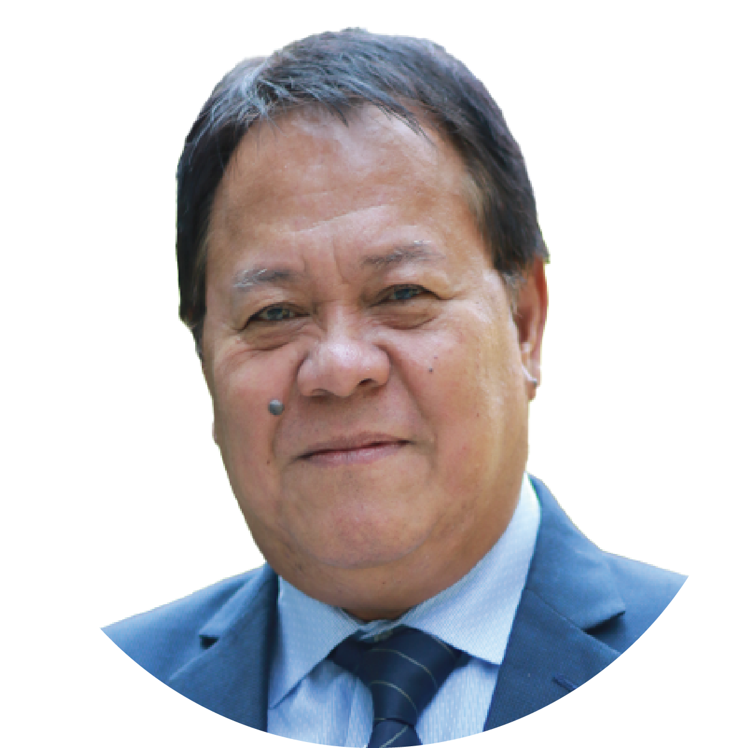
SURGE EXTERNAL AND INDEPENDENT PERFORMANCE EVALUATION TEAM
Dr. Nicasio Agustin
SURGE Performance Evaluation Team Leader
Professorial Lecturer
Eng. Rudini Baoy
SURGE Performance Evaluation Team Member
M&E in Local Governance
Dr. Ginny Santiago
SURGE Performance Evaluation Team Member
Research in MSMEs
Engr. Senen Dizon
SURGE Performance Evaluation Team Member
Water Supply and Sanitation

Slide 4
EVALUATION CRITERIA
1
To what extent has SURGE contributed to addressing the development challenges that motivated the Partnership for Growth-Cities Development Initiative, the thrusts of the National Spatial Strategy (NSS)/Philippine Development Plan (PDP, 2017-2022), the USAID/Philippines Country Development Cooperation Strategy (CDCS) (previous and current), and USAID’s policies on urban resiliency and water, sanitation, and hygiene (WASH)? (Relevance)
2
To what extent did SURGE achieve its objectives on improving local urban development processes, promoting local economic development, and expanding connectivity and access between urban and rural areas? (Effectiveness)
3
What is the likelihood that initiatives and gains will continue after the completion of the project? (Sustainability)

Slide 5
METHODOLOGY MIXED METHODS
Participants
Implementing partner (ICMA)
Government agencies at the city level
National government agencies
Local chief executives
LGU department heads and personnel
Group representatives (private sector, business and farmers)
WASH service providers
Academe
Qualitative
Quantitative
Triangulation

Slide 6
FINDINGS
RELEVANT, EFFECTIVE, SUSTAINABLE
Highly relevant
to the needs of Philippine CDI cities
Achievements
are likely to be sustained
Achieved considerable success in primary
areas of assistance.
Notes:
RELEVANCE
SURGE is aligned to national policies and strategies (i.e., Philippine Development Plan, National Urban Development and Housing Framework, Philippine Water Supply and Sanitation Master Plan, RA 11032: Ease of Doing Business and Efficient Government Service Delivery Act of 2018, RA 9484: Anti-Red Tape Act of 2007, National Spatial Strategy, Government policy in the provision of services during the pandemic)
SURGE is aligned with the following USAID Policies and Strategies:
Policy on Sustainable Service Delivery in an Increasingly Urbanized World
Policy on Water and Development
policy on social capital on resilience
CDI-PFG
policy on urban development and competitiveness (second-tier cities as engines of growth)
W-GDP
SURGE’s approach ensured careful alignment between project activities, local policies and availability of resources.
EFFECTIVENESS
SURGE interventions empowered the CDI cities to be more resilient, competitive, and inclusive
Resilient
Technical assistance and capacity enhancement in CDI Cities in the following:
formulation of risk-sensitive and climate resilient development plans
mainstreaming of disaster risks and climate change concerns in plans (i.e., the CDRA-enhanced CLUPs)
Strengthened linkages between national government agencies (CCC, DHSUD & DOST) and local government units in development planning within the context of disaster risk and climate change
Improved capacities of Water Service Providers with DRR and CCA mainstreaming in water safety regulations and business continuity plans in CDI Cities and Marawi City
Brought knowledge down to local government level through the establishment of Urban Development Learning Program (UDLP)
Competitive
Technical assistance and capacity enhancement of CDO Cities in the following:
streamlining of business registration and permitting, building occupancy, and fire safety certification processes
development of electronic tax revenue assessment and collection system (e-TRACS)
asset management and financial planning
land and cadastral information management
More investments through active engagement of private sector partner organizations and more active investment promotions activities
Inclusive
Technical assistance and institutional capacity enhancement in:
market access and value chain linkages (e.g., seaweed farmers in Puerto Princesa and cassava growers in Zamboanga)
market expansion outside the region (e.g., GenSan and Clark)
inter-LGU collaboration (e.g., PADTEC)
Tourism network promotion through the preparation of tourism master plans (e.g., Legazpi, Puerto Princesa, and Tagbilaran)
urban-rural linkages (e.g., road network and traffic management planning, transport route planning, and reduction of local regulatory barriers for products)
market connectivity through the improvement of air transport facilities (e.g., Aerotropolic planning in GenSan)
SUSTAINABILITY
The strong commitment of CDI cities and willingness of partners to fund activities crystallized sustainability.
By design, and through good management, it is likely that most of SURGE’s initiatives can be sustained beyond the life of the project
The enabling factors to these accomplishments are:
The project was highly relevant to the needs of Philippine CDI cities
SURGE achieved considerable success in its primary areas of assistance (as models for success in the second batch areas
Demand-driven nature of SURGE activities that responds to local needs
Policy issuances both at the local and national level thereby ensuring continuity of activities and benefits
Availability of funds to implement PPAs identified in local plans
Willingness of local executive officials to implement interventions
Active engagement of the private sector
Key factors that undermine sustainability are 1) inadequate stakeholder engagement and follow-through activities (e.g., institutional strengthening of BoSNet and PADTEC), 2) lack of post-project capacity building plans, especially for second-line staff and new LGU personnel; and 3) changes in political leadership in 2022, which may result in a shift of LGU priorities.

Slide 7
FINDINGS ON RELEVANCE
Highy relevant to the needs of Philippine CDI cities
National Policies and Strategies
Philippine Development Plan 2017-2022
Philippine Water Supply and Sanitation Master Plan
National Urban Development and Housing Framework
National Spatial Strategy
RA 11032 or the Ease of Doing Business and Efficient Government Service Delivery Act of 2018
RA 9484 or the Anti-Red Tape Act of 2007
Government policy in the provision of services during the pandemic
USAID Strategies
Policy on Sustainable Service Delivery in an Increasingly Urbanized World
Policy on Water and Development
Policy on Social Capital on Resilience
Cities Development Initiative – Partnership for Growth
Policy on urban development and competitiveness
Women’s Global Development and Prosperity Initiative

Slide 8
SURGE’S DEMAND-DRIVEN APPROACH
Highy relevant to the needs of Philippine CDI cities
Identified individual activities through close consultation with partner city governments
Relevance and responsive of assistance: focused interventions according to individual cities’ needs
Reinforces local autonomy: cities had more freedom and are more self-reliant
Efficient use of resources: careful alignment between activities, policies, and resources
Notes:
How did SURGE enrich implementation through its demand driven approach?
SURGE operated as a demand-driven project whereby SURGE identified individual activities through close consultation with partner city governments.
Relevance and responsive of assistance: SURGE was able to focus its interventions according to what the individual cities need within the context identified broad areas of assistance.
An approach that reinforces local autonomy: Partner cities had more freedom in carrying-out programs suitable for their areas and to be more self-reliant and active partners in development.
Efficient use of resources: This approach ensures careful alignment between project activities, local policies and availability of resources.

Slide 9
FINDINGS ON EFFECTIVENESS
Resilience (Component 1)
Achieved considerable success in primary areas
of assistance
Technical assistance and capacity enhancement on mainstreaming climate change and disaster risks in local development plans
Strengthened linkages between national
government agencies and
local government units
Improved capacities of Water Service Providers
Brought knowledge down to the local government level through Urban Development Learning Program (UDLP)
Notes:
A. Resilient
Technical assistance and capacity enhancement in CDI Cities in the following:
formulation of risk-sensitive and climate resilient development plans
mainstreaming of disaster risks and climate change concerns in plans (i.e., the CDRA-enhanced CLUPs) in development planning within the context of disaster risk and climate change
2. Strengthened linkages between national government agencies (CCC, DHSUD & DOST) and local government units in development planning within the context of disaster risk and climate change
3. Improved capacities of Water Service Providers with DRR and CCA mainstreaming in water safety regulations and business continuity plans in CDI Cities and Marawi City
4. Brought knowledge down to local government level through the establishment of Urban Development Learning Program (UDLP)

Slide 10
FINDINGS ON RELEVANCE
Competitiveness (Component 2)
Achieved considerable success in primary areas
of assistance
Technical assistance and capacity enhancement on streamlining and digitalization of business processes
More investments through active engagement of the private sector and more active investment
promotions activities
Notes:
A. Resilient
Technical assistance and capacity enhancement in CDI Cities in the following:
formulation of risk-sensitive and climate resilient development plans
mainstreaming of disaster risks and climate change concerns in plans (i.e., the CDRA-enhanced CLUPs) in development planning within the context of disaster risk and climate change
2. Strengthened linkages between national government agencies (CCC, DHSUD & DOST) and local government units in development planning within the context of disaster risk and climate change
3. Improved capacities of Water Service Providers with DRR and CCA mainstreaming in water safety regulations and business continuity plans in CDI Cities and Marawi City
4. Brought knowledge down to local government level through the establishment of Urban Development Learning Program (UDLP)

Slide 11
FINDINGS ON RELEVANCE
Inclusiveness (Component 3)
Establishment of business centers for women entrepreneurs;
Design and establishment of e-commerce platforms;
Granting of business permits to women-owned or managed enterprises;
Conduct of capacity-building programs on entrepreneurial development;
Review and drafting of laws, policies, and ordinances on gender equality; and
Compilation of government assistance to MSMEs during pandemic.
Achieved considerable success in primary areas
of assistance
Technical assistance
and institutional
capacity enhancement on:
market access, expansion, and connectivity;
inter-LGU collaboration;
tourism network promotion; and
urban-rural linkages.
Technical assistance on
Notes:
A. Resilient
Technical assistance and capacity enhancement in CDI Cities in the following:
formulation of risk-sensitive and climate resilient development plans
mainstreaming of disaster risks and climate change concerns in plans (i.e., the CDRA-enhanced CLUPs) in development planning within the context of disaster risk and climate change
2. Strengthened linkages between national government agencies (CCC, DHSUD & DOST) and local government units in development planning within the context of disaster risk and climate change
3. Improved capacities of Water Service Providers with DRR and CCA mainstreaming in water safety regulations and business continuity plans in CDI Cities and Marawi City
4. Brought knowledge down to local government level through the establishment of Urban Development Learning Program (UDLP)

Slide 12
RELEVANT, EFFECTIVE, SUSTAINABLE
Highly relevant
to the needs of Philippine CDI cities
Achievements
are likely to be sustained
Achieved considerable success in primary
areas of assistance.
Notes:
RELEVANCE
SURGE is aligned to national policies and strategies (i.e., Philippine Development Plan, National Urban Development and Housing Framework, Philippine Water Supply and Sanitation Master Plan, RA 11032: Ease of Doing Business and Efficient Government Service Delivery Act of 2018, RA 9484: Anti-Red Tape Act of 2007, National Spatial Strategy, Government policy in the provision of services during the pandemic)
SURGE is aligned with the following USAID Policies and Strategies:
Policy on Sustainable Service Delivery in an Increasingly Urbanized World
Policy on Water and Development
policy on social capital on resilience
CDI-PFG
policy on urban development and competitiveness (second-tier cities as engines of growth)
W-GDP
SURGE’s approach ensured careful alignment between project activities, local policies and availability of resources.
EFFECTIVENESS
SURGE interventions empowered the CDI cities to be more resilient, competitive, and inclusive
Resilient
Technical assistance and capacity enhancement in CDI Cities in the following:
formulation of risk-sensitive and climate resilient development plans
mainstreaming of disaster risks and climate change concerns in plans (i.e., the CDRA-enhanced CLUPs)
Strengthened linkages between national government agencies (CCC, DHSUD & DOST) and local government units in development planning within the context of disaster risk and climate change
Improved capacities of Water Service Providers with DRR and CCA mainstreaming in water safety regulations and business continuity plans in CDI Cities and Marawi City
Brought knowledge down to local government level through the establishment of Urban Development Learning Program (UDLP)
Competitive
Technical assistance and capacity enhancement of CDO Cities in the following:
streamlining of business registration and permitting, building occupancy, and fire safety certification processes
development of electronic tax revenue assessment and collection system (e-TRACS)
asset management and financial planning
land and cadastral information management
More investments through active engagement of private sector partner organizations and more active investment promotions activities
Inclusive
Technical assistance and institutional capacity enhancement in:
market access and value chain linkages (e.g., seaweed farmers in Puerto Princesa and cassava growers in Zamboanga)
market expansion outside the region (e.g., GenSan and Clark)
inter-LGU collaboration (e.g., PADTEC)
Tourism network promotion through the preparation of tourism master plans (e.g., Legazpi, Puerto Princesa, and Tagbilaran)
urban-rural linkages (e.g., road network and traffic management planning, transport route planning, and reduction of local regulatory barriers for products)
market connectivity through the improvement of air transport facilities (e.g., Aerotropolic planning in GenSan)
SUSTAINABILITY
The strong commitment of CDI cities and willingness of partners to fund activities crystallized sustainability.
By design, and through good management, it is likely that most of SURGE’s initiatives can be sustained beyond the life of the project
The enabling factors to these accomplishments are:
The project was highly relevant to the needs of Philippine CDI cities
SURGE achieved considerable success in its primary areas of assistance (as models for success in the second batch areas
Demand-driven nature of SURGE activities that responds to local needs
Policy issuances both at the local and national level thereby ensuring continuity of activities and benefits
Availability of funds to implement PPAs identified in local plans
Willingness of local executive officials to implement interventions
Active engagement of the private sector
Key factors that undermine sustainability are 1) inadequate stakeholder engagement and follow-through activities (e.g., institutional strengthening of BoSNet and PADTEC), 2) lack of post-project capacity building plans, especially for second-line staff and new LGU personnel; and 3) changes in political leadership in 2022, which may result in a shift of LGU priorities.

Slide 13
SUSTAINABILITY: ENABLING FACTORS
Achievements are likely to be sustained
Demand-driven nature of SURGE activities that responds to local needs
Policy issuances both at the local and national level ensuring continuity of activities and benefits
Availability of funds to implement PPAs identified in local plans
Willingness of local executive officials to implement interventions
Active engagement of the private sector and the academe
Notes:
Enabling Factors:
The project was highly relevant to the needs of Philippine CDI cities
SURGE achieved considerable success in its primary areas of assistance (as models for success in the second batch areas
Demand-driven nature of SURGE activities that responds to local needs
Policy issuances both at the local and national level thereby ensuring continuity of activities and benefits
Availability of funds to implement PPAs identified in local plans
Willingness of local executive officials to implement interventions
Active engagement of the private sector

Slide 14
RECOMMENDATIONS
Expand and further institutionalize SURGE initiatives to sustain their gains, specifically:
Improve organizational structure at the city government
Develop relevant policies
Set or establish appropriate structures
Publish manuals of processes and systems
Document effective training modules for possible replication
Institutionalization
of initiatives
Notes:
SURGE undertook several trailblazing initiatives. To sustain their gains, these initiatives can be expanded and further institutionalized. Examples include:
SURGE capacity and skills development programs
Manuals produced by the project
Partnerships that were facilitated on the ground (e.g., PADTEC, business service centers for women enterprises, supply chain)
Processes and systems that the project introduced and established (e.g., integration and connectivity of streamlined processes such as BPLS, Building Construction, Occupancy and Fire Safety Certification).
Methods and tools could be institutionalized by improving the organization structure at the city government level, developing relevant policies, setting or establishing appropriate structures, publishing manuals of processes and systems, and documenting effective training modules for possible replication.

Slide 15
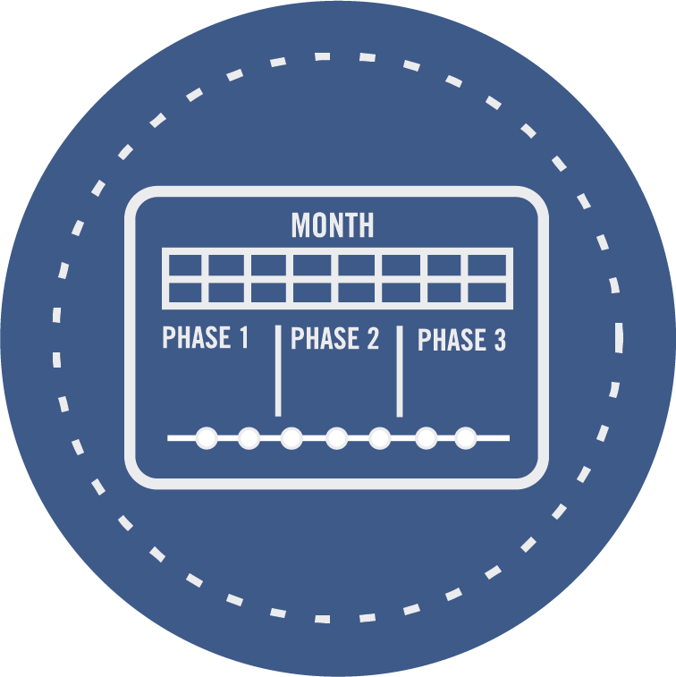
RECOMMENDATIONS
Succeeding programs or interventions should focus on strengthening the capacities of partner LGUs to implement them and conduct follow-through activities.
Closely align future programs with the Government of the Philippines’ development plans
Mobilize resources for climate change mitigation and adaptation.
Succeeding efforts should further capacitate the cities in responding to climate-related disasters and risks.
Implementation
of plans
Notes:
SURGE was able to assist in the formulation and approval of plans and planning documents (e.g., CDRA-compliant CLUPs, WASH master plans, Tourism Plans, GenSan Aerotropolis plan, transportation plans), and succeeding programs or interventions should focus on strengthening the capacities of partner LGUs to implement them and conduct follow-through activities.
More specifically, the evaluation team recommends that USAID continue to:
Closely align future programs with Government of the Philippines development plans, as has been done by SURGE, with a continued focus on building the capacities of CDI cities to implement the climate-resilient PPAs identified in their local development plans.
Mobilize resources for climate change mitigation and adaptation.
Succeeding efforts should further capacitate the cities in responding to climate-related disasters and risks. This includes strengthening the local disaster risk reduction and management councils (DRRMCs) not only in disaster response but, more specifically, in preparing communities—especially the more vulnerable sectors (women, children, and those in disaster-prone areas)—so that they can reduce risks and hazards.

Slide 16
RECOMMENDATIONS
Continue assistance on the application of GIS for integration into LGU’s various operations
Future interventions should focus on capacity development and development of integrated IT system for local and urban governance and management.
Pursue development of the Unified Land Information System
Application of ICT
in urban governance
and management
Notes:
Assistance to LGUs should be continued, especially on the application of GIS, which could be integrated into the LGUs’ various operations (e.g., planning and zoning, BPLS, land registration, business tax assessment and collection, among others). Future interventions should focus on capacity development (institutions and people) and the development of an integrated IT system for local and urban governance and management. Specifically, it is recommended that succeeding efforts pursue the development of the ULIS because this benefits land tenure and security and enhances a city’s ability to generate revenue . In particular, utilize the GIS to create the digital cadastral databases and ensure that this is linked to other systems such as those in the Finance group. Identifying and titling properties provides opportunities to assess the properties correctly, thereby increasing revenue collection. Also, identification of LGU property can help the LGU decide to convert idle property to productive property.
In particular, utilize the GIS to create the digital cadastral databases and ensure that this is linked to other systems such as those in the Finance group. Identifying and titling properties provides opportunities to assess the properties correctly, thereby increasing revenue collection. Also, identification of LGU property can help the LGU decide to convert idle property to productive property

Slide 17
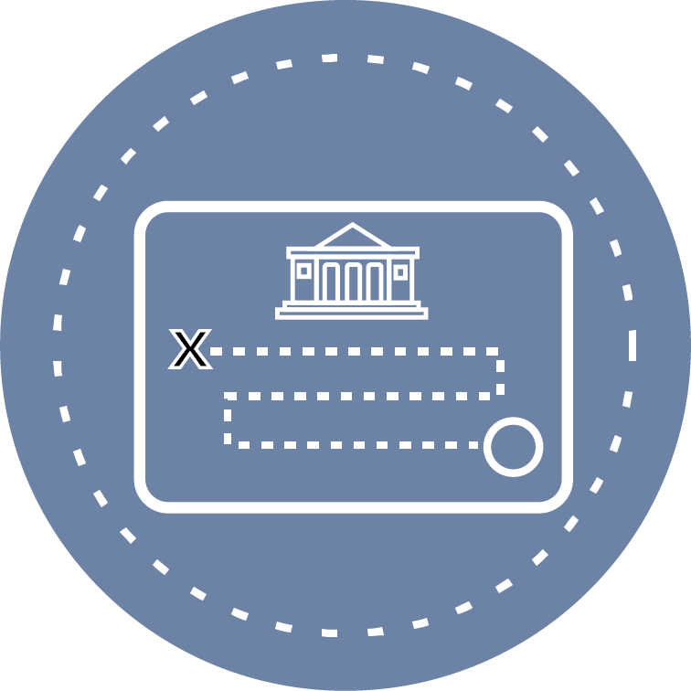
RECOMMENDATIONS
Adopt an Urban Development Learning Program (UDLP)-like mechanism but expand UDLP to include other thematic and functional areas
Include capacity development to enhance LGU skills in accessing and using climate change data and communicating climate change impacts.
Formulation of partner-LGU holistic post-project capacity development roadmaps
Notes:
To further ensure that gains are sustained, and knowledge transfer continues, a UDLP-like mechanism could be adopted. However, the coverage of UDLP should be expanded to include other thematic and functional areas to build local-level knowledge. More generally, a holistic post-project capacity development road map should be formulated and adopted, coupled with capacity development to enhance LGU skills in accessing and using climate change data in developing climate-resilient and risk-sensitive development plans and in communicating climate change impacts to local stakeholders.

Slide 18
Thank you

