Slide 1
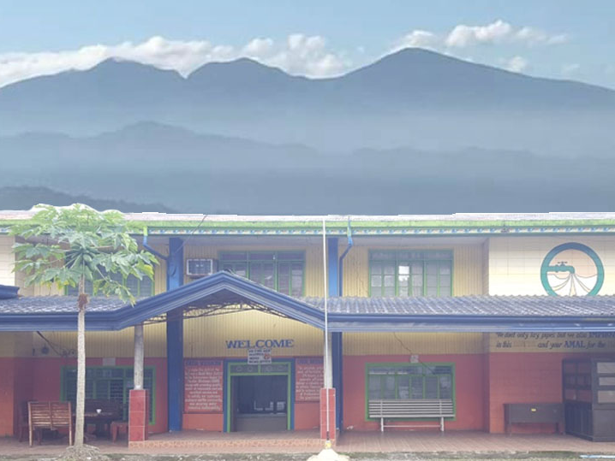
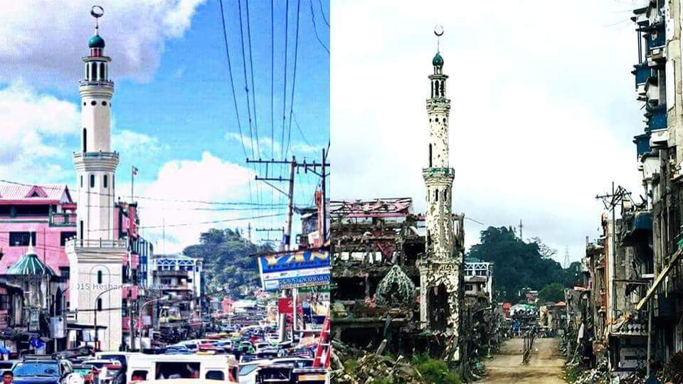
MARAWI CITY WATER DISTRICT
Restoring Water Supply Services
in Marawi City
Engr. Rashdi T. Adiong
General Manager

Slide 2
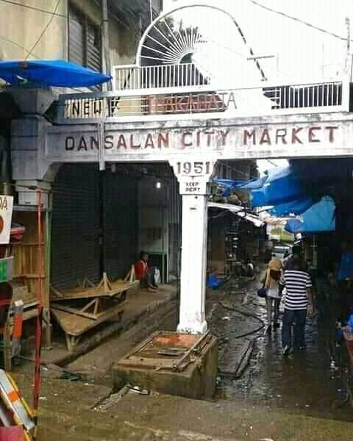
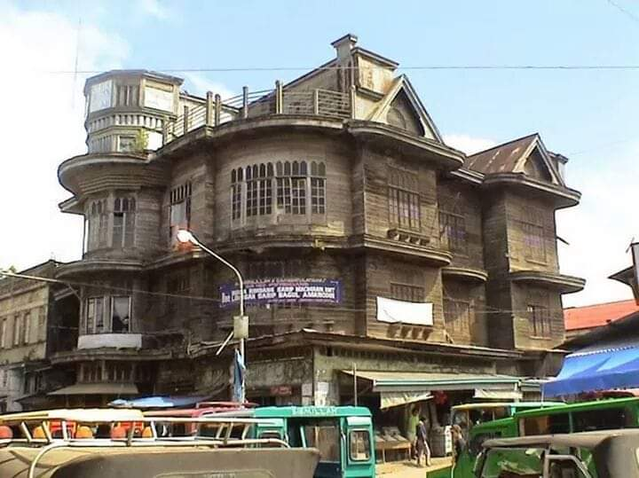
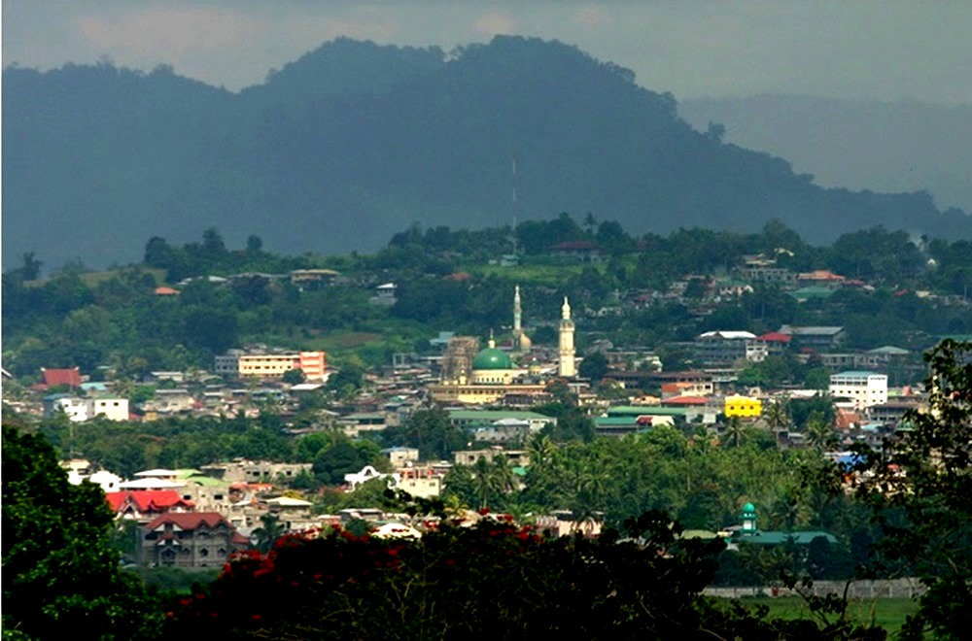
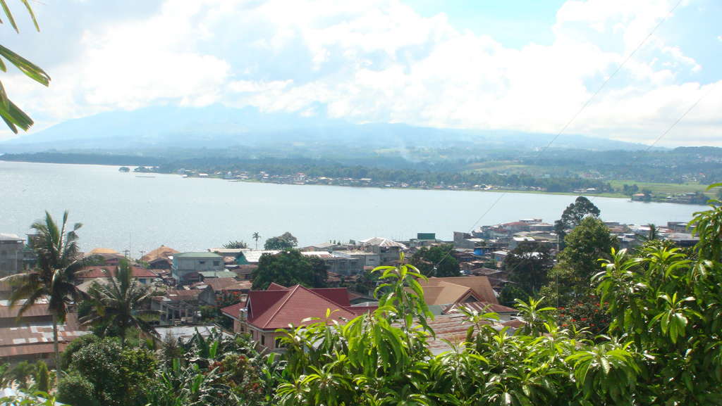
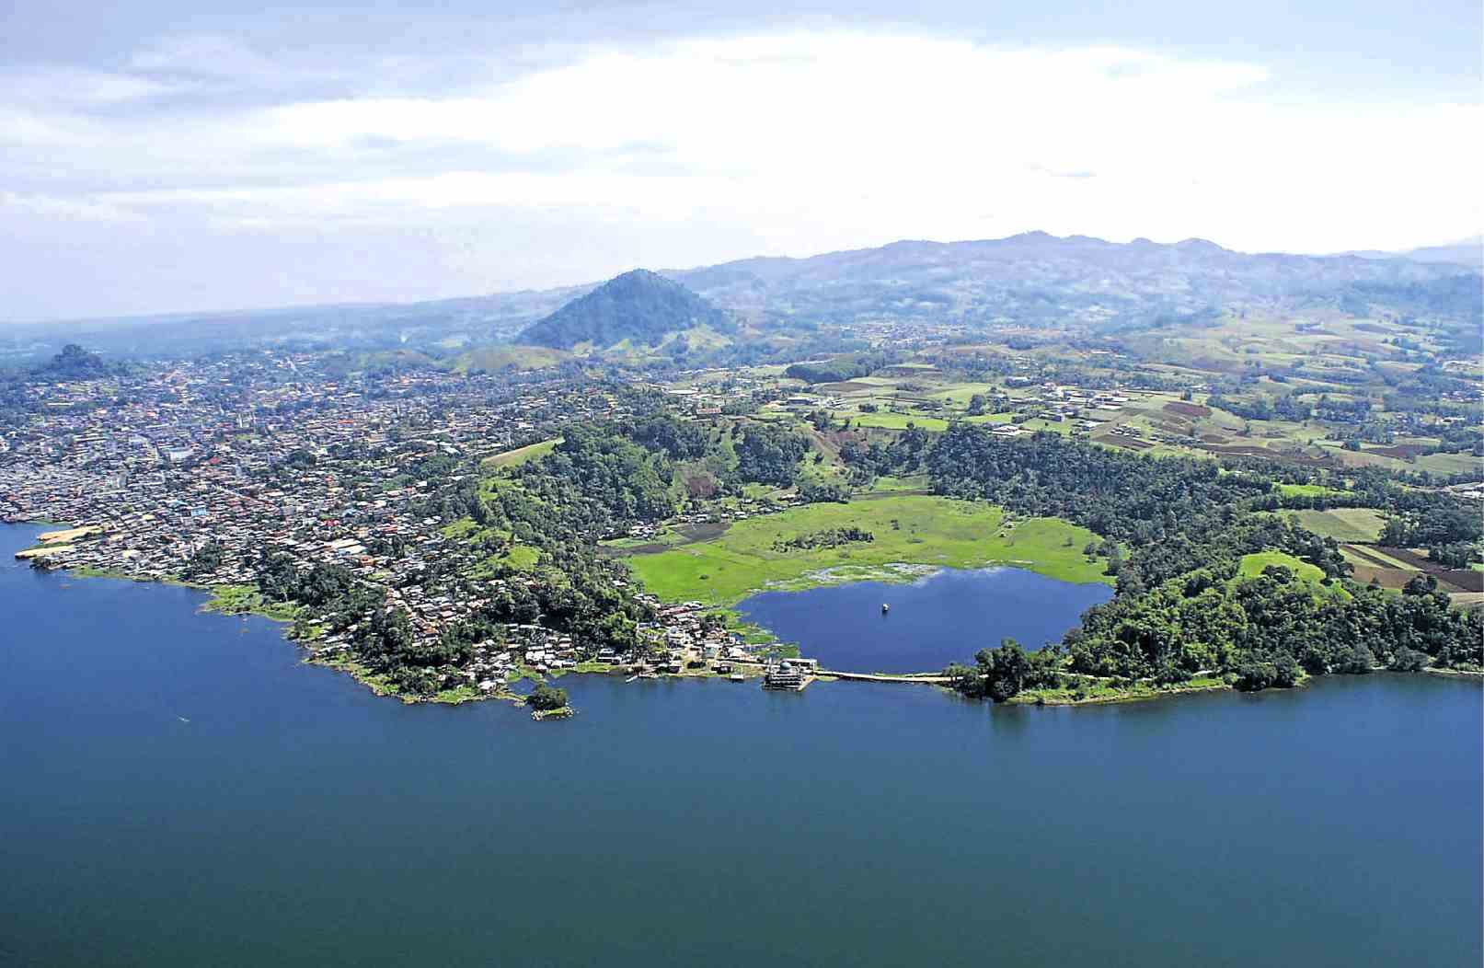
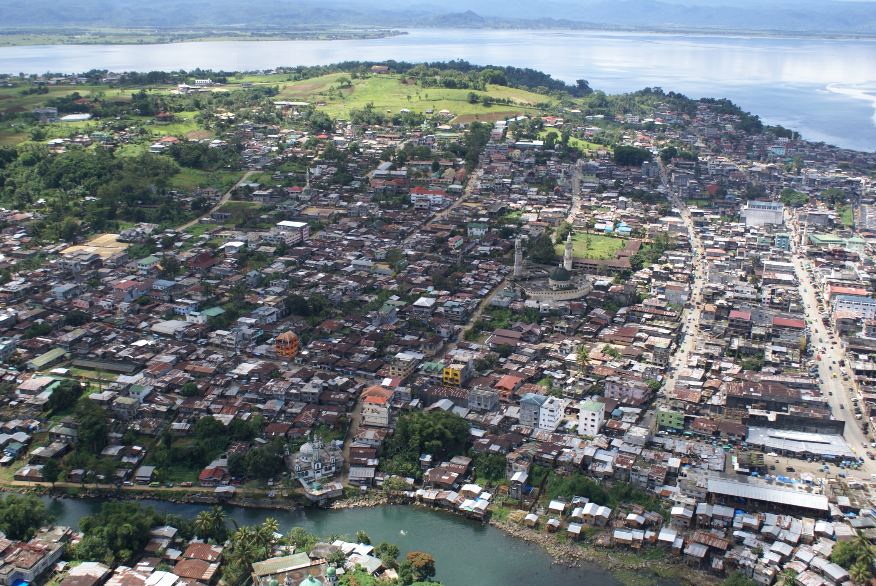
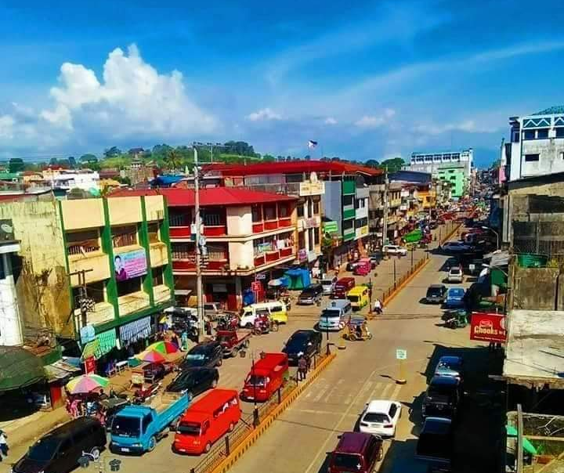
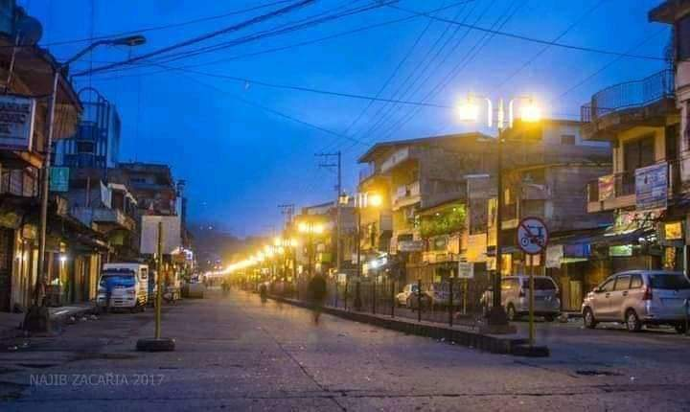
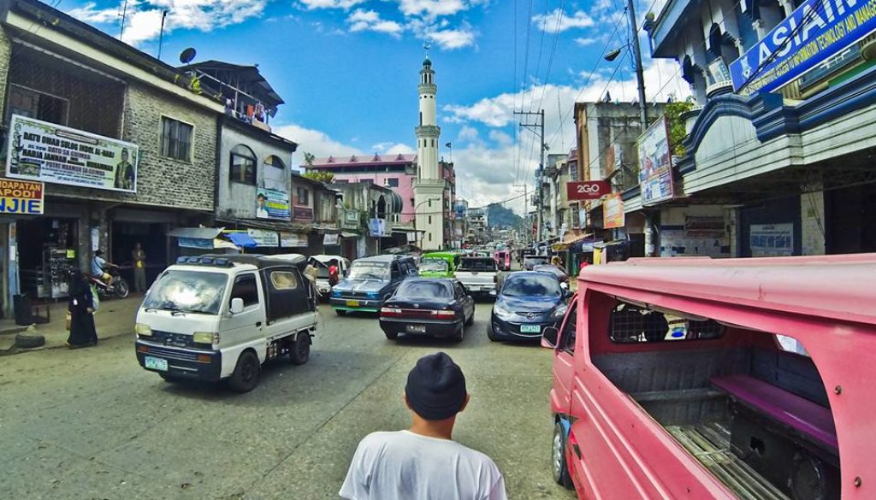
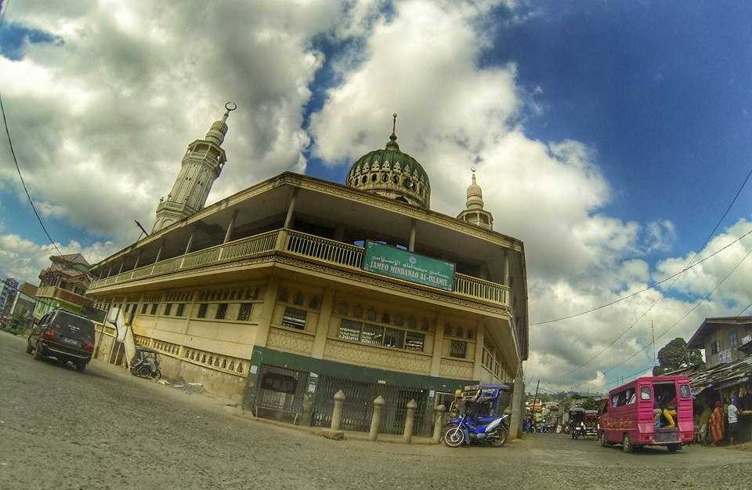
Marawi City Before the Siege
The Caloc-an Cove
Aerial View of Marawi City

Slide 3
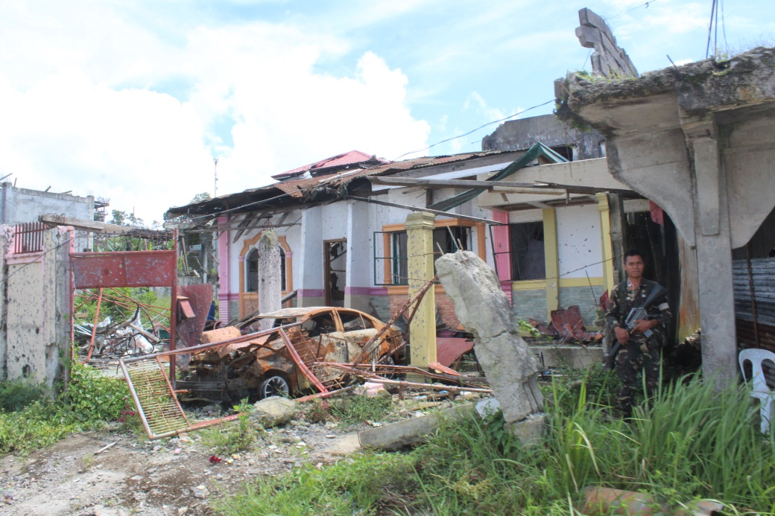
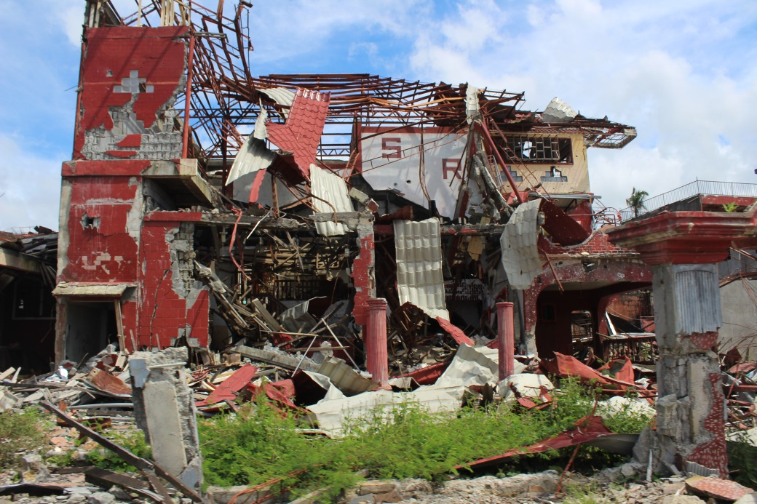
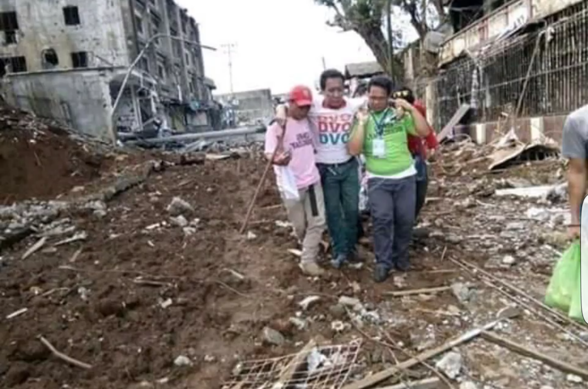
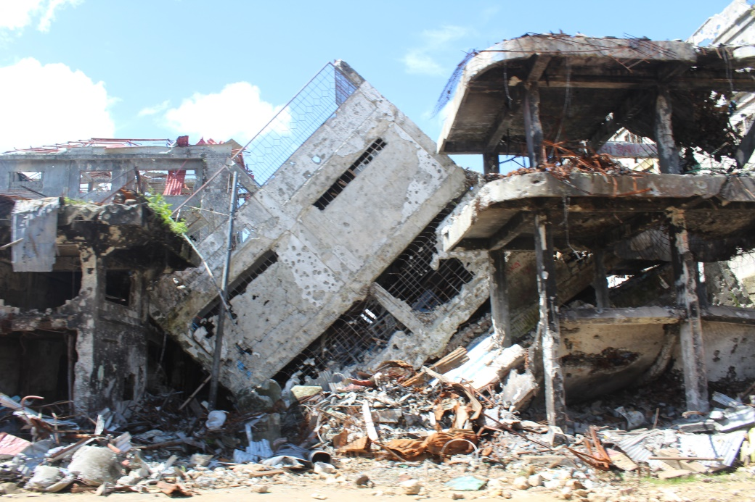
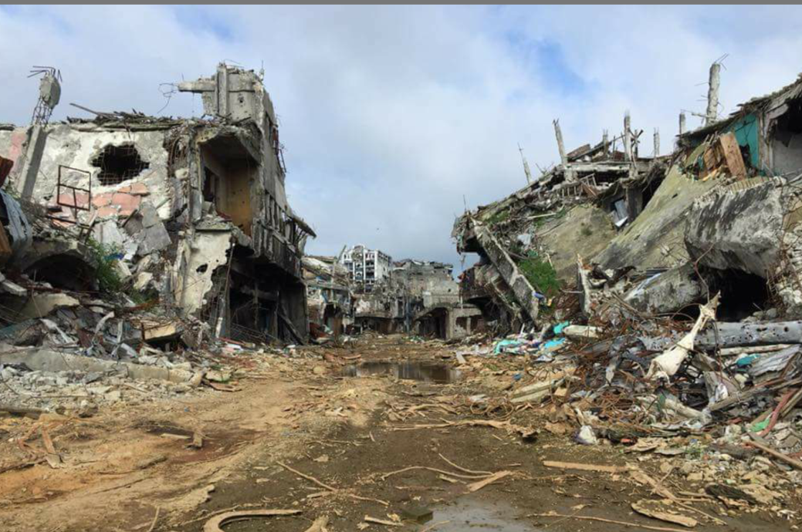
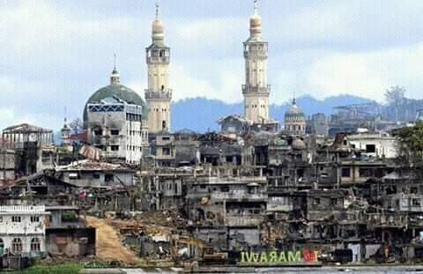
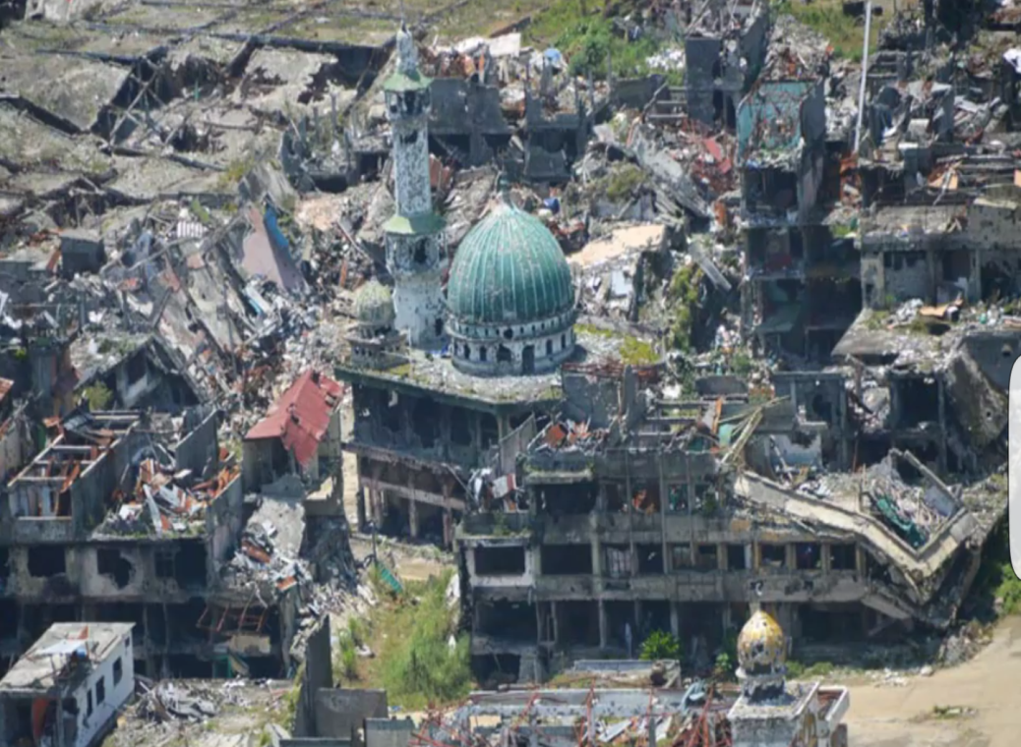
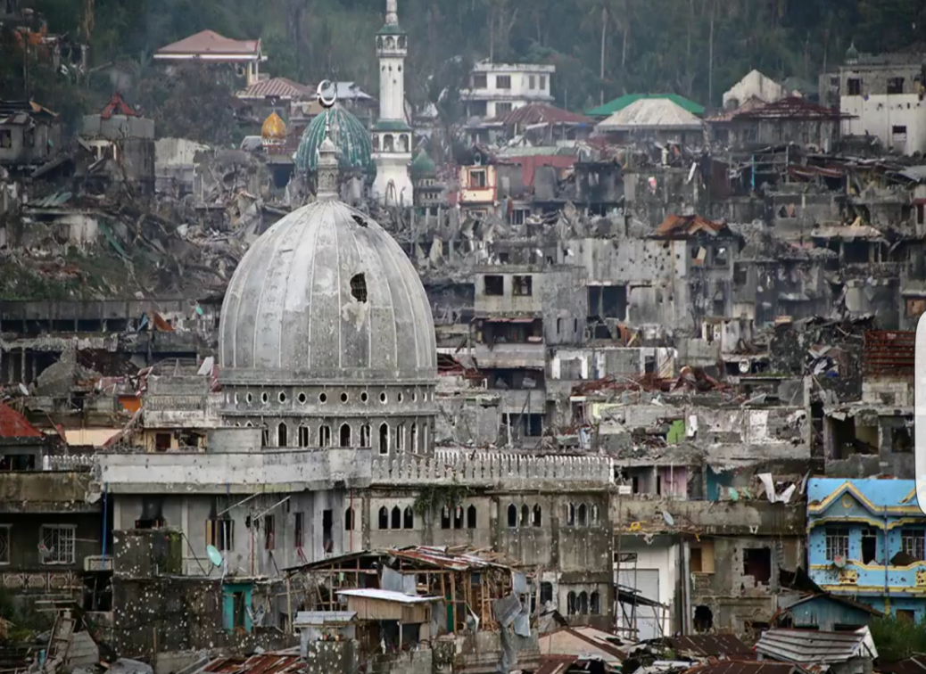
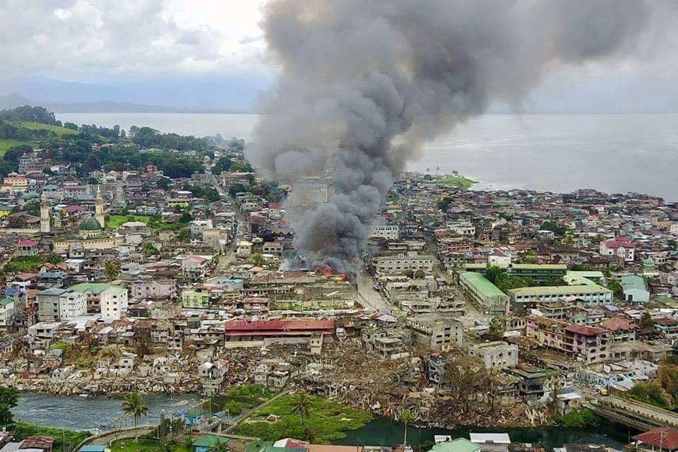
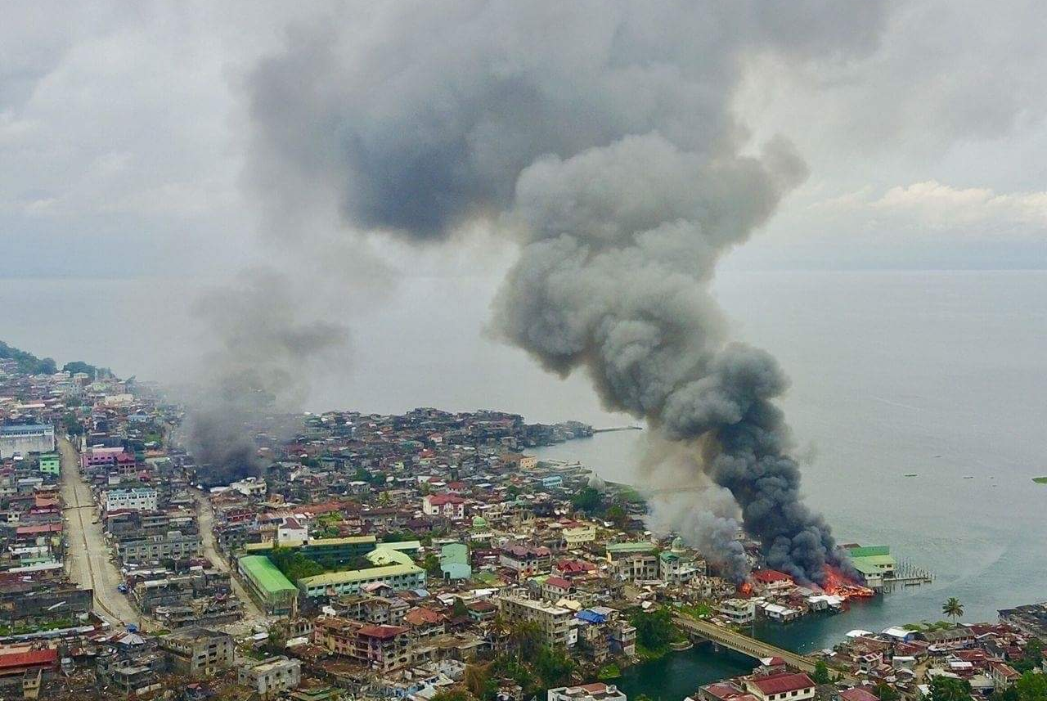
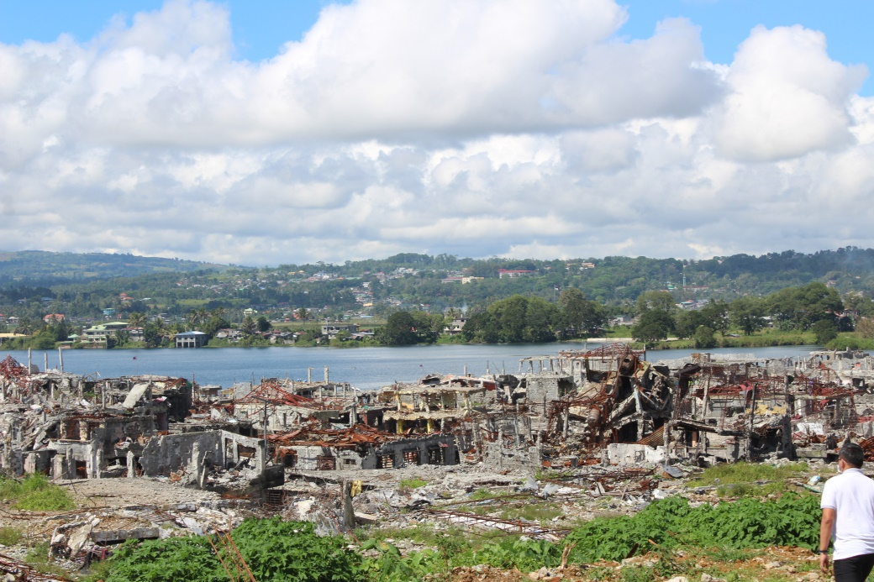
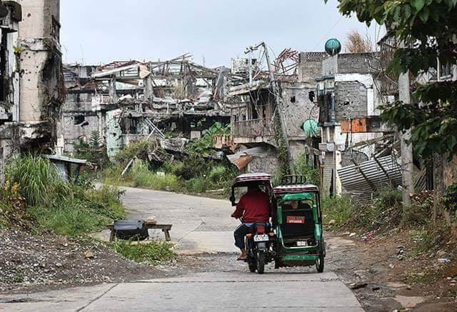
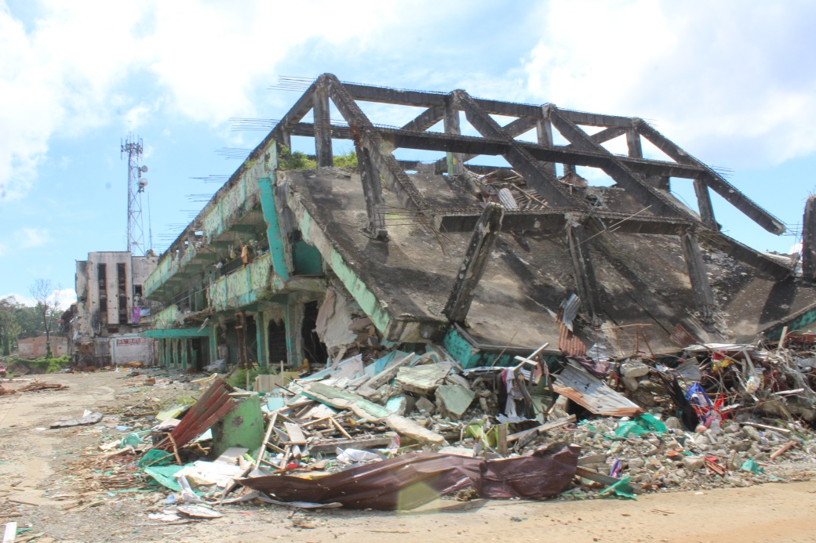
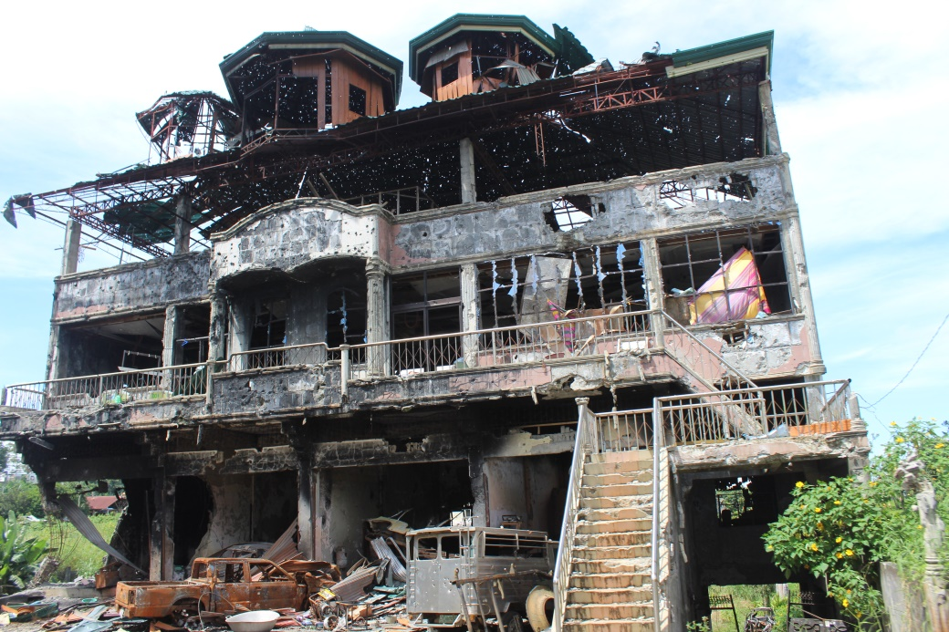
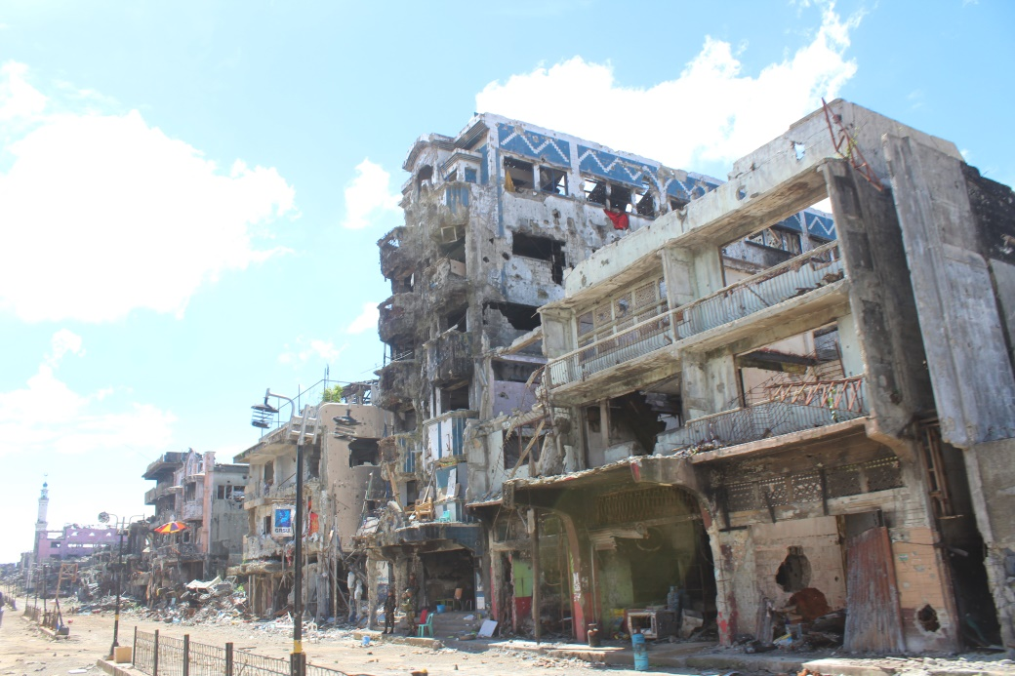
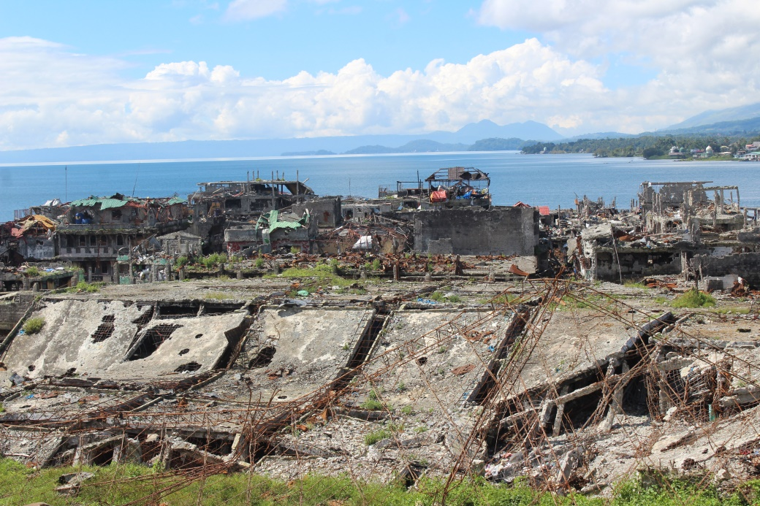
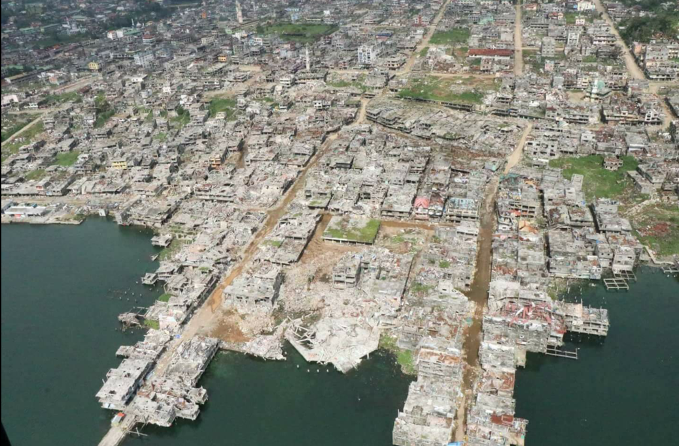
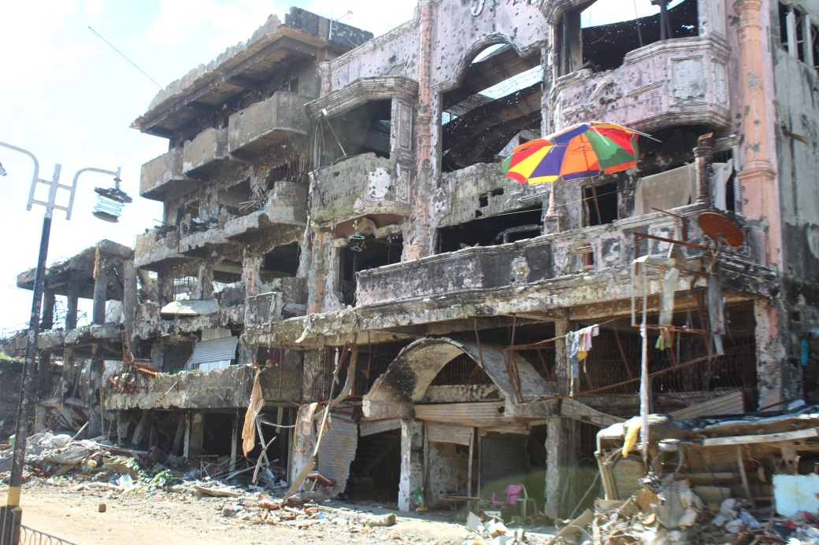
Aftermath of the Marawi Siege
Masjeed Bato Ali before and after

Slide 4
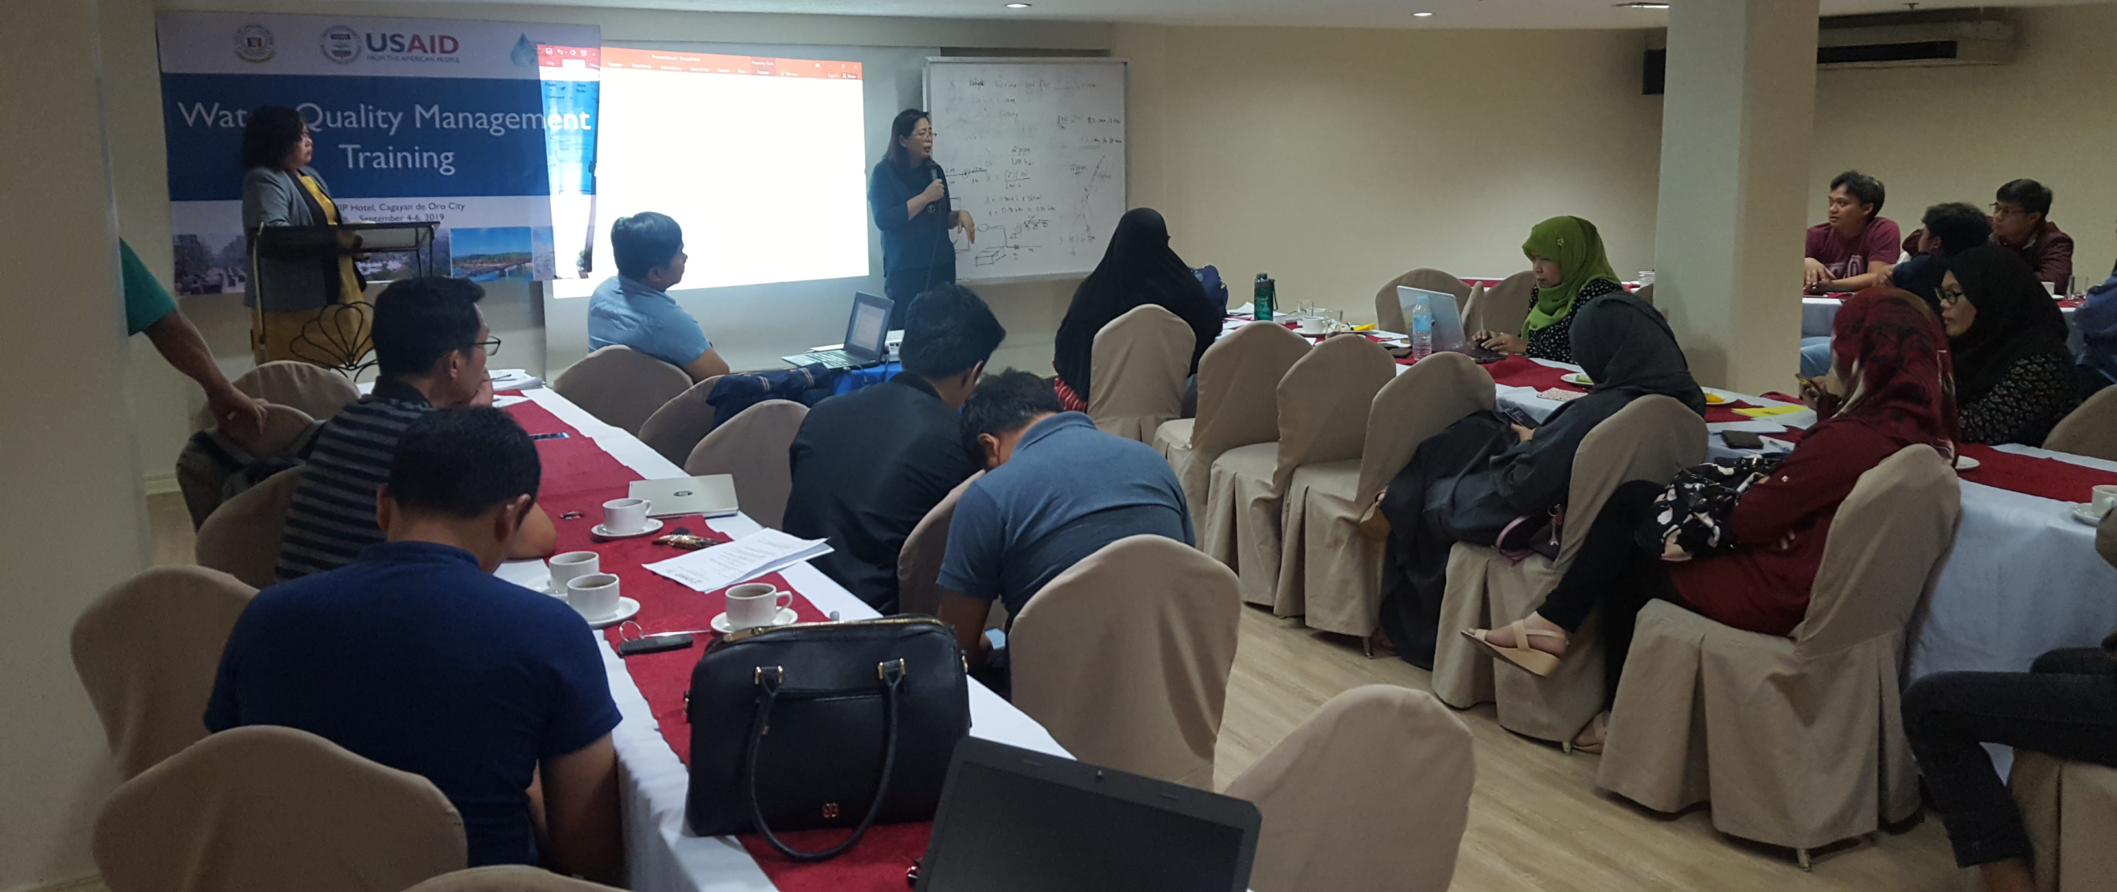
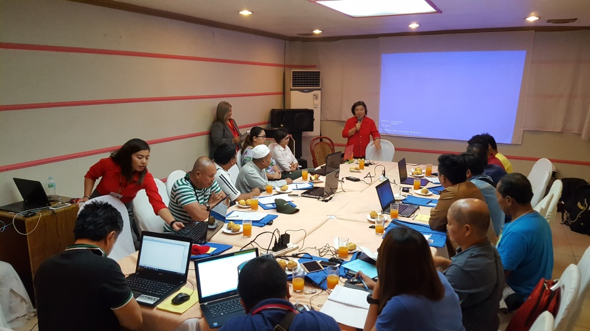
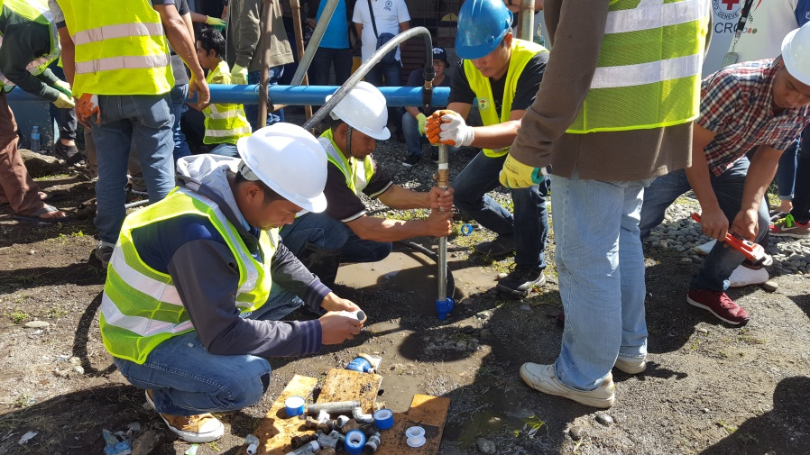
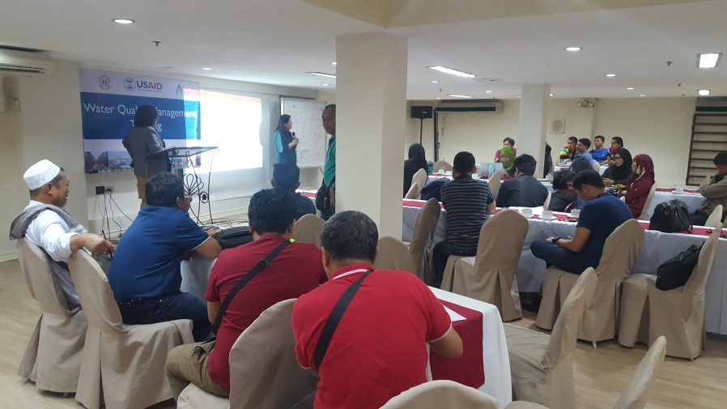
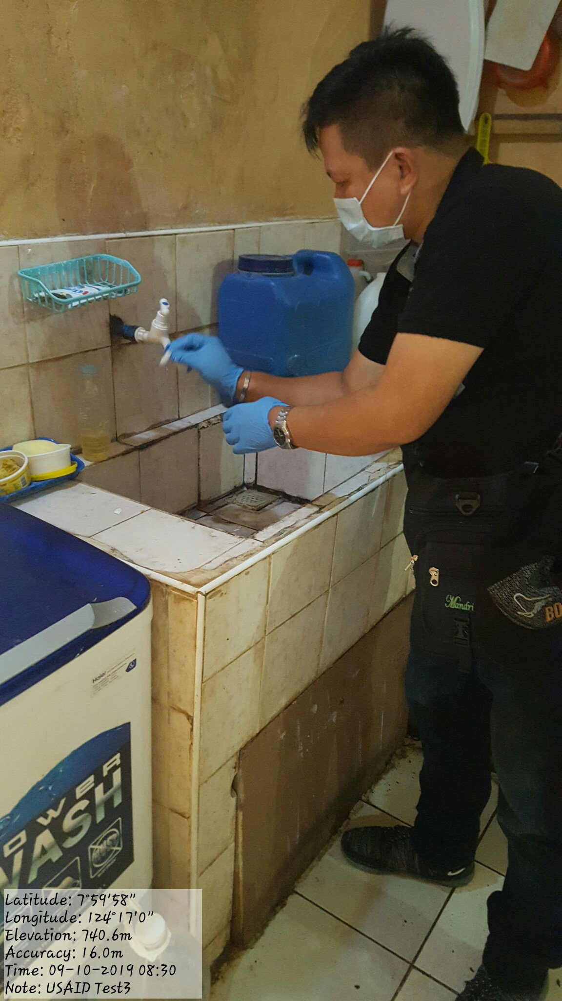
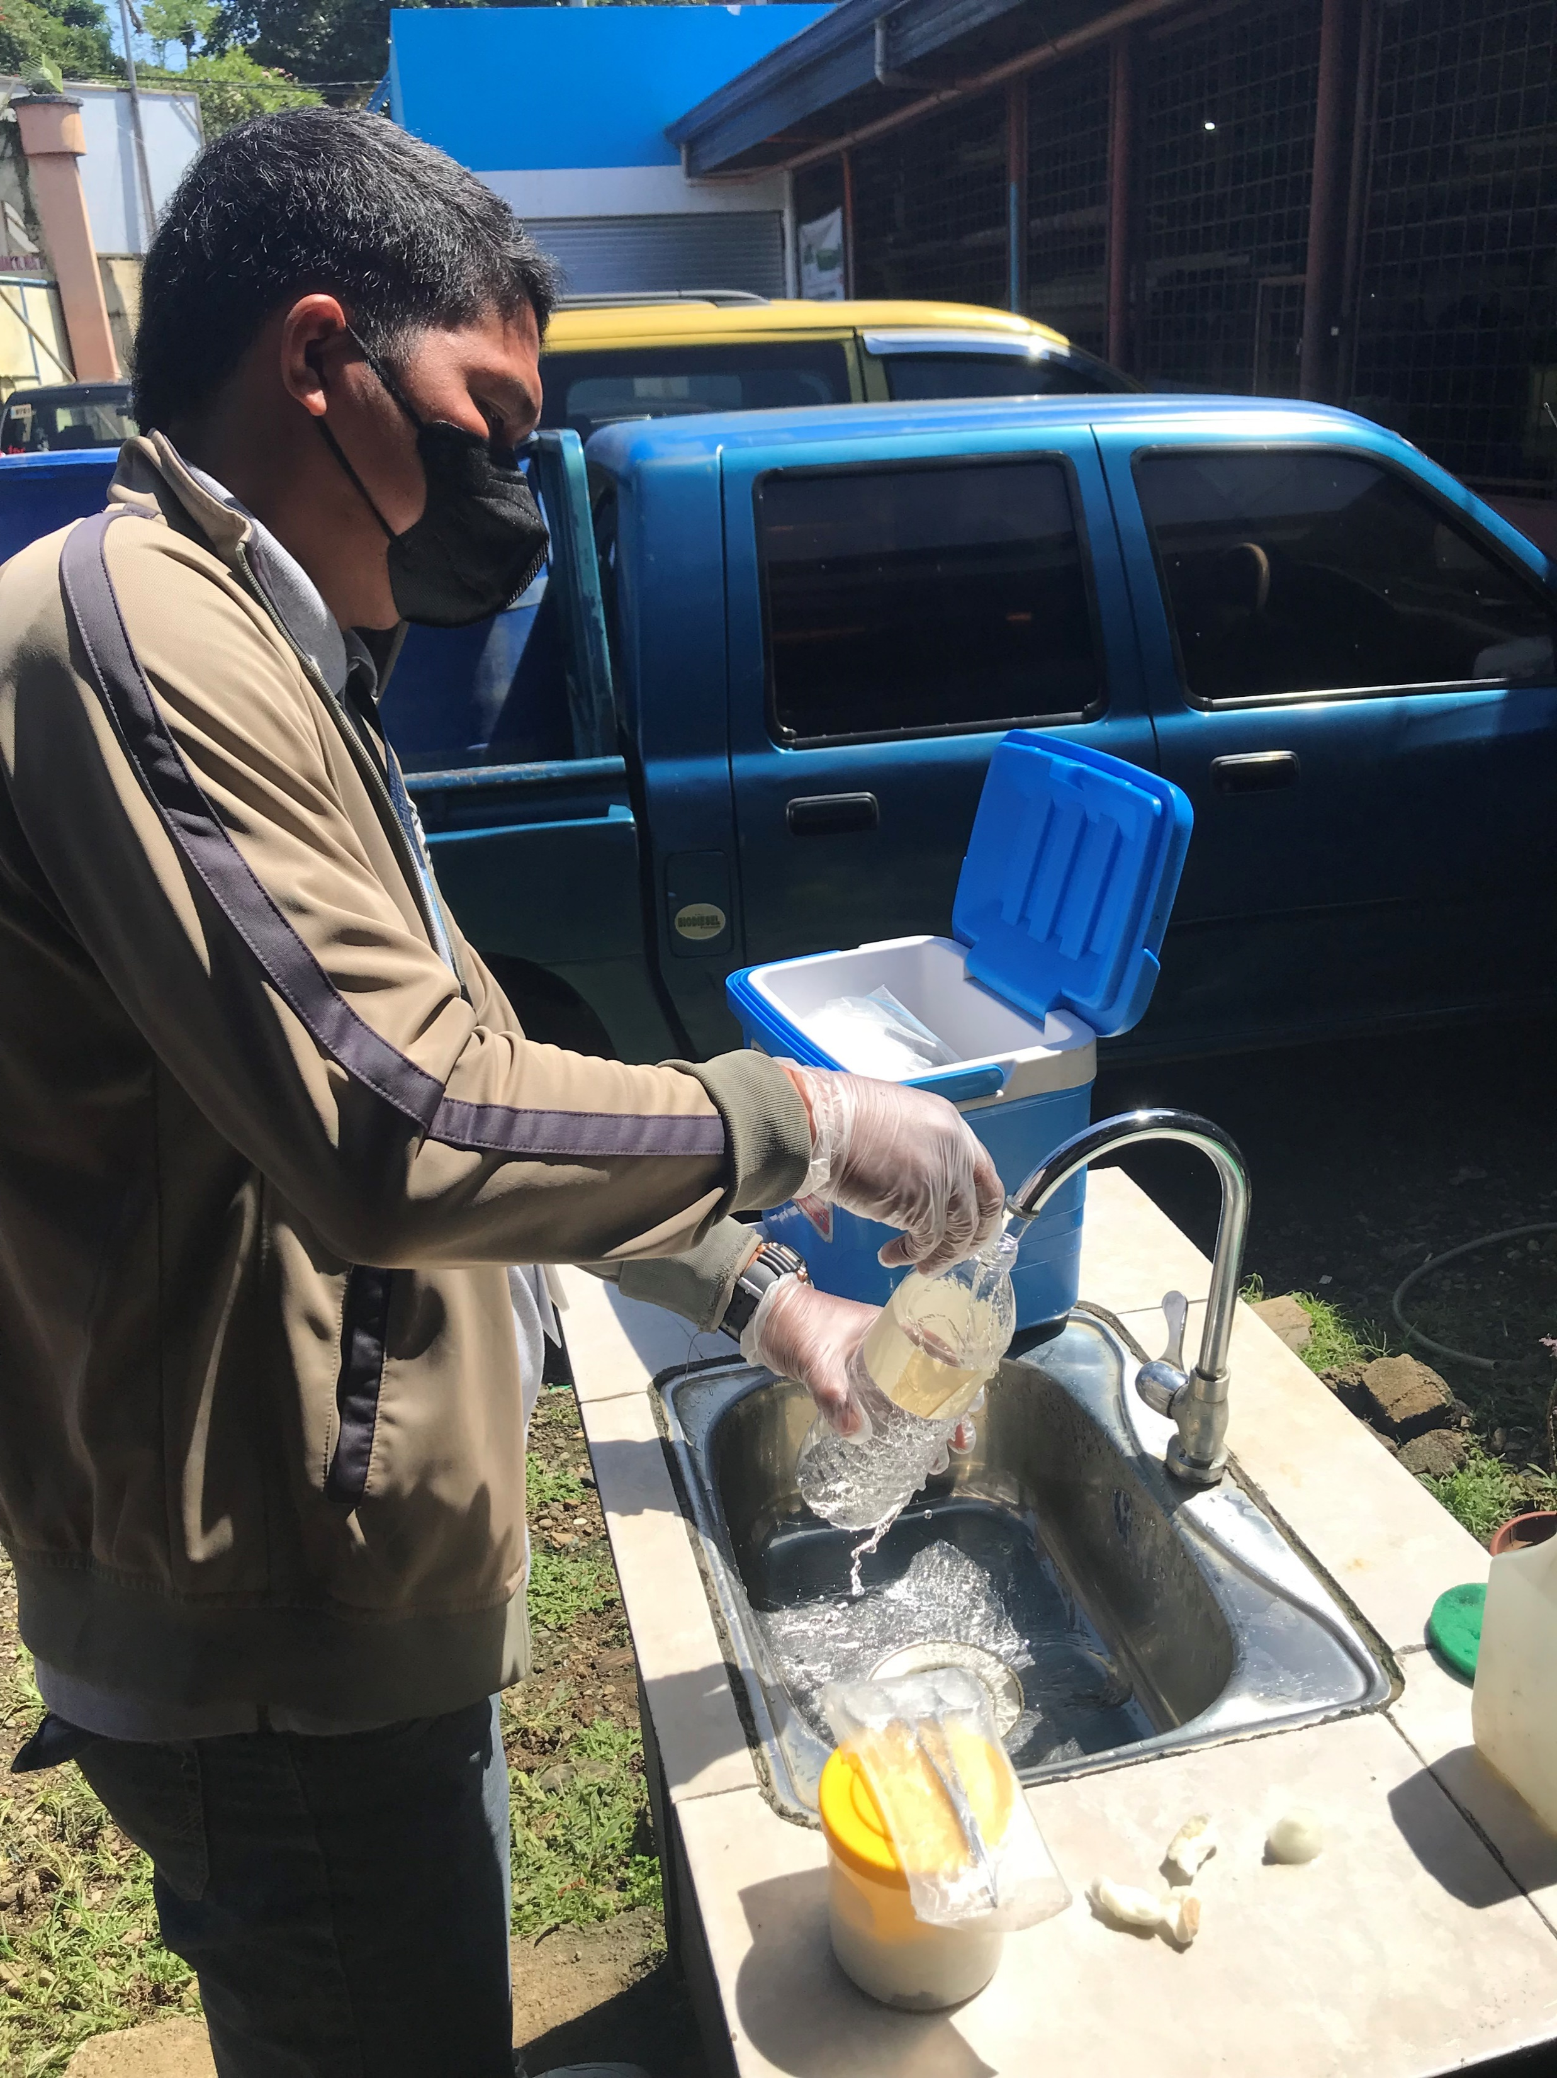
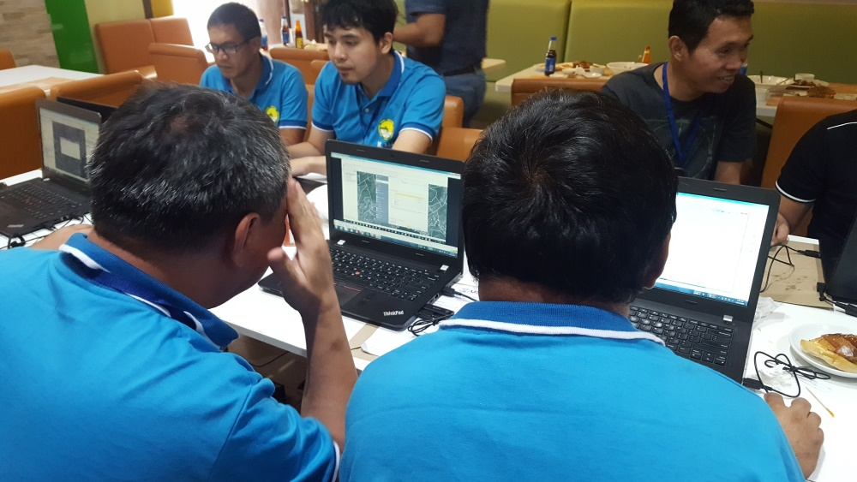
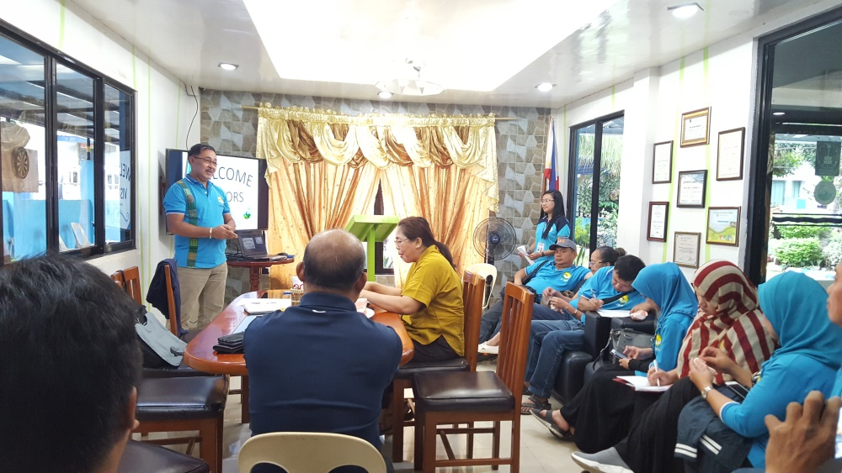
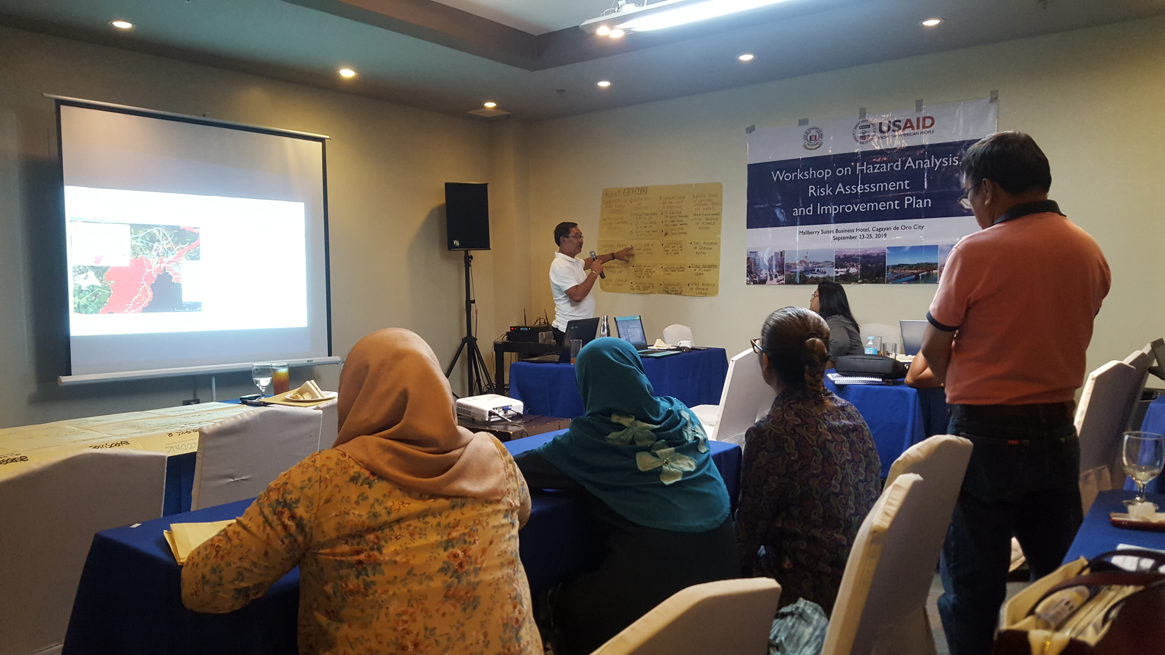
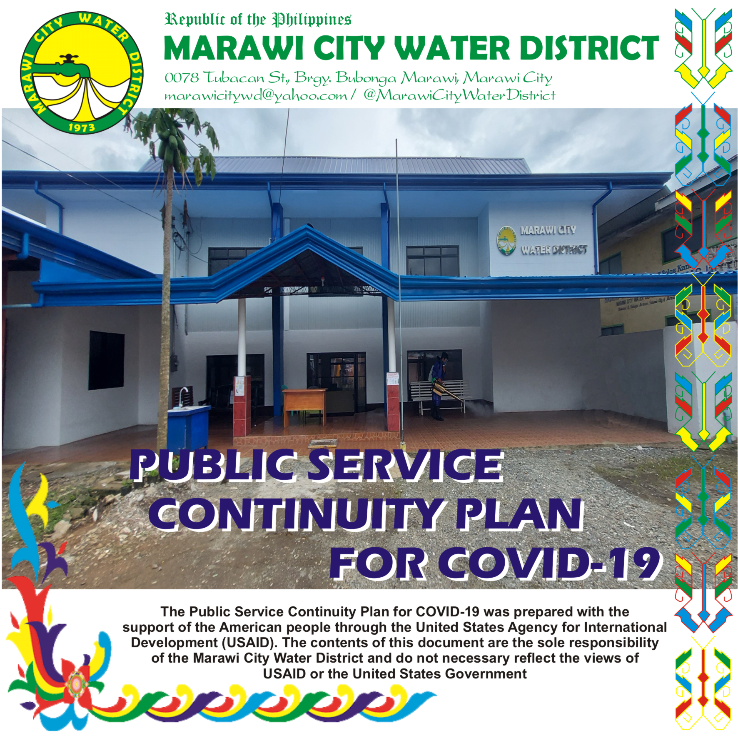
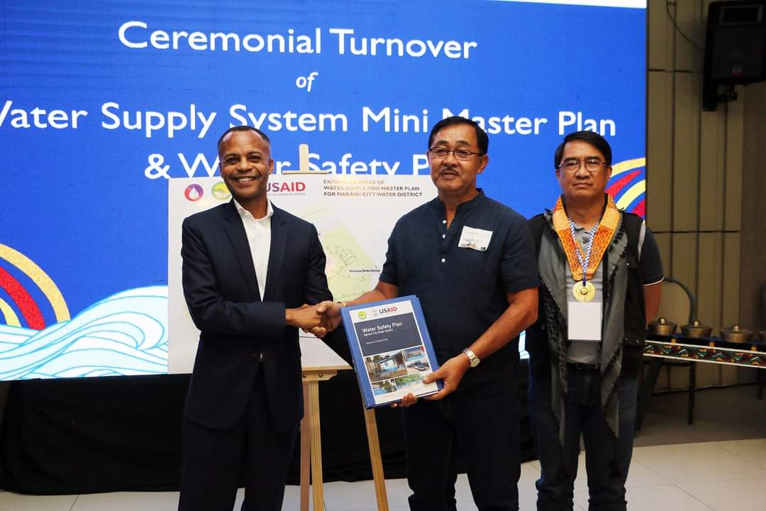
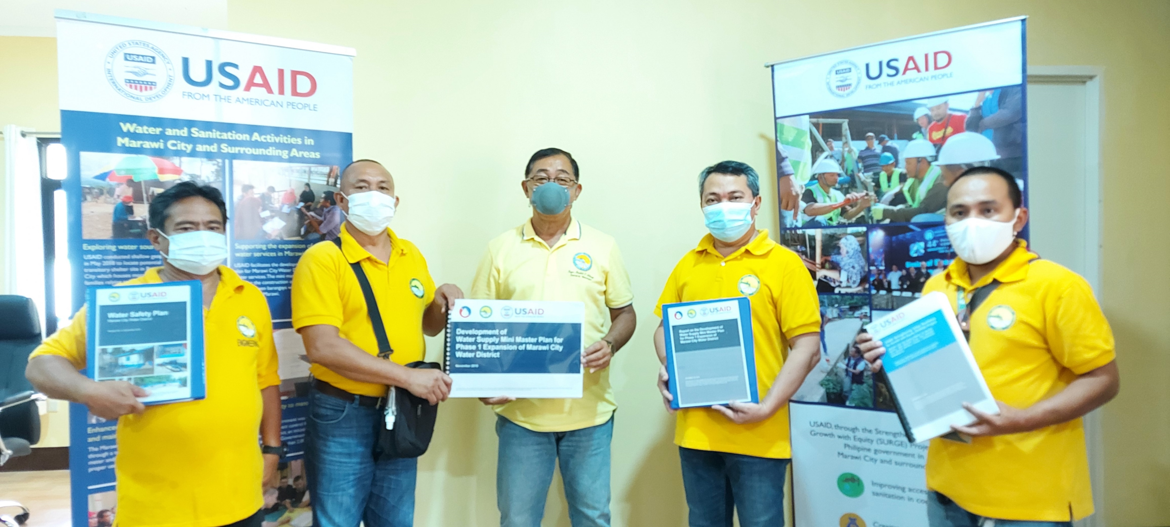
Various Capacity Building
Trainings, Seminars and Workshops Conducted by USAID
1.) Development of Water Safety Plan (WSP)
Status: WSP already submitted to LWUA for Approval
2.) Training of Understanding Ground Water and Wells
Conducted by Falcon CEST and NWRB (May 26, 2021 )
3.) Training on BCRP Business Continuity and Recovery Plan for Covid-19
Conducted January 27, 2021
4.) Business Planning Training for MCWD (November 16-18, 2020)
5.) Orientation On Public Financial Management Systems (November 5, 2020)
6.) Training On Septage Treatment Facility (October 27, 2020)
7.) Orientation on Government’s Hazard and Risk Assessment Tools (Sept. 30, 2020)
8.) Maynilad Nextwave: Glide Into The New Normal (September 24, 2020)
9.) Behavioral Change Communication Social Marketing Training for MCWD (Sept. 22, 2020)
10.) Orientation on E-Payment for WD (July 17, 2020)
11.) Rapid Assssment for Water Service Providers on E-Payment (June 17, 2020)
12.) Round Table Discussion on the Impacts of Covid19 Pandemic to Water Service Providers
Conducted: May 15, 2020
13.) Septage Management Ordinance Review (March 12-13, 2020)
14.) Banchmarking of MCWD: Peer to Peer Sharing with Wao Water District last January 23, 2020
15.) Training on GIS for the Establishment of Water Supply System ( December 11-13, 2019)
16.) Water Quality Management Training (September 4-6, 2019)
17.) Seminar on Operation and Maintenance (November 14, 2018)
18.) WaterLinks Forum (September 25-27, 2018)
19.) Hydraulic Modeling (August 29-31, 2018)
20.) NEDA Regional Planning Workshop on Philippine Water Supply and Sanitation (June 19-21, 2018)
Hydraulic Analysis Through Ephanet conducted by Cagayan de Oro WD
Operation and Maintenance conducted by Cagayan de Oro WD
Water Quality Management Training conducted by Cagayan de Oro WD
Training of Geographical Information System (GIS) for the Establishment of Water Supply System
Peer to Peer Sharing with Big Brother Wao Water District
Development of
Water Safety Plan (WSP)

Slide 5
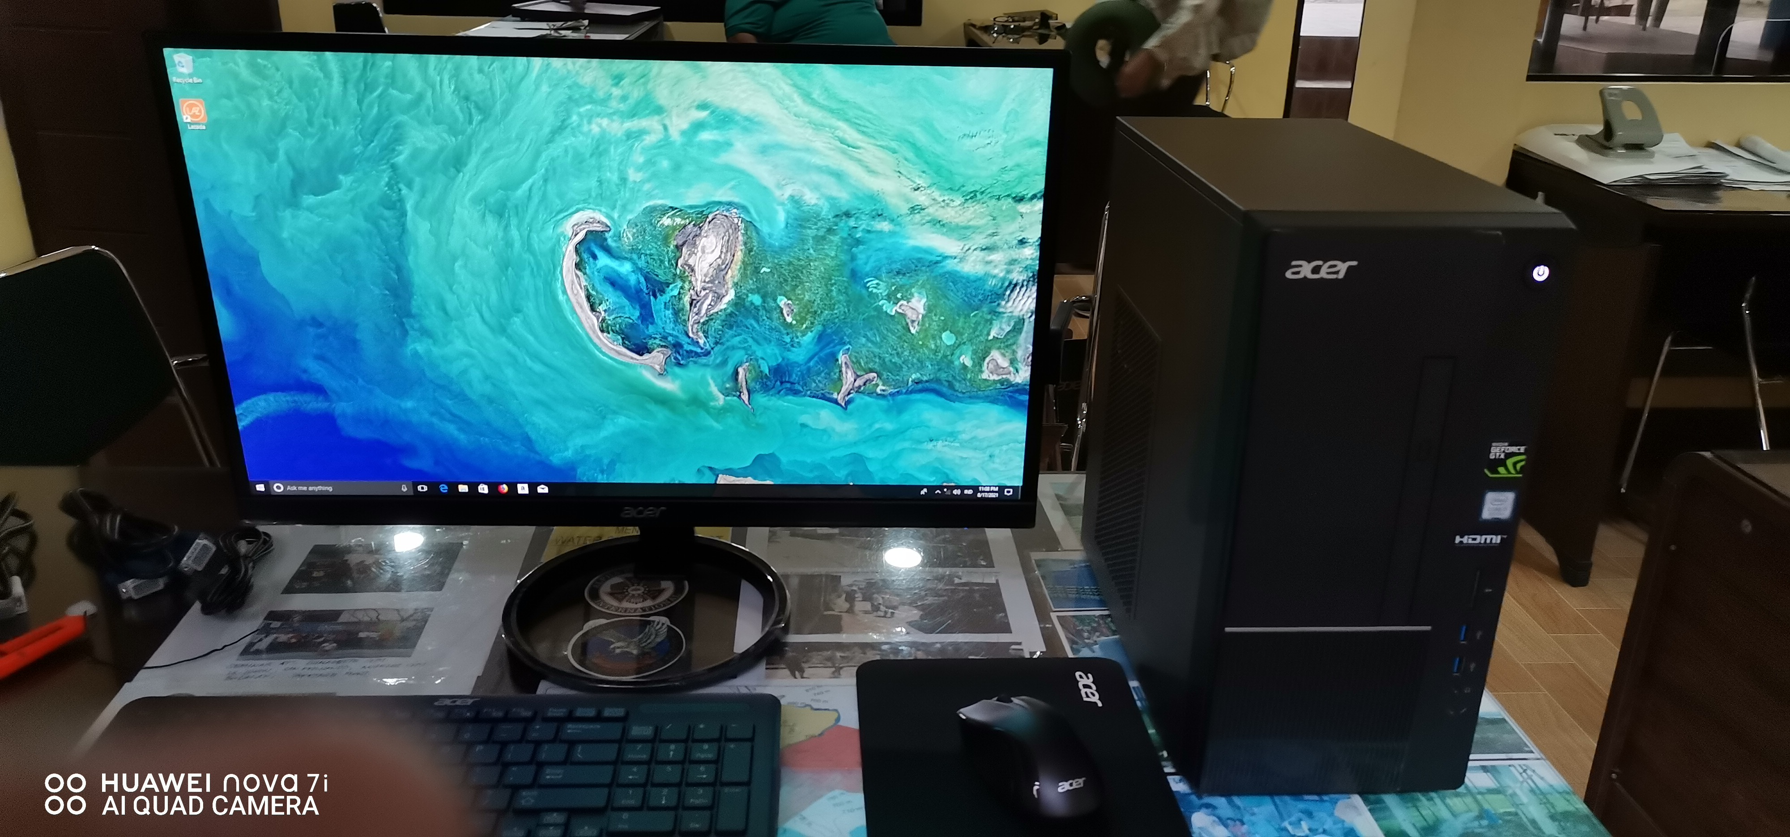
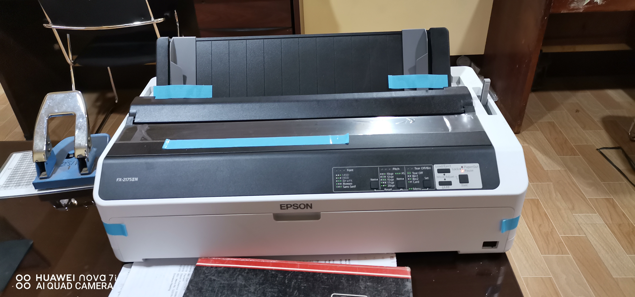
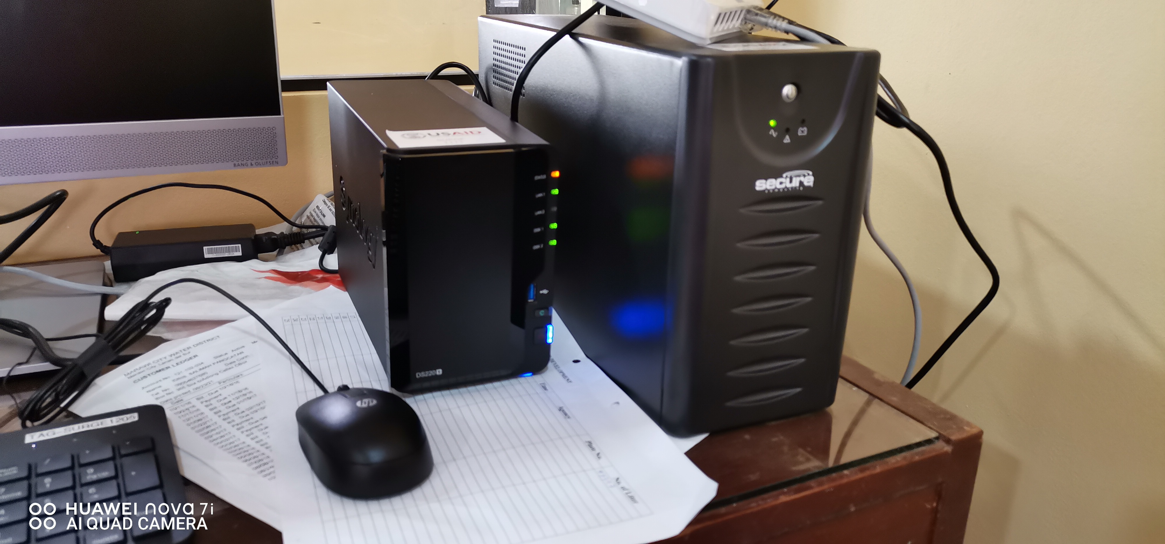
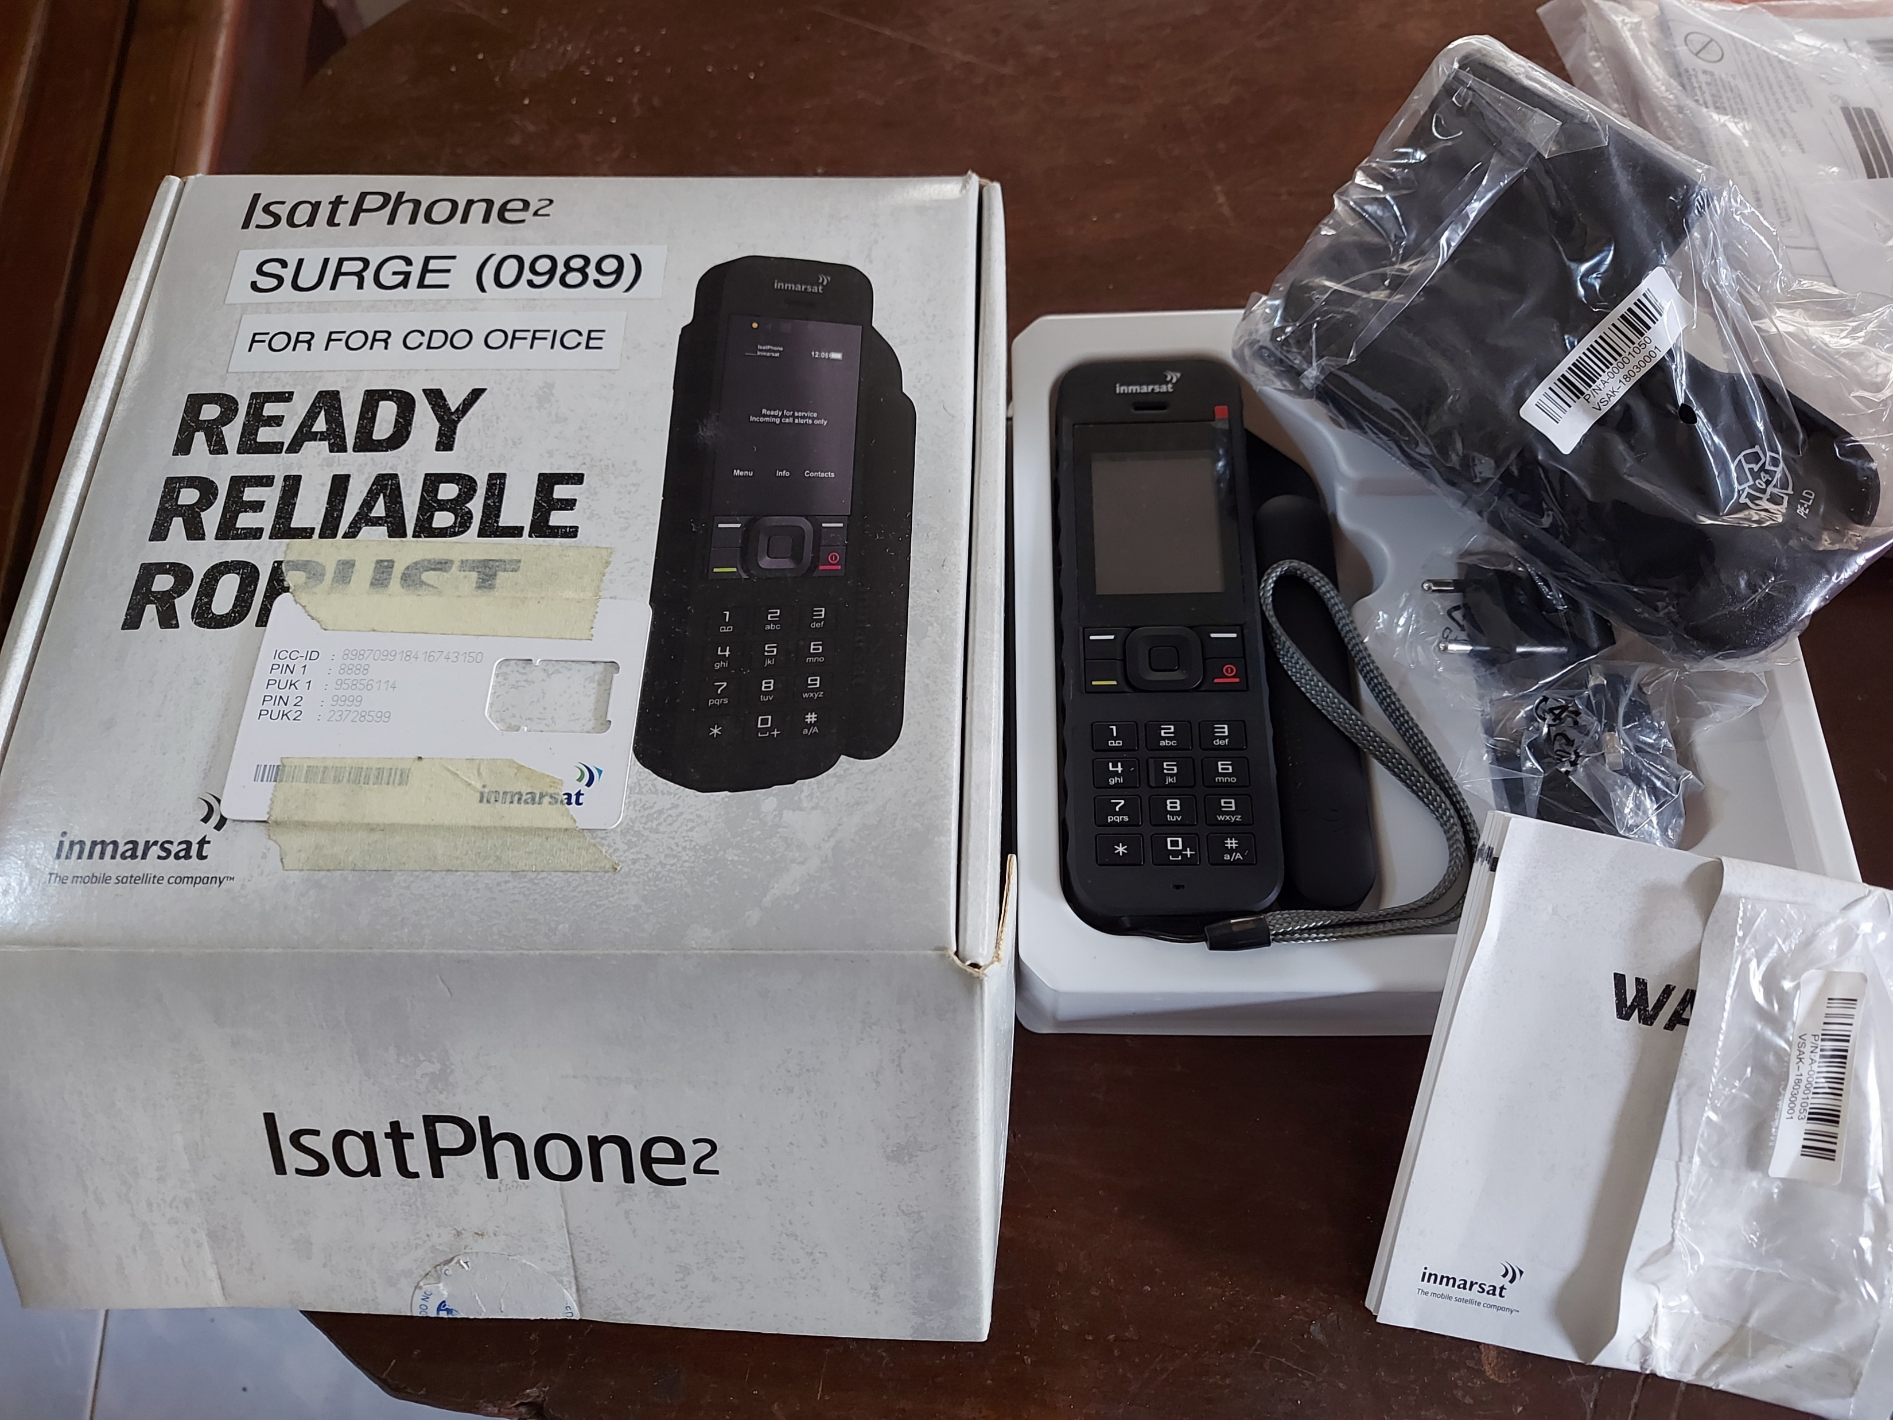
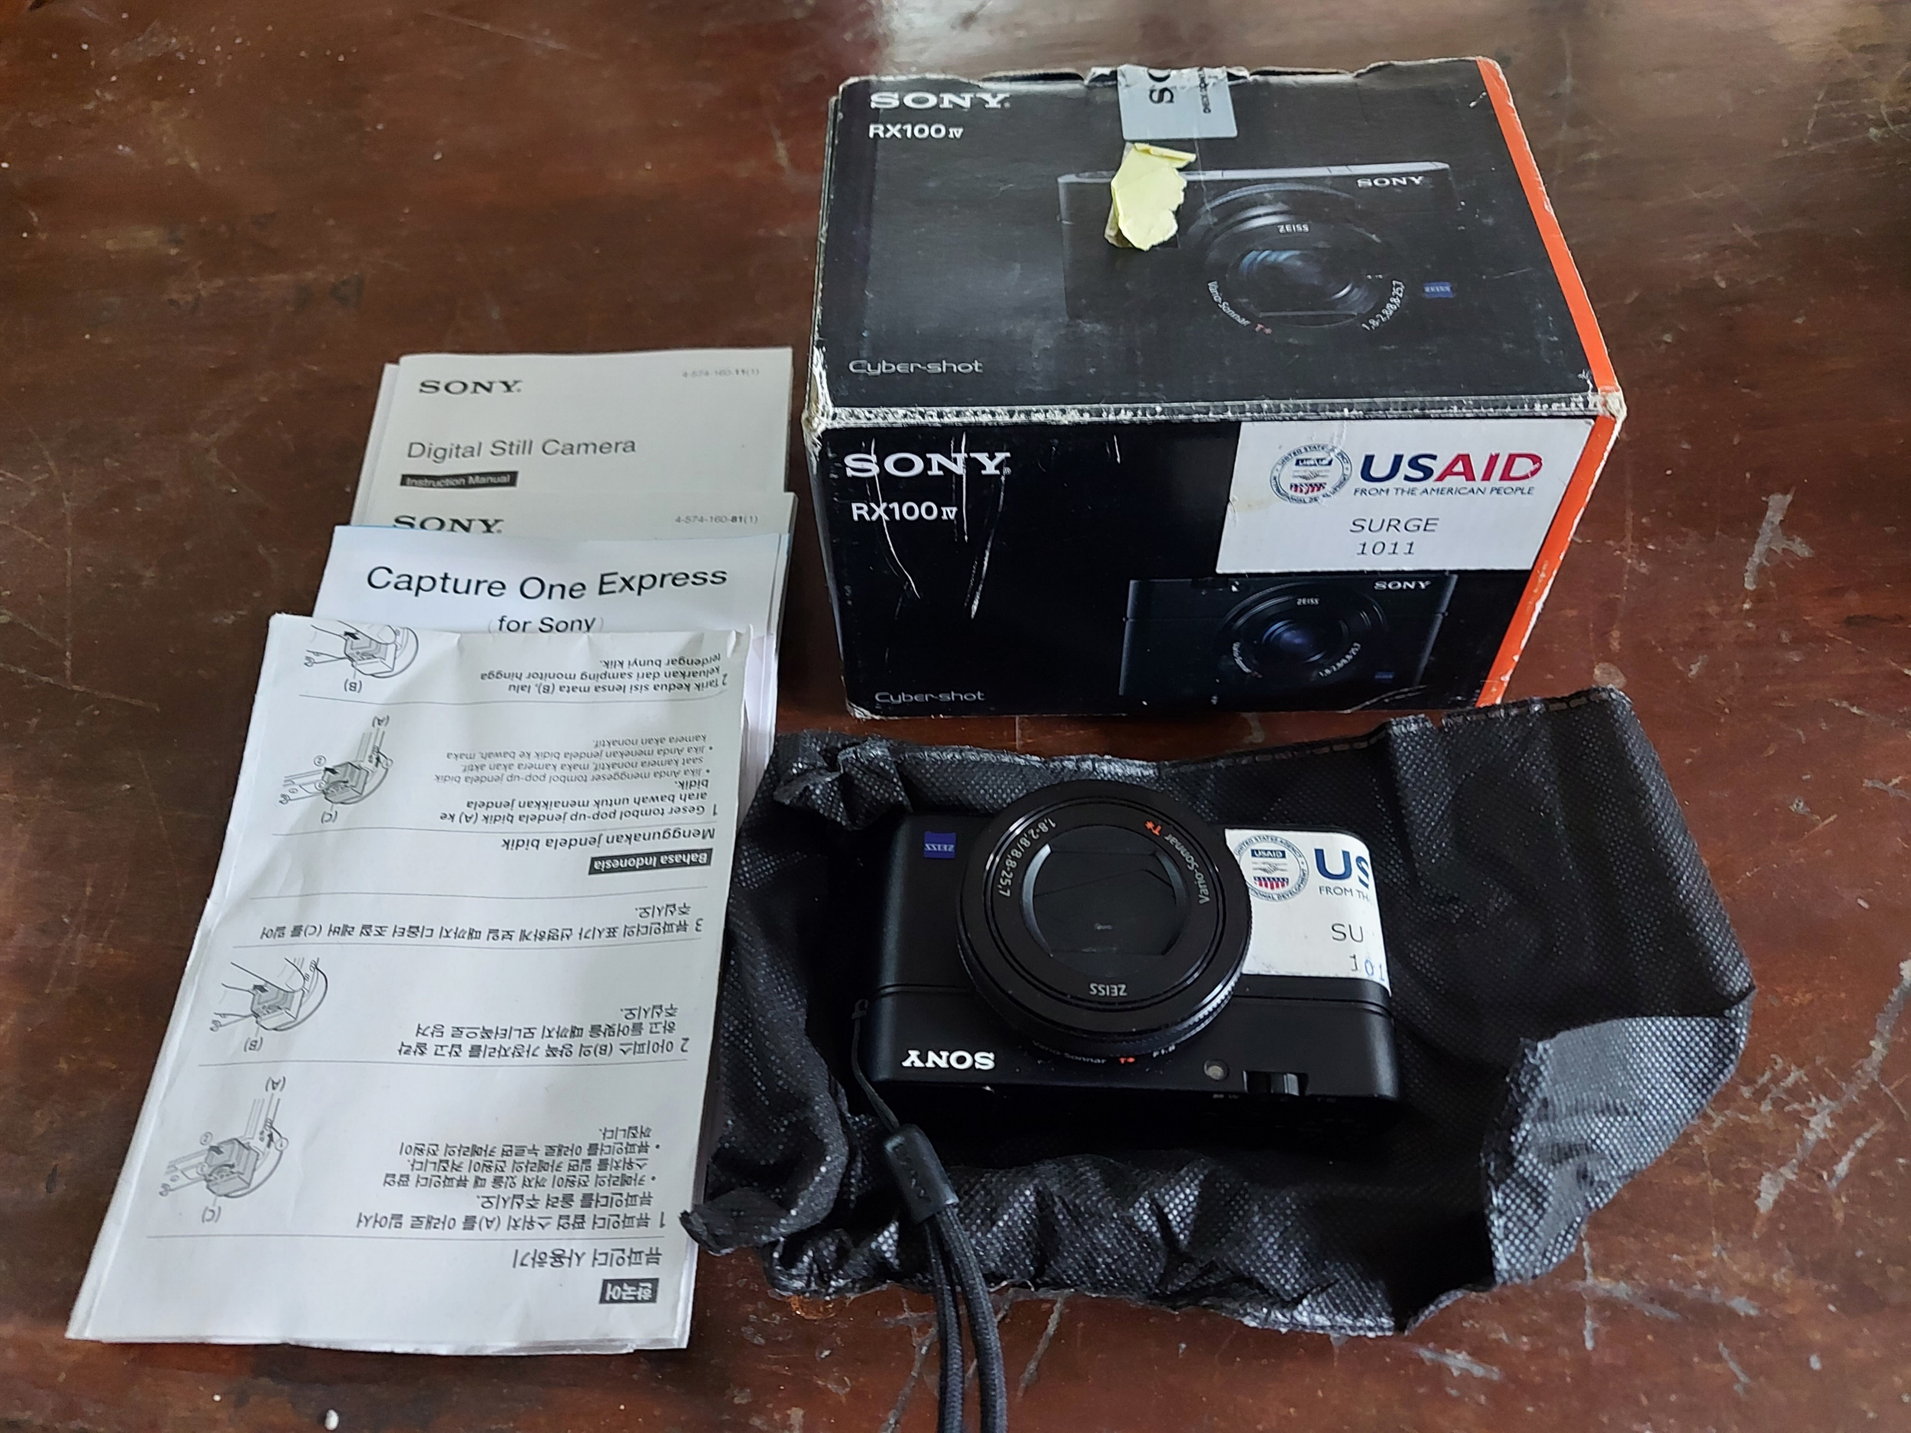
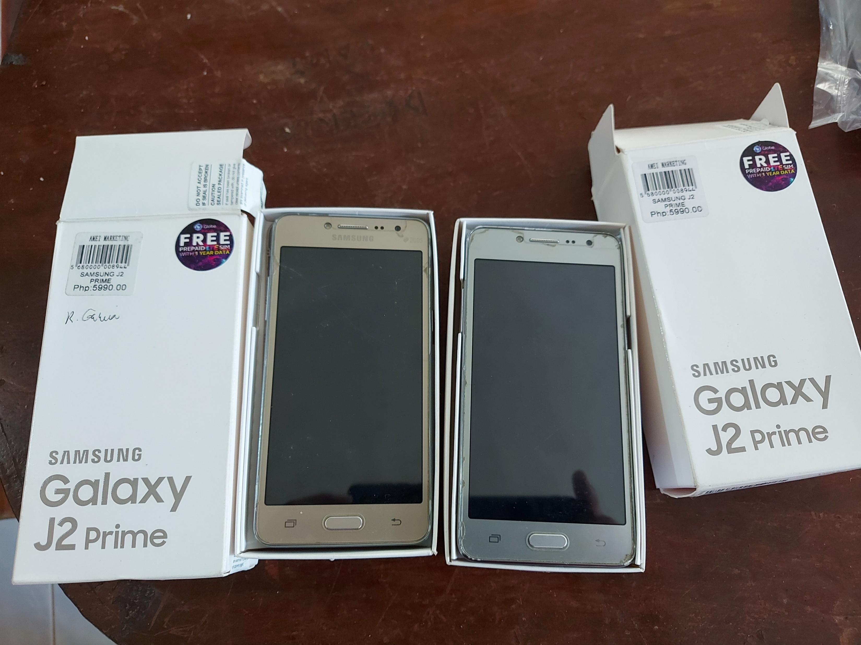
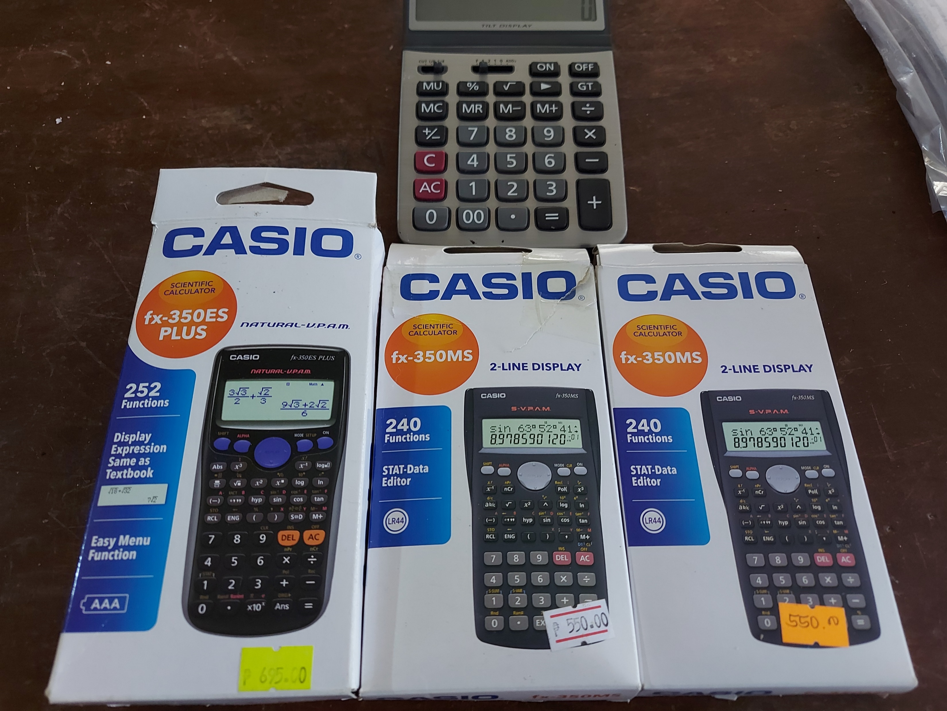
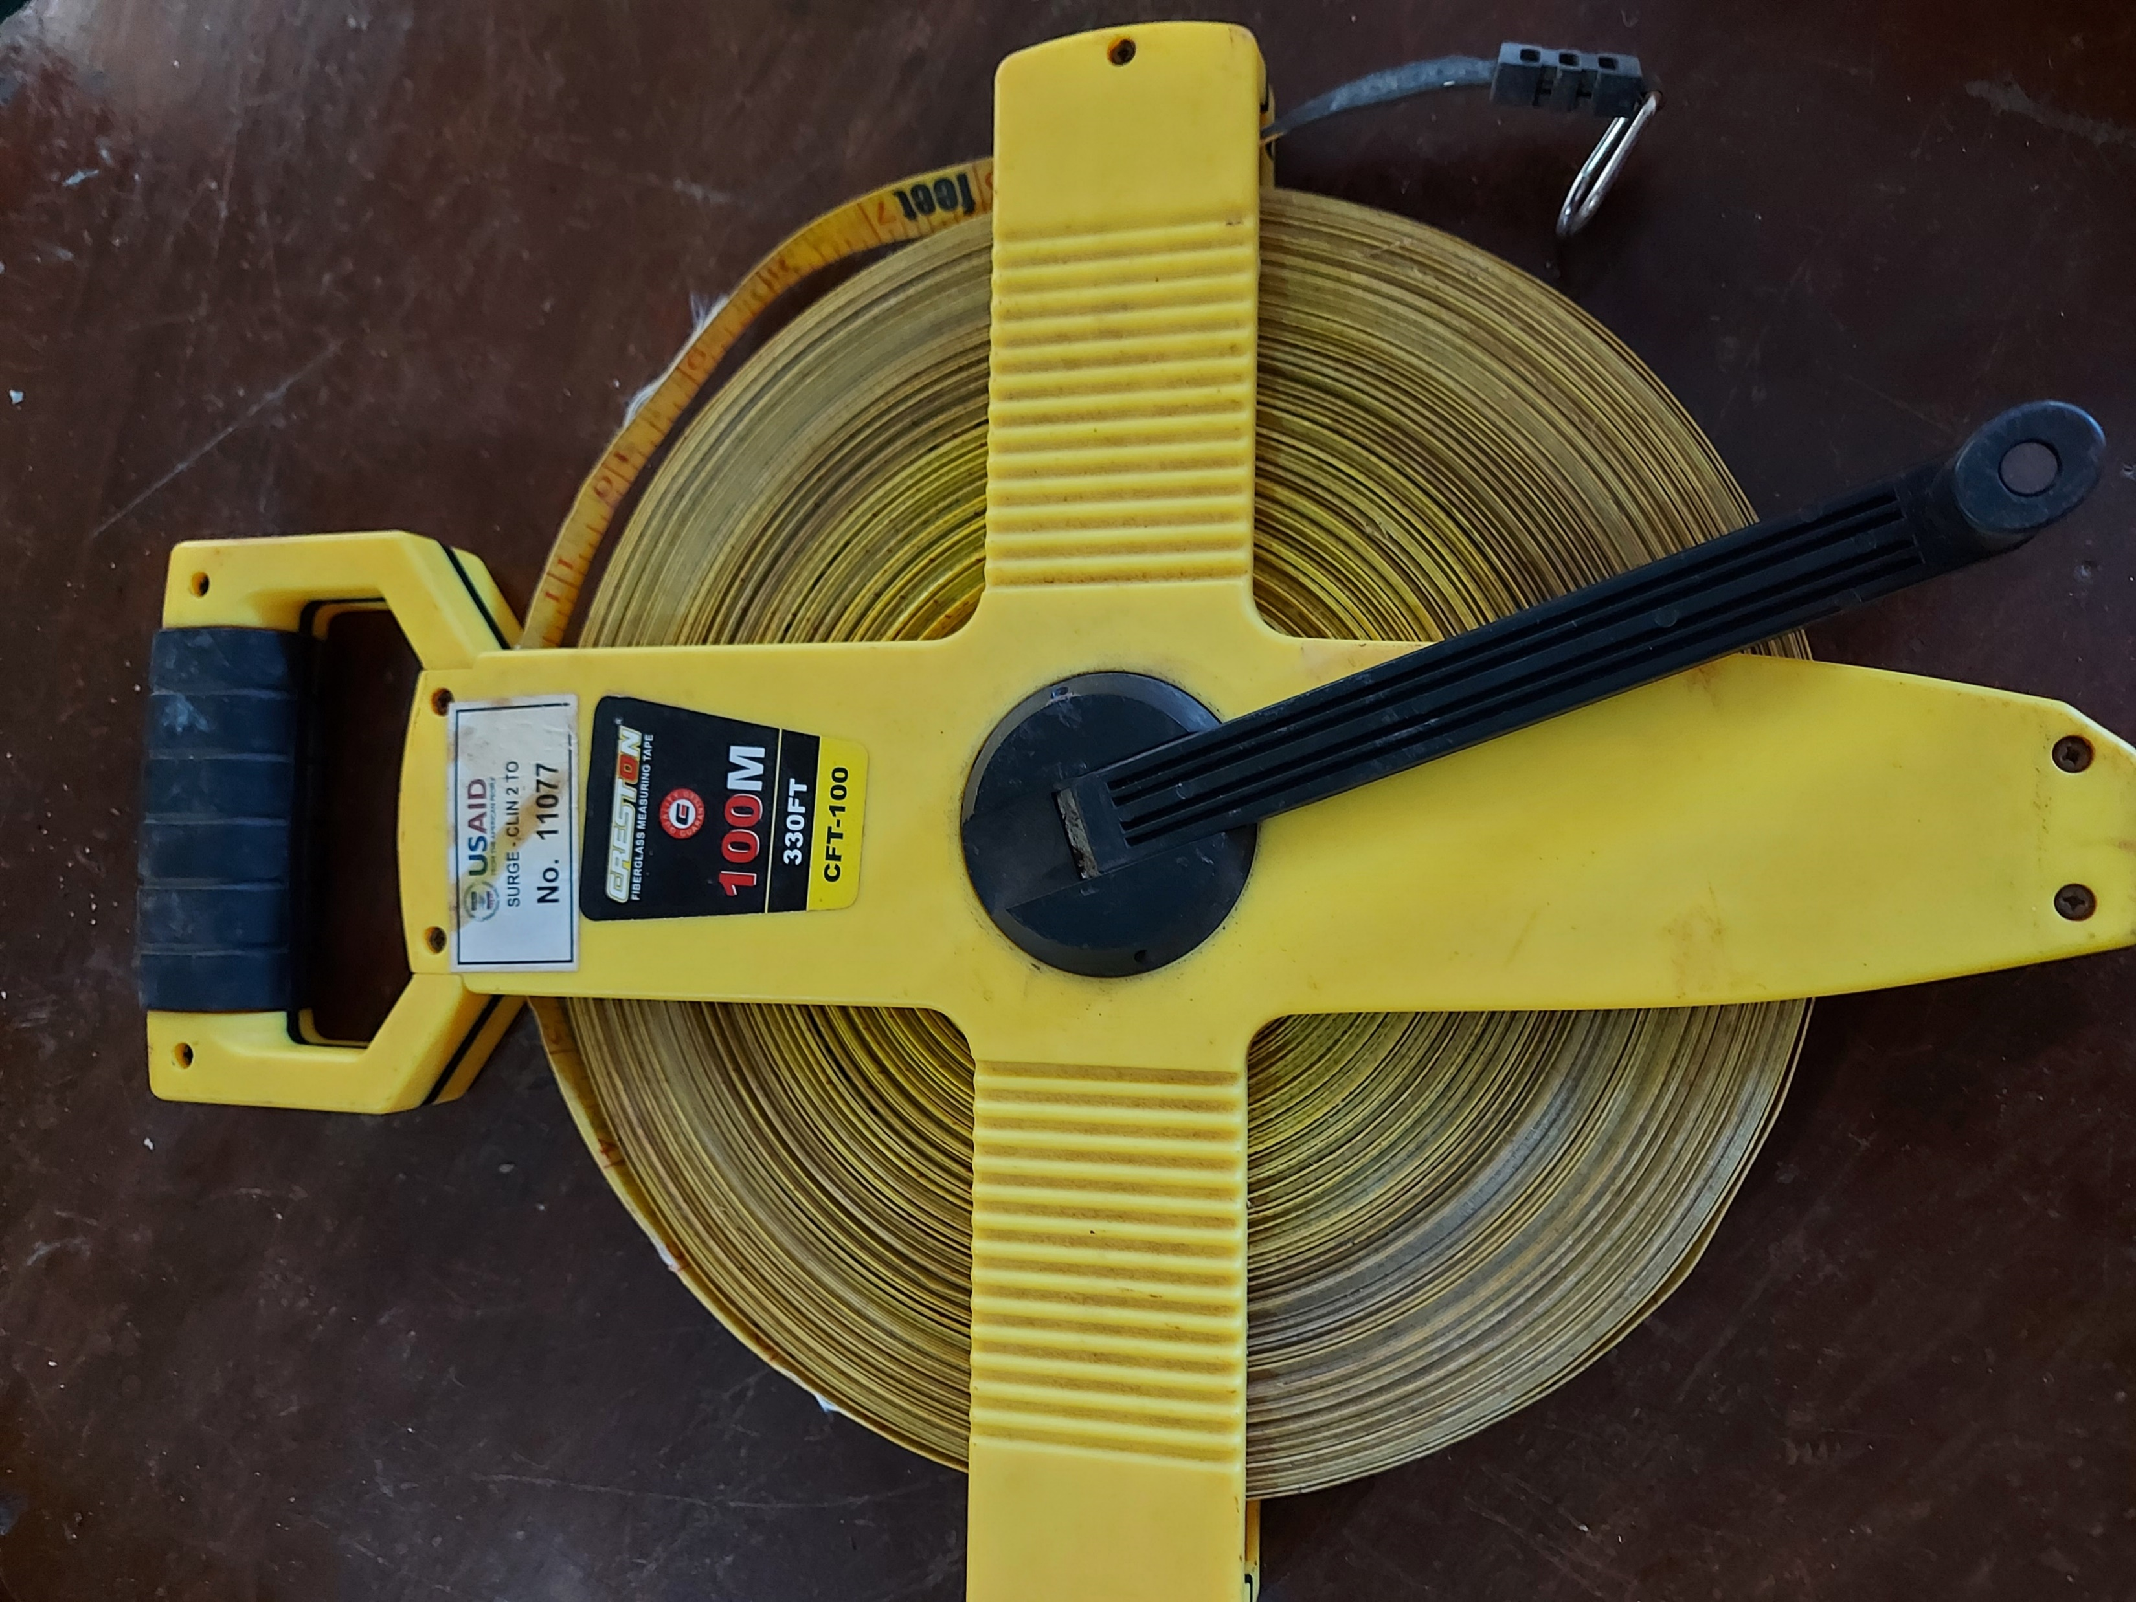
USAID SURGE Donated GIS Equipment and various tools and gadgets

Slide 6
USAID SURGE conducted Geo-Earth Resistivity Survey for the Permanent and Temporary Shelters in Barangays: Sagonsongan, Buganga, Kilala, Gadongan, Dulay, Patani and MSU seven (7) barangays
Deepwell drilling at Gadongan Permanent Shelter
Deepwell drilling at Dulay Temporary Shelter

Slide 7
EXPANSION PLAN: Technical Assistance for the Mini Master Plan of MSU 7 Barangays Water System (Biaba Damag, Cadayonan, Salam [Lomidong], Cabingan, Dimalna, Rapasun and Banga)
ZONE 1 Barangays:
Banga and Salam (Lomidong)
ZONE 4 Barangays:
Biaba Damag and Cadayonan
Barangays | Population (2020) | No of HH
Banga | 1,250 | 179
Salam Lomidong | 5,149 | 634
Biaba Damag | 2,437 | 363
Cadayonan | 3,368 | 446
Dimalna | 6,647 | 803
Cabingan | 4,390 | 630
Rapasun | 4,141 | 515
Total | 27,382 | 3,570
April 10, 2019 – Meeting with Falcon Geoenvironmental Services Co.
November 12, 2019 – 6th Marawi WASH Partners Meeting for the presentation of MSU 7 Brgys Water System.
ZONE 2 Barangays: Dimalna and Cabingan
April 24, 2019 – Meeting with Barangay Chairman of the seven (7) barangays with Falcon Geoenvironmental Services Co.
ZONE 3 Barangay Rapasun

Slide 8
EXPANSION PLAN: Technical Assistance for the Mini Master Plan of MSU 7 Barangays Water System (Biaba Damag, Cadayonan, Salam [Lomidong], Cabingan, Dimalna, Rapasun and Banga)
Marawi City Population (PSA 2020) 207,010
MSU 7 Barangays Population 27,382
13% of Marawi City’s Population will be served
70% Accomplishment as of June 2022
Target of Completion October 2022
April 11, 2018 MCWD meeting with USAID for the Marawi Intervention
March 3, 2020 USAID turn over the MSU Water Supply System Mini Master Plan
Concrete Ground Reservoir
400 cu. m. Capacity
Elevated Steel Tank
350 cu. m. Capacity
July 22, 2021 Ground Breaking Ceremony of MSU 7 Barangays Water Supply System
Pump House
Pipe Laying
July 6, 2021 BARMM turn over 400M to Provincial Government of Lanao del Sur
May 30, 2021 BARMM Allocates 400M

Slide 9
USAID SURGE incoordination of MCWD had installed 10 Hand Wash Facilities to fight against Covid-19 & Behavioral Change Communication Social Marketing Training
Behavioral Change Communication Social Marketing

Slide 10
Thank You Very Much

