Slide 1
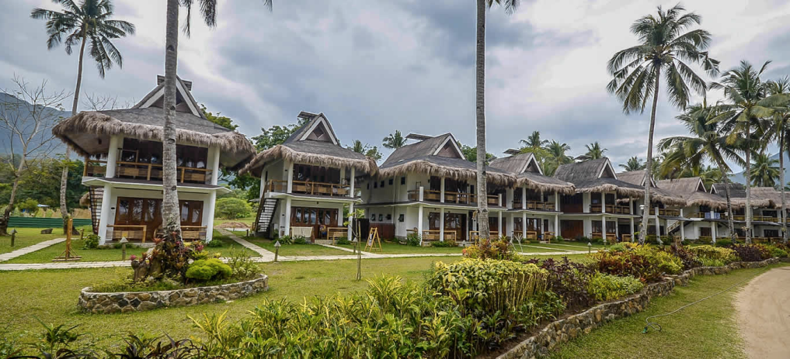
Strengthening the Enabling Environment For Local Economic Development
Boosting Private Sector Investments in Puerto Princesa City
July 14, 2022
Lorraine M. Banzuelo
LEIPO - Puerto Princesa City

Slide 2
OUTLINE OF PRESENTATION
1
Puerto Princesa City and LEIPO
2
Challenges and Opportunities in Engagement with Private Sector
3
Notable Interventions and Activities on Private Sector Investment Promotion
4
Results of Partnership with City’s Constituents and Stakeholders
5
Contributing and Hindering Factors on Activities
6
Moving towards
Sustainability of Private Sector Investment

Slide 3
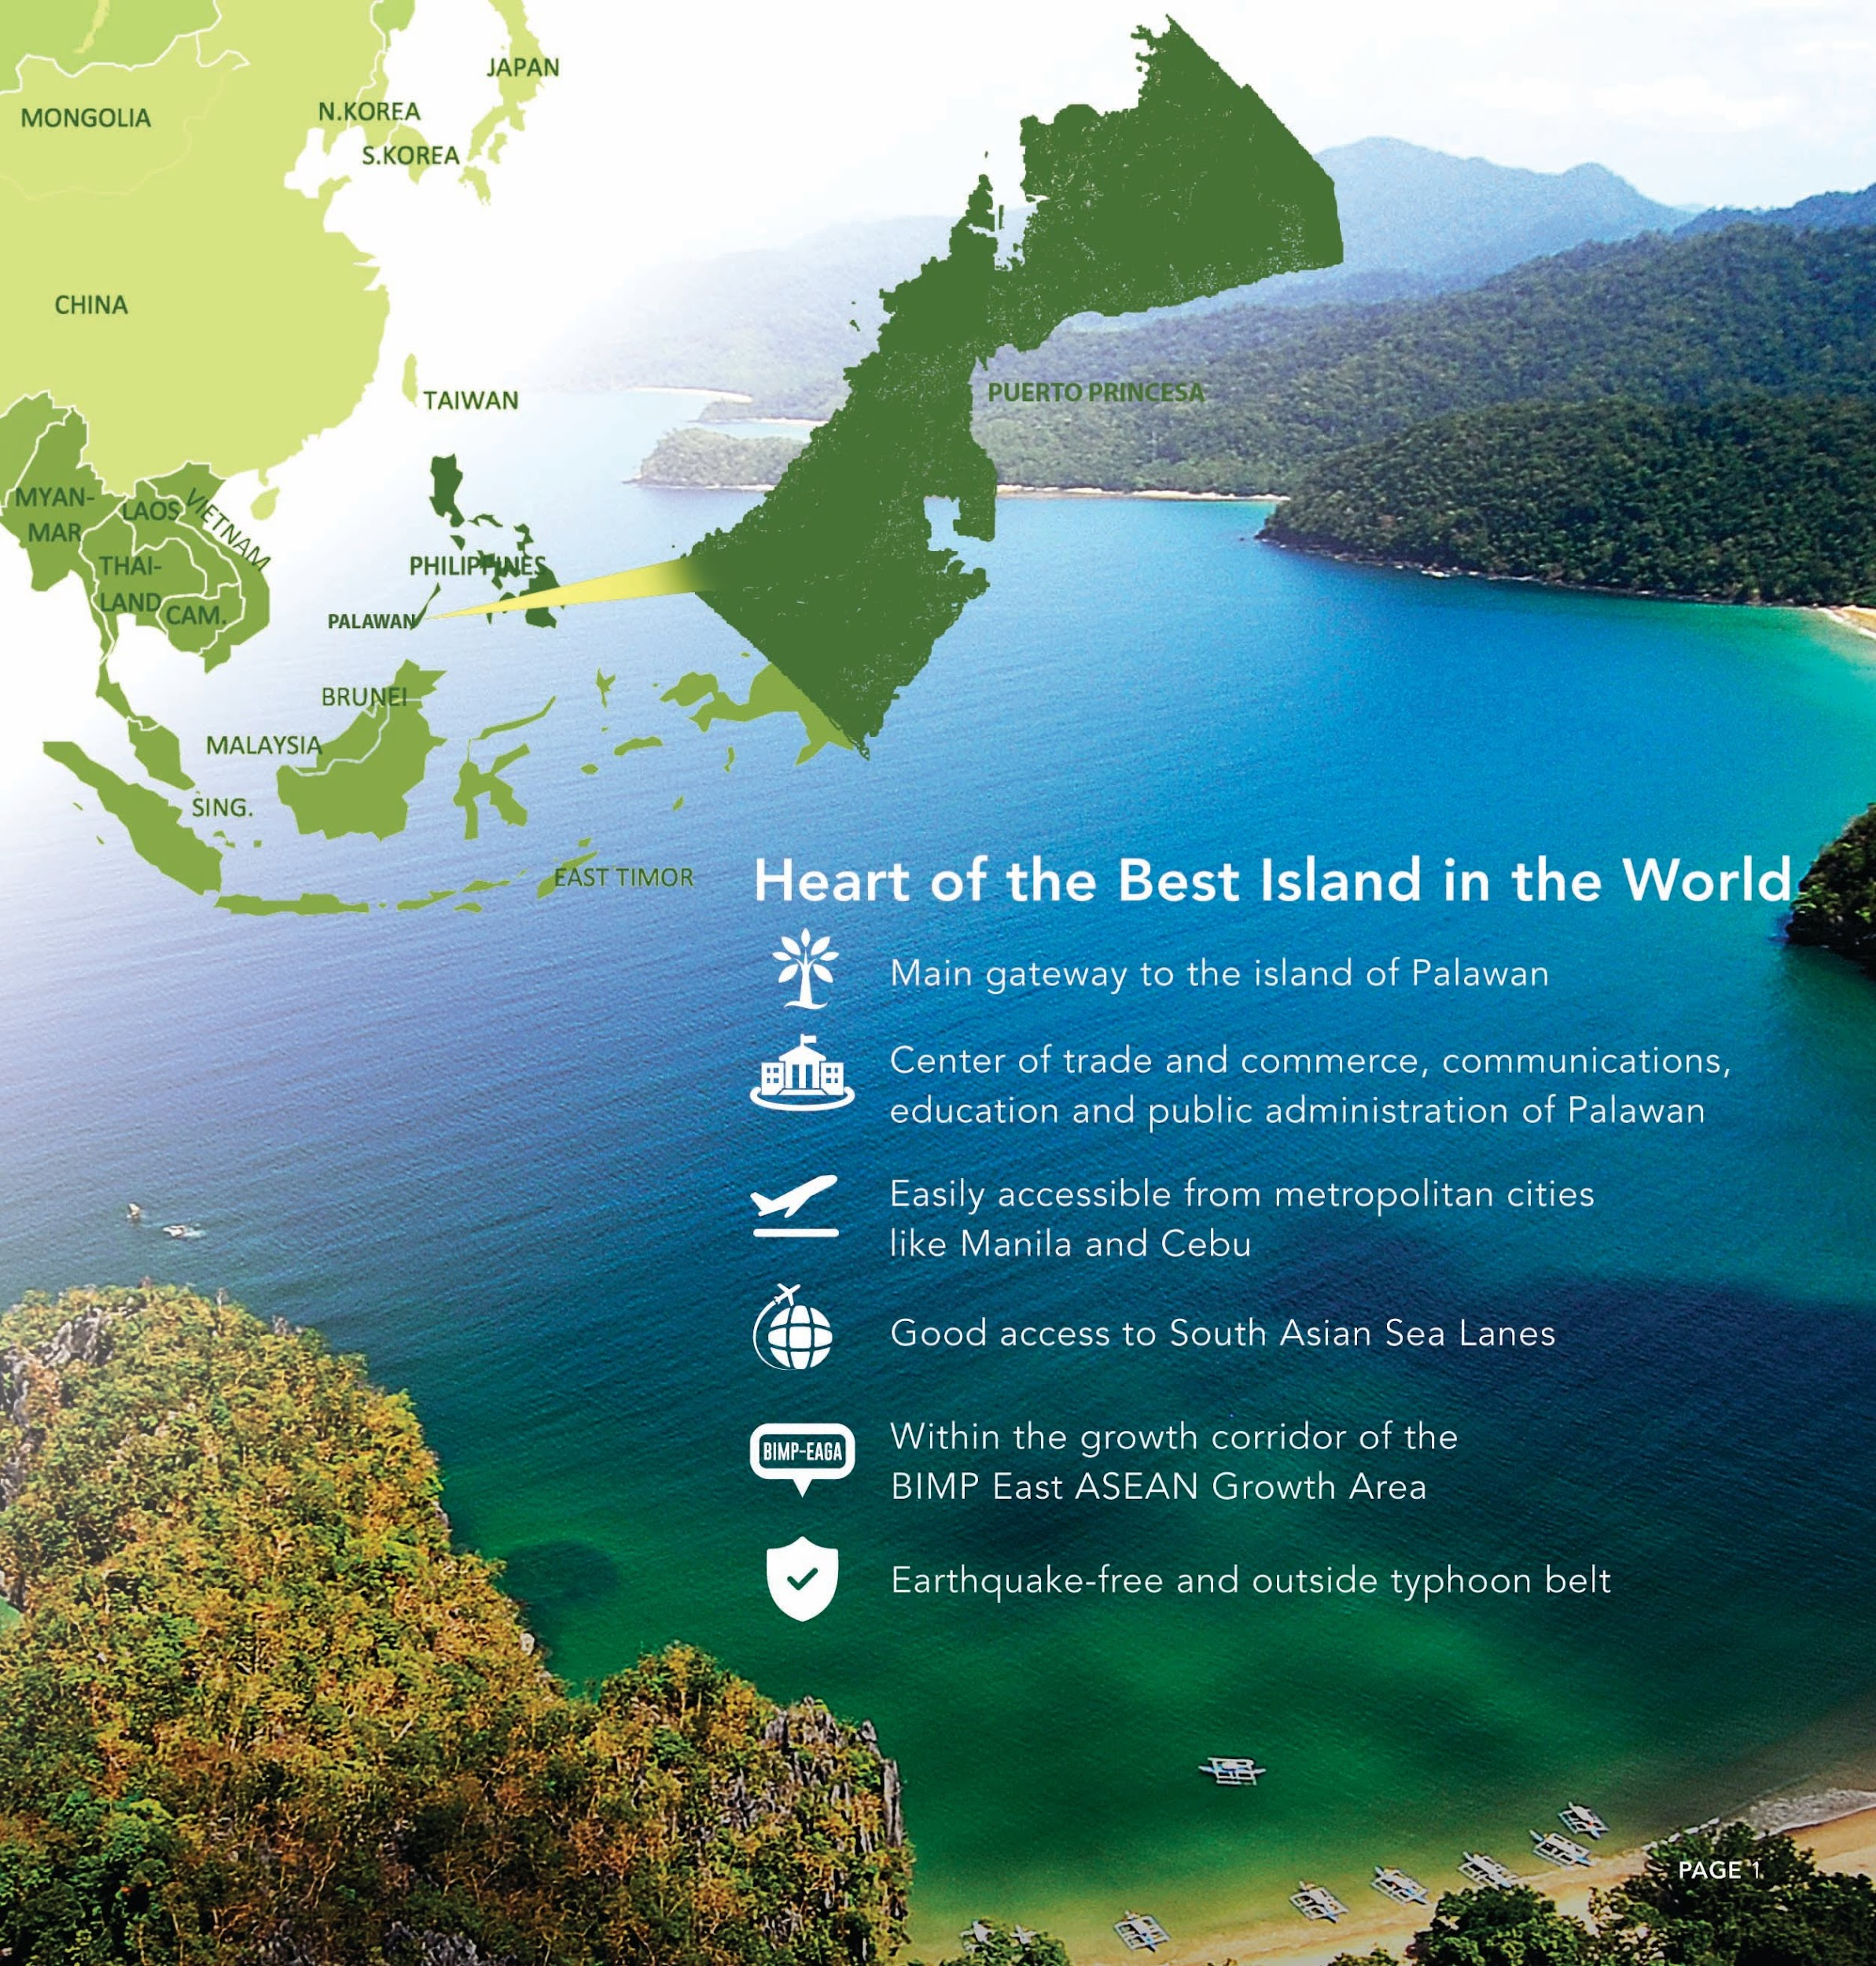
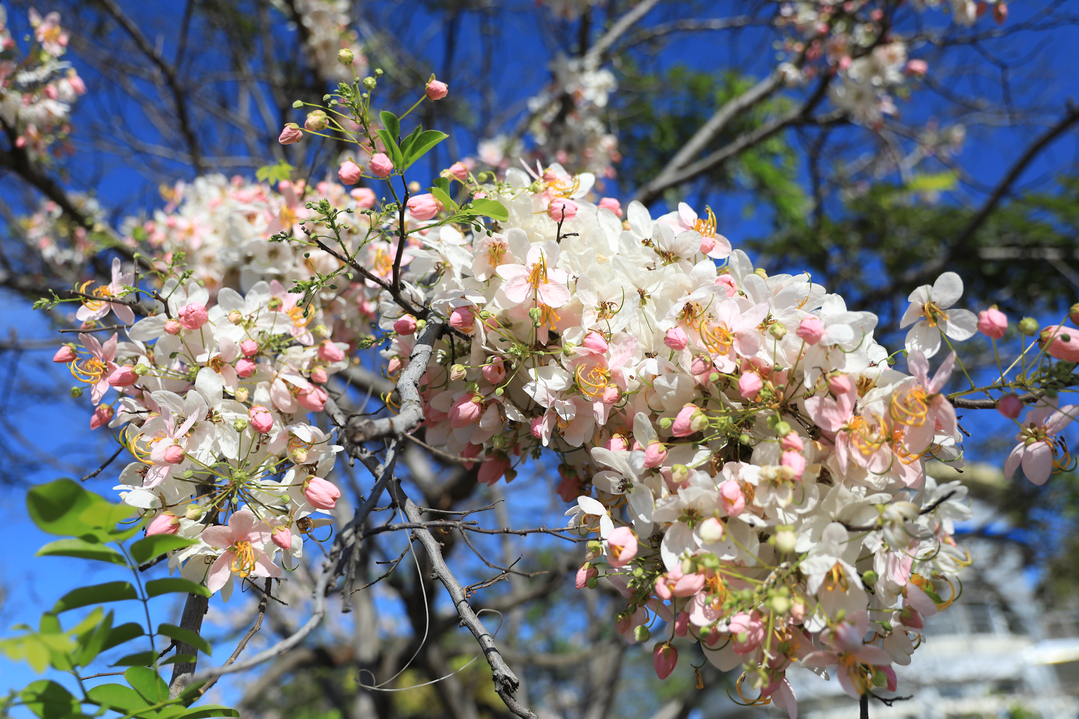
1
Puerto Princesa City and LEIPO

Slide 4
Puerto Princesa City
Total Population: 307,079 (as of May 2020)
Population Growth: 3.4%
Land area: 219,339.40 hectares
Main economies: tourism, agriculture, and trading

Slide 5
Ordinance No. 461
Puerto Princesa City Investment Code
Support investment facilitation and promotion activities
Local enterprise development
Establishment of support mechanisms for the growth of Micro, Small and Medium Enterprises (MSMEs)
Provide mechanisms for business retention and expansion
Other business and economic activities to attract investments and generate employment

Slide 6
2
Challenges and Opportunities in engagement with the Private Sector

Slide 7
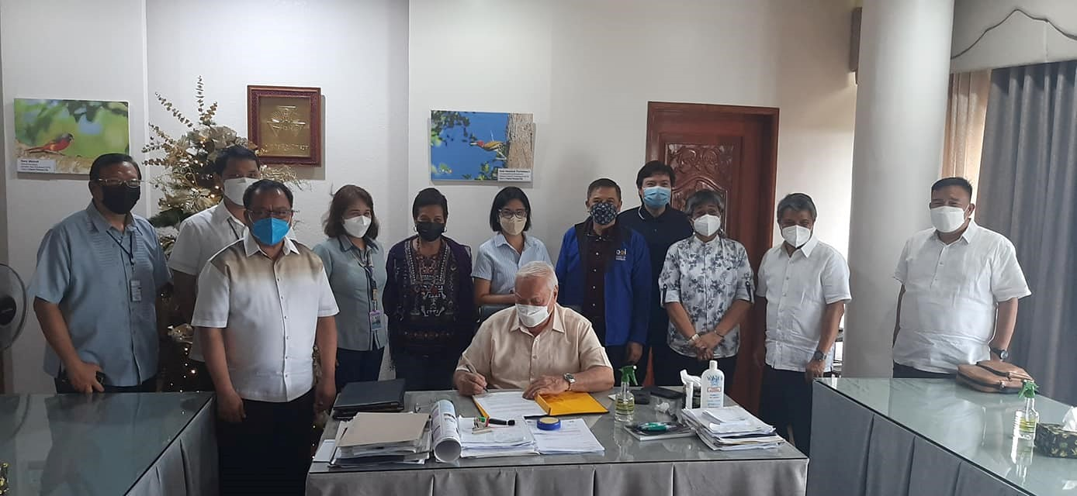
Challenges to Private Sector Engagement Prior to USAID Technical Assistance
Weak business network and coordination;
Unclear processes in engaging private sector (business and investors);
Limited foreign and national investors to complement local initiatives;
Non-functioning systems and procedures in organizing investment promotion activities;
Inadequate operating budget;
Inter-office cooperation;
No work plan defining collaboration with partners;
No proactive information, communication
education campaign;
Investment related policies not prioritized.
Notes:
Weak business network and coordination with national agencies and investors;
Unclear processes in engaging private sector (businesses and investors);
Non-functioning systems and procedures in organizing investment promotions
Inadequate operating budget, inter-office cooperation and work plan defining collaboration with partners
Limited foreign and national investors to complement local initiatives
No proactive information and communication campaign.
Investment related policies not prioritized.
1. Weak policy enforcement to support a better business environment such as the implementation of the investment and incentives code as well as sanitation policies. New ordinances to directly support and incentivize MSMEs are also needed.
2. The quality of business services and offices for investor relations and business support needs
further improvement. For one, the offices for investment promotion and LEIPO are not
institutionalized. The personnel in these offices are mostly seconded from the planning office and
skills are not adequately supported to ensure responsiveness to the needs of targeted investors
and business clients. Furthermore, the LEIPO and investment offices need to be linked with the
USAID Strengthening Urban Resilience for Growth with Equity (SURGE) Project Page 63
Assessment of the Business Enabling Environment
Negosyo Center including PESO. The linkage will enable sharing of physical, human and financial
resources to achieve greater coherence and dynamism. There has to be more training to help
the current personnel achieve competence in business planning, investor pitching, organization
of investment forums, preparation of investment briefs and primers, project feasibility, economic
profiling, investor relations, business matching and marketing. A competency- based process for
hiring manpower and staff needs to be in place to support the offices' programs for investor
assistance and relations.

Slide 8
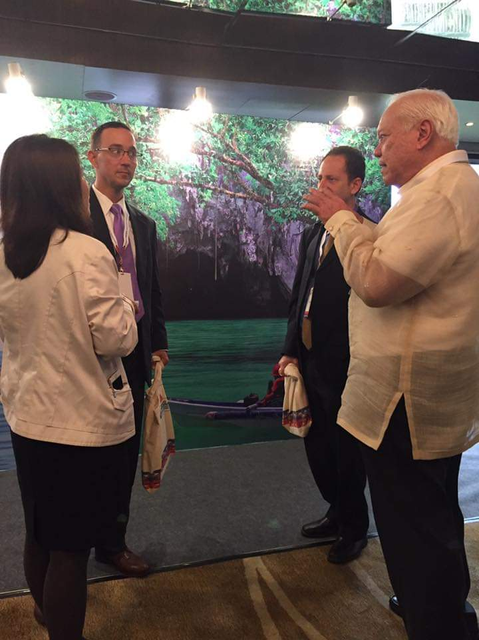
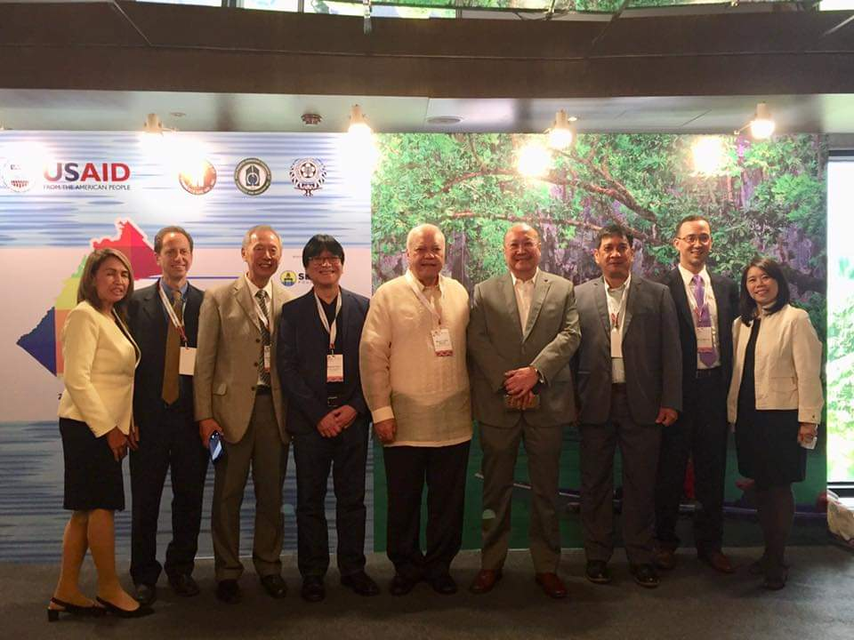
Opportunities for Engagement with Private Sector
Strong Executive and Legislative Coordination
Presence private sector groups
Expansion of the international airport as gateway for trade and investmnent
Increasing international and national events in the City.
Investment Priorities on Tourism, Agriculture, Renewable Energy, Health and Light Industries
Online business assessment and collection system.
Support of USAID and partnership with BOI
Notes:
Strong Executive-Legislative Coordination. Both the executive and legislative branches of the city
government understand the need to proactively support an enabling regulatory environment that
tries to maximize the effectiveness of regulations through efficient processes. This can be
summed up in the willingness of the city government to undertake significant reforms
The private sector is keen on supporting efforts to enable the city to attract and retain investors
but a more robust and institutional consultation process needs to organized. The private sector,
especially the Chambers of Commerce, needs to be strengthened in terms of developing their
business advocacy agenda and long term strategy to attract and retain members. This way, they
can provide the needed expertise in responding to the request of the city government for inputs
and participation in critical business and economic issues.
New international airport enables the city achieve important gateway status. The development of
an international airport in the city has signaled the city’s importance as a gateway for investment,
tourism and trade. This will play a critical role in the investment climate of the Puerto Princesa.
Local Public-Private Partnership (PPP) (Project on “waste to power”) in place. Other PPPs are
on waste management, power generation, addressing pollution and environmental pollution, and
water supply
Public-private partnership dialogue mechanism is present. The city government provides venues
for participation for the private sector through various forums and initiatives such as local
development council, bids and awards, and peace and order. Other channels for dialogue such
as regular meetings and consultations with the mayor and other officials of the city government
are available.

Slide 9
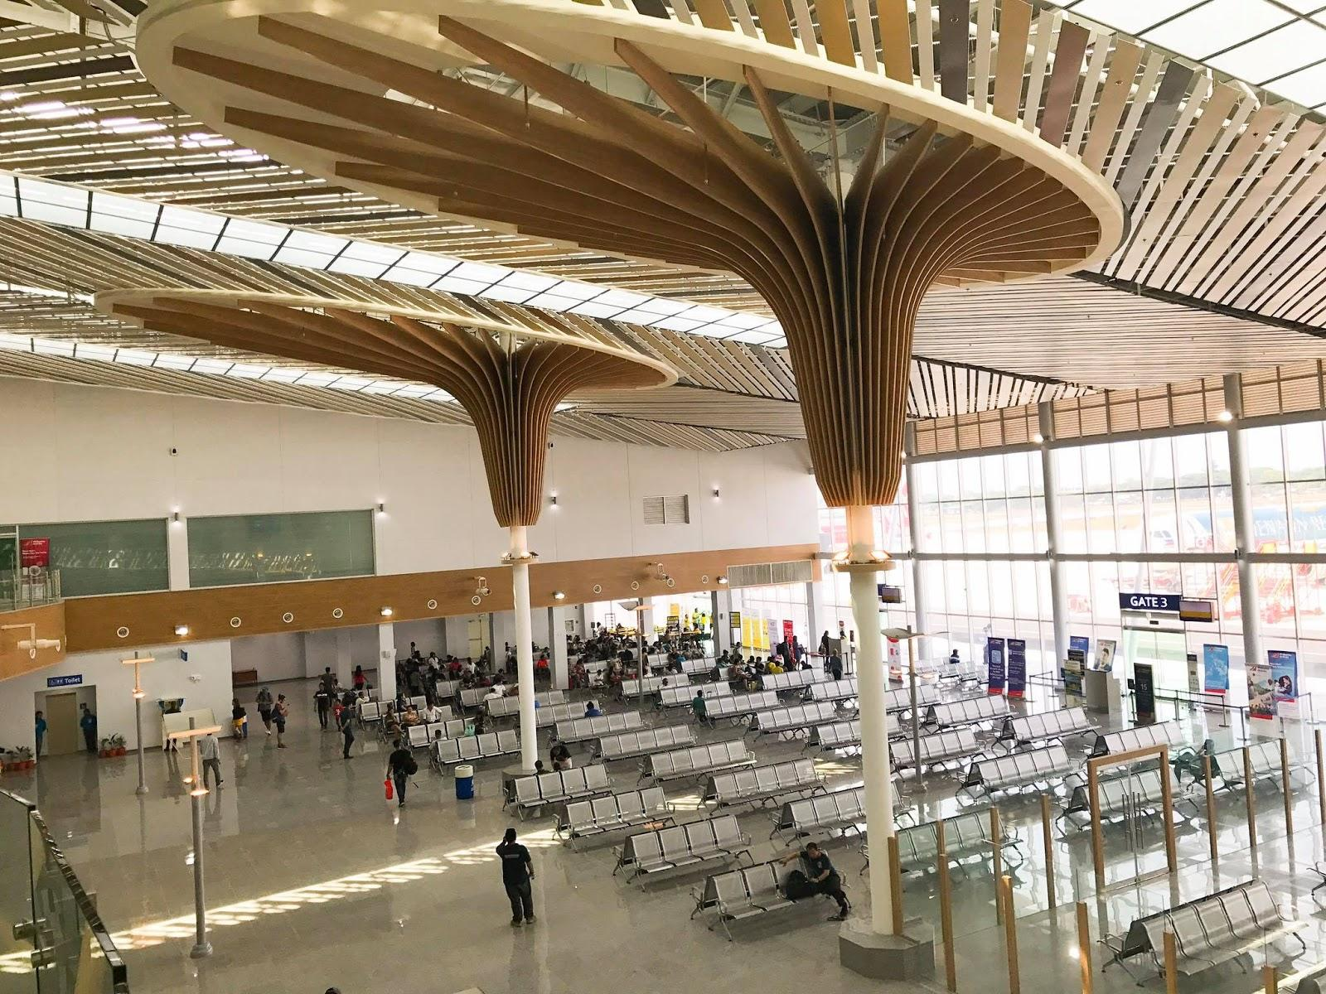
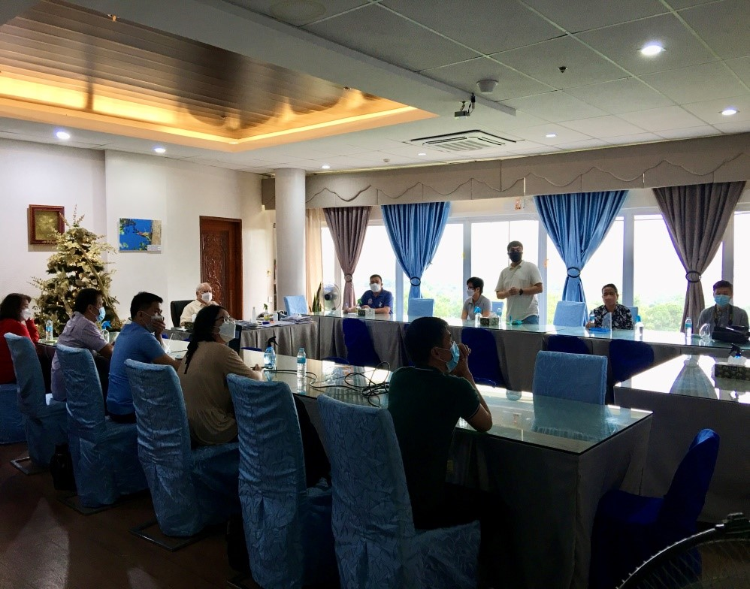
3
Notable Interventions and Activities on Investment Promotions

Slide 10
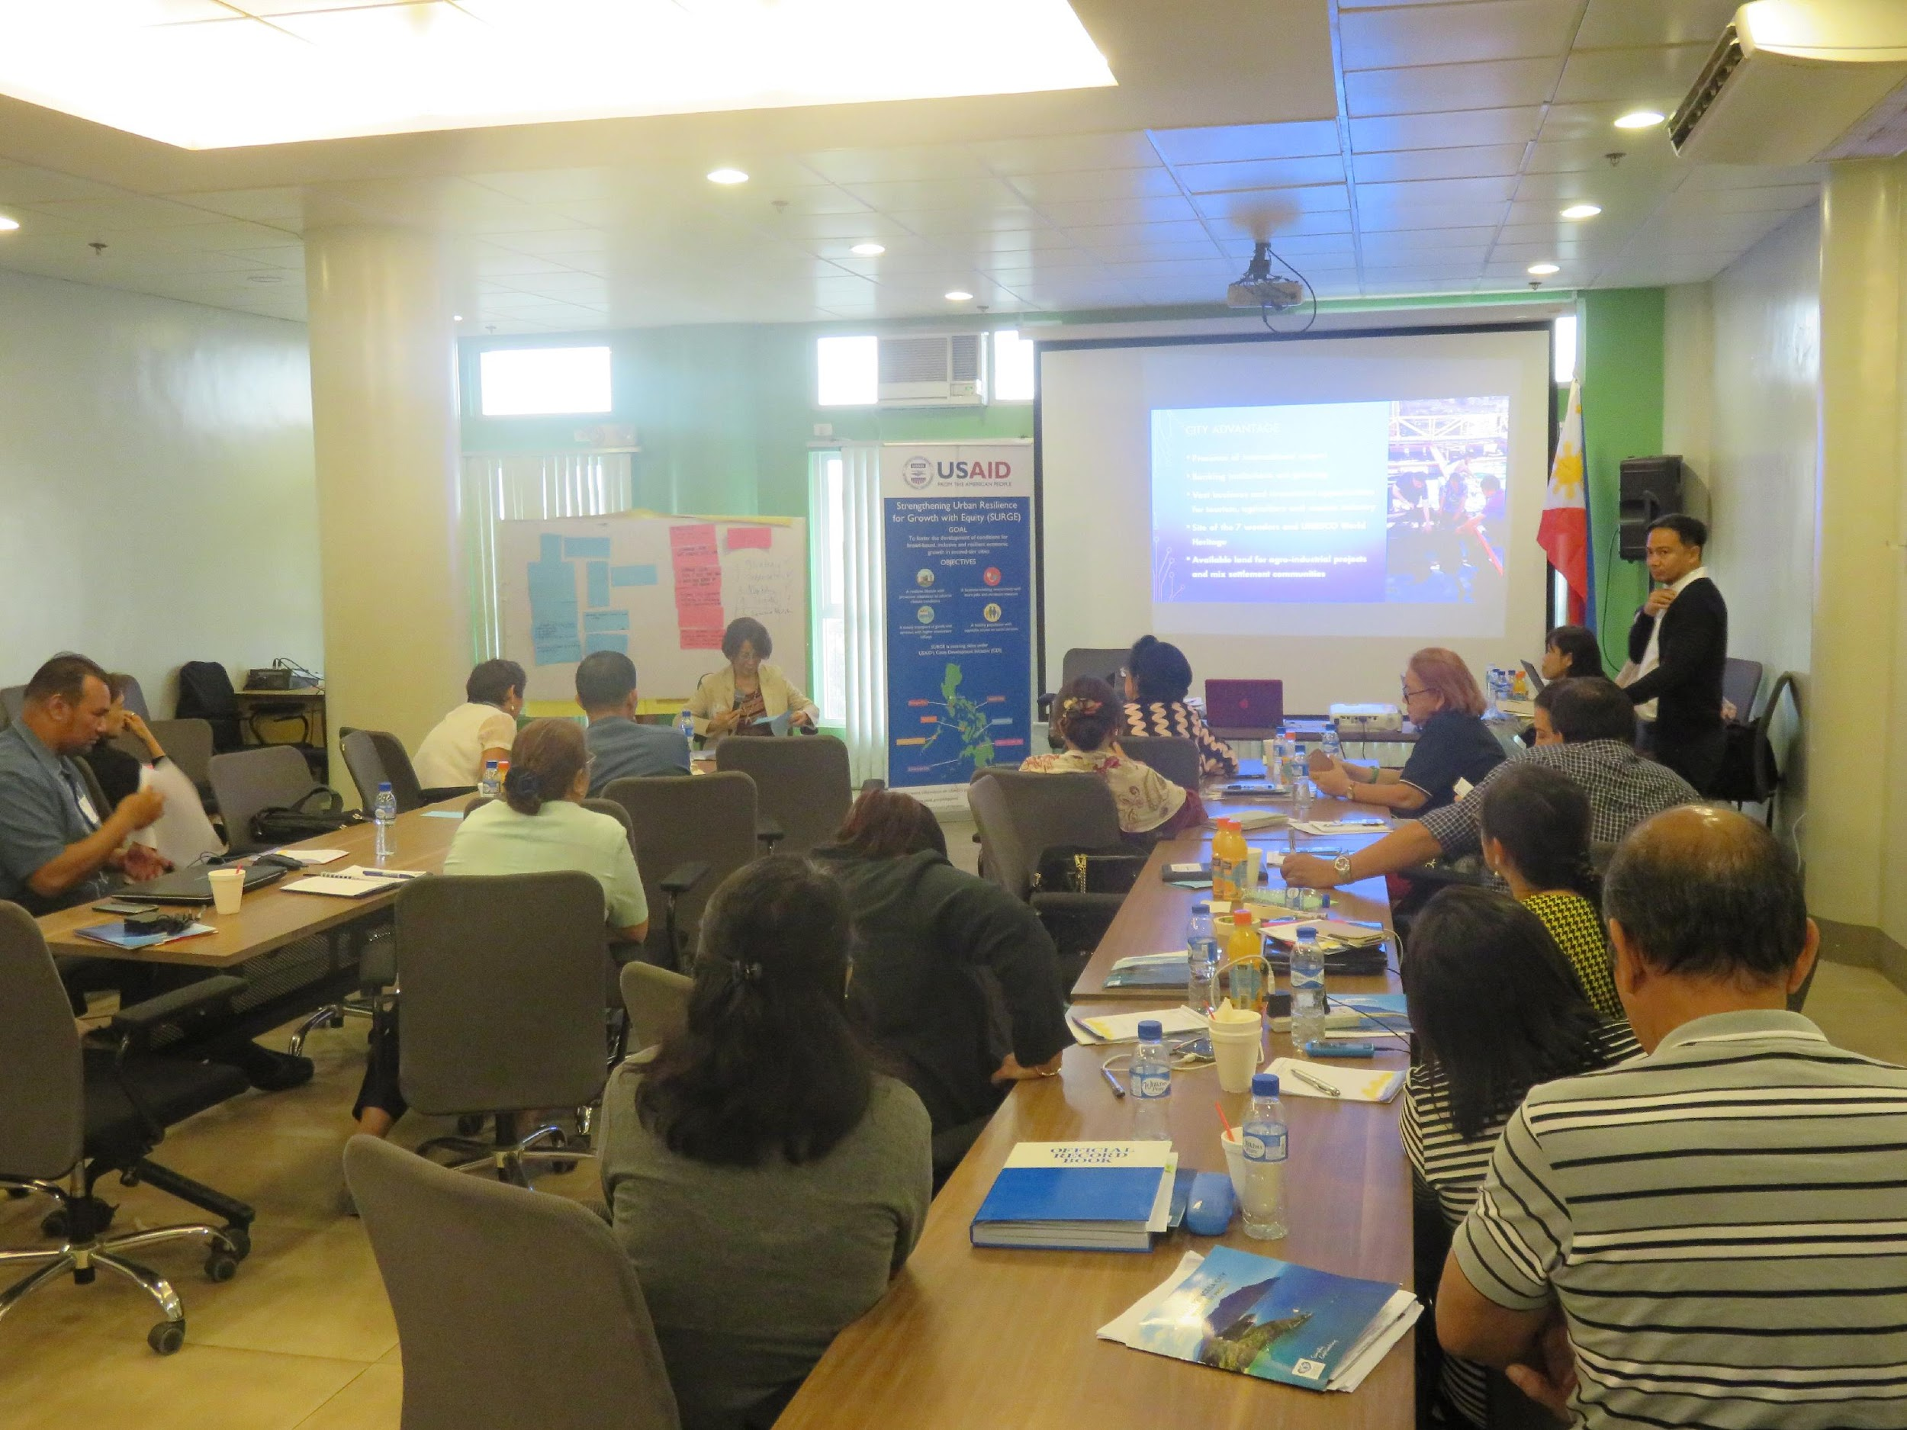
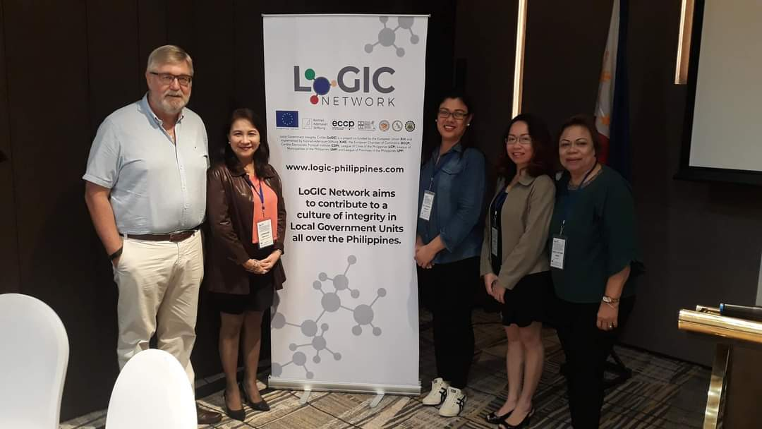
LEIPO Activities with USAID TA
Internal System Developed:
Benchmarking and TA on Investment Promotions
Developed LEIPO Charter
Online Webinar on Investment After Care Service in 2020
Institutional Arrangement Established and Formalized:
Establishment of LEIPO in 2017
Inter-office and business partners’ collaboration on Investment Priorities, Assets and Reforms on business permitting, investment and incentives
Private Sector Buy In and Commitment
Consultation and Cooperation with Business Sector in Developing Investment Collaterals (Brochure, AVP, Guide, Briefs and Profile), Investment Promotion, Targetting and Facilitation
Engaged Business Sector in organizing the City Investment Forums Formalized partnership with the Board of Investments in 2021
Notes:
Internal System Developed:
Benchmarking and TA on Investment Promotions
Developed LEIPO Charter
Online Webinar on Investment After Care Service in 2020
Institutional Arrangement Established and Formalized:
Establishment of LEIPO in 2017
Inter-office and business partners’ collaboration on Investment Priorities, Assets and Reforms on business permitting, investment and incentives in 2018
Consultation and Cooperation of Business Sector in Developing Investment Collaterals (Brochure, AVP, Guide, Briefs and Profile), Investment Promotion, Targetting and Facilitation
Engaged the Business Sector in Organizing the City Investment Forum in 2019
Formalized partnership with the Board of Investments in 2021

Slide 11
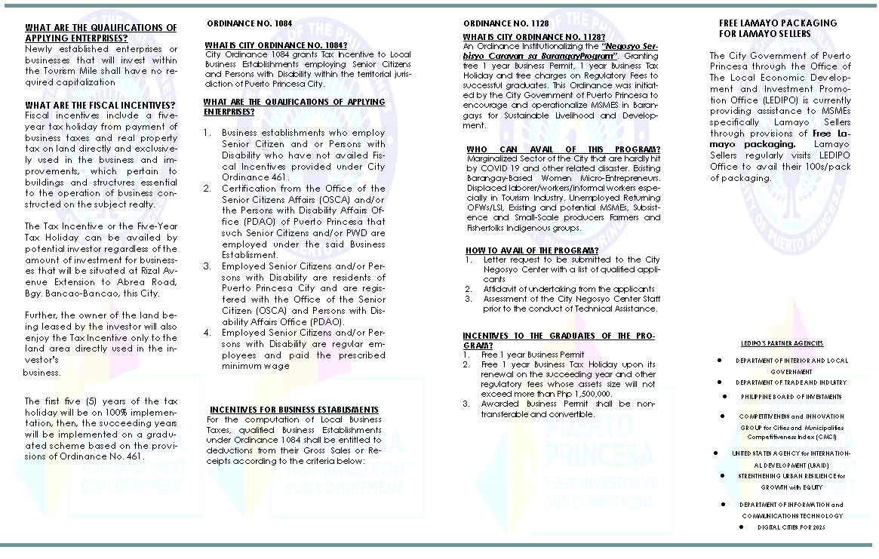
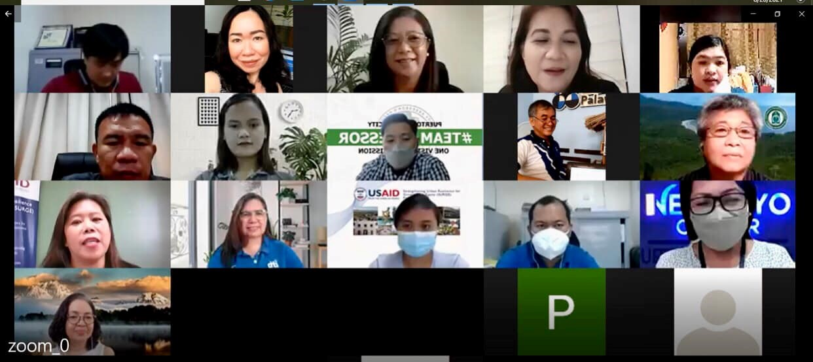
Other Activities supporting Public-Private Sector Engagement in Investment
Ease in Doing Business
Establishment of Business One Stop Shop, streamlining the Business Permitting System and Building Permits and Occupancy System
Formulation of Tourism Development Plan, Tourism Recovery Plan, Seaweed Network Plan and Business and Service Area Response and Recovery (Economic Plan)
Investment in Water, Septage and Sewerage
Strengthening the Negosyo Center and Re-organized the SMED Council
Land and Asset Management
Creation of an operational Asset Management Structure to support investment and businesses
Formulation of the Asset Management Plan
Development of the Unified Asset Registry and Land Information System
Notes:
Strong Executive-Legislative Coordination. Both the executive and legislative branches of the city
government understand the need to proactively support an enabling regulatory environment that
tries to maximize the effectiveness of regulations through efficient processes. This can be
summed up in the willingness of the city government to undertake significant reforms
The private sector is keen on supporting efforts to enable the city to attract and retain investors
but a more robust and institutional consultation process needs to organized. The private sector,
especially the Chambers of Commerce, needs to be strengthened in terms of developing their
business advocacy agenda and long term strategy to attract and retain members. This way, they
can provide the needed expertise in responding to the request of the city government for inputs
and participation in critical business and economic issues.
New international airport enables the city achieve important gateway status. The development of
an international airport in the city has signaled the city’s importance as a gateway for investment,
tourism and trade. This will play a critical role in the investment climate of the Puerto Princesa.
Local Public-Private Partnership (PPP) (Project on “waste to power”) in place. Other PPPs are
on waste management, power generation, addressing pollution and environmental pollution, and
water supply
Public-private partnership dialogue mechanism is present. The city government provides venues
for participation for the private sector through various forums and initiatives such as local
development council, bids and awards, and peace and order. Other channels for dialogue such
as regular meetings and consultations with the mayor and other officials of the city government
are available.

Slide 12
Other Activities supporting Public-Private Sector Engagement in Investment
Public Financial Management
Formulated the Strategic Public Financial Management Plan
Business Planning on Local Economic Enterprises (Domestic Resource Mobilization)
Internal Audit and Internal Control
Notes:
Strong Executive-Legislative Coordination. Both the executive and legislative branches of the city
government understand the need to proactively support an enabling regulatory environment that
tries to maximize the effectiveness of regulations through efficient processes. This can be
summed up in the willingness of the city government to undertake significant reforms
The private sector is keen on supporting efforts to enable the city to attract and retain investors
but a more robust and institutional consultation process needs to organized. The private sector,
especially the Chambers of Commerce, needs to be strengthened in terms of developing their
business advocacy agenda and long term strategy to attract and retain members. This way, they
can provide the needed expertise in responding to the request of the city government for inputs
and participation in critical business and economic issues.
New international airport enables the city achieve important gateway status. The development of
an international airport in the city has signaled the city’s importance as a gateway for investment,
tourism and trade. This will play a critical role in the investment climate of the Puerto Princesa.
Local Public-Private Partnership (PPP) (Project on “waste to power”) in place. Other PPPs are
on waste management, power generation, addressing pollution and environmental pollution, and
water supply
Public-private partnership dialogue mechanism is present. The city government provides venues
for participation for the private sector through various forums and initiatives such as local
development council, bids and awards, and peace and order. Other channels for dialogue such
as regular meetings and consultations with the mayor and other officials of the city government
are available.

Slide 13
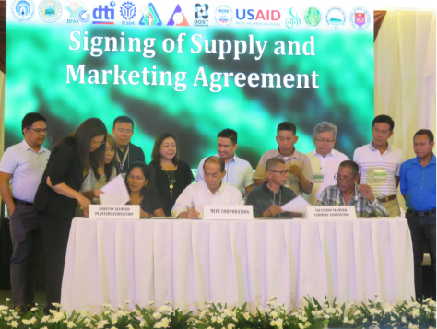
Other Activities supporting Public-Private Sector Engagement in Investment
Strengthening industry value -chain through the Puerto Princesa City and Palawan Seaweed Network
Notes:
Strong Executive-Legislative Coordination. Both the executive and legislative branches of the city
government understand the need to proactively support an enabling regulatory environment that
tries to maximize the effectiveness of regulations through efficient processes. This can be
summed up in the willingness of the city government to undertake significant reforms
The private sector is keen on supporting efforts to enable the city to attract and retain investors
but a more robust and institutional consultation process needs to organized. The private sector,
especially the Chambers of Commerce, needs to be strengthened in terms of developing their
business advocacy agenda and long term strategy to attract and retain members. This way, they
can provide the needed expertise in responding to the request of the city government for inputs
and participation in critical business and economic issues.
New international airport enables the city achieve important gateway status. The development of
an international airport in the city has signaled the city’s importance as a gateway for investment,
tourism and trade. This will play a critical role in the investment climate of the Puerto Princesa.
Local Public-Private Partnership (PPP) (Project on “waste to power”) in place. Other PPPs are
on waste management, power generation, addressing pollution and environmental pollution, and
water supply
Public-private partnership dialogue mechanism is present. The city government provides venues
for participation for the private sector through various forums and initiatives such as local
development council, bids and awards, and peace and order. Other channels for dialogue such
as regular meetings and consultations with the mayor and other officials of the city government
are available.

Slide 14
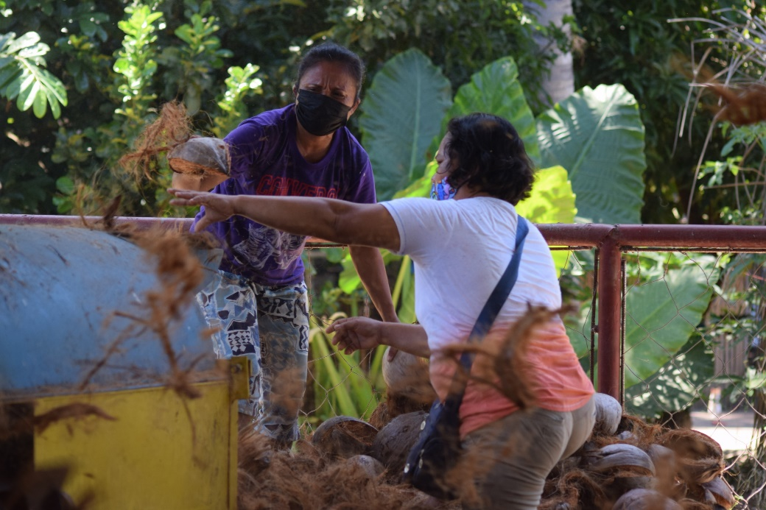
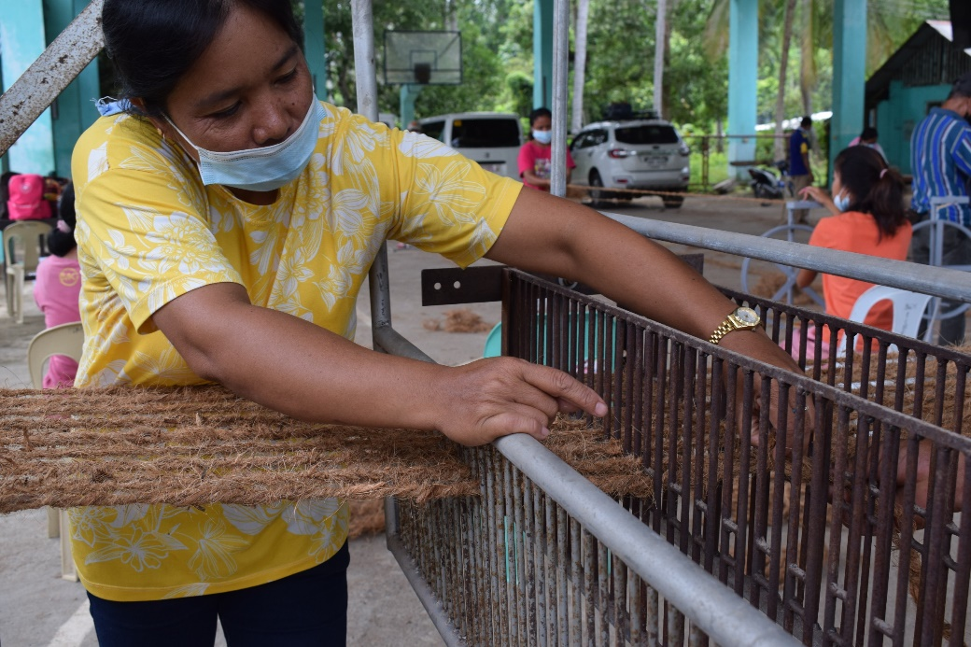
Initiatives of Puerto Princesa City to promote Women’s Participation in Economic Growth
Strengthening MSMEs through the Women Grassroots Livelihood and Entrepreneurship Program supported by the Women Global Development for Prosperity Initiatives. This in partnership with LEIPO and DTI
Started in 2019 focused package of assistance for women entrepreneurs
Continuing partnership with Puerto Princesa City and DTI to strengthen and expand the delivery of business support services for women MSMEs to recover from the impact of COVID19 pandemic
Help women access more markets, participate in viable supply chains and enhance efficiency and profitability of their existing business ventures
Notes:
Strong Executive-Legislative Coordination. Both the executive and legislative branches of the city
government understand the need to proactively support an enabling regulatory environment that
tries to maximize the effectiveness of regulations through efficient processes. This can be
summed up in the willingness of the city government to undertake significant reforms
The private sector is keen on supporting efforts to enable the city to attract and retain investors
but a more robust and institutional consultation process needs to organized. The private sector,
especially the Chambers of Commerce, needs to be strengthened in terms of developing their
business advocacy agenda and long term strategy to attract and retain members. This way, they
can provide the needed expertise in responding to the request of the city government for inputs
and participation in critical business and economic issues.
New international airport enables the city achieve important gateway status. The development of
an international airport in the city has signaled the city’s importance as a gateway for investment,
tourism and trade. This will play a critical role in the investment climate of the Puerto Princesa.
Local Public-Private Partnership (PPP) (Project on “waste to power”) in place. Other PPPs are
on waste management, power generation, addressing pollution and environmental pollution, and
water supply
Public-private partnership dialogue mechanism is present. The city government provides venues
for participation for the private sector through various forums and initiatives such as local
development council, bids and awards, and peace and order. Other channels for dialogue such
as regular meetings and consultations with the mayor and other officials of the city government
are available.

Slide 15
Results of Partnership: How did the partnership affect the City constituents and involved stakeholders?
4

Slide 16
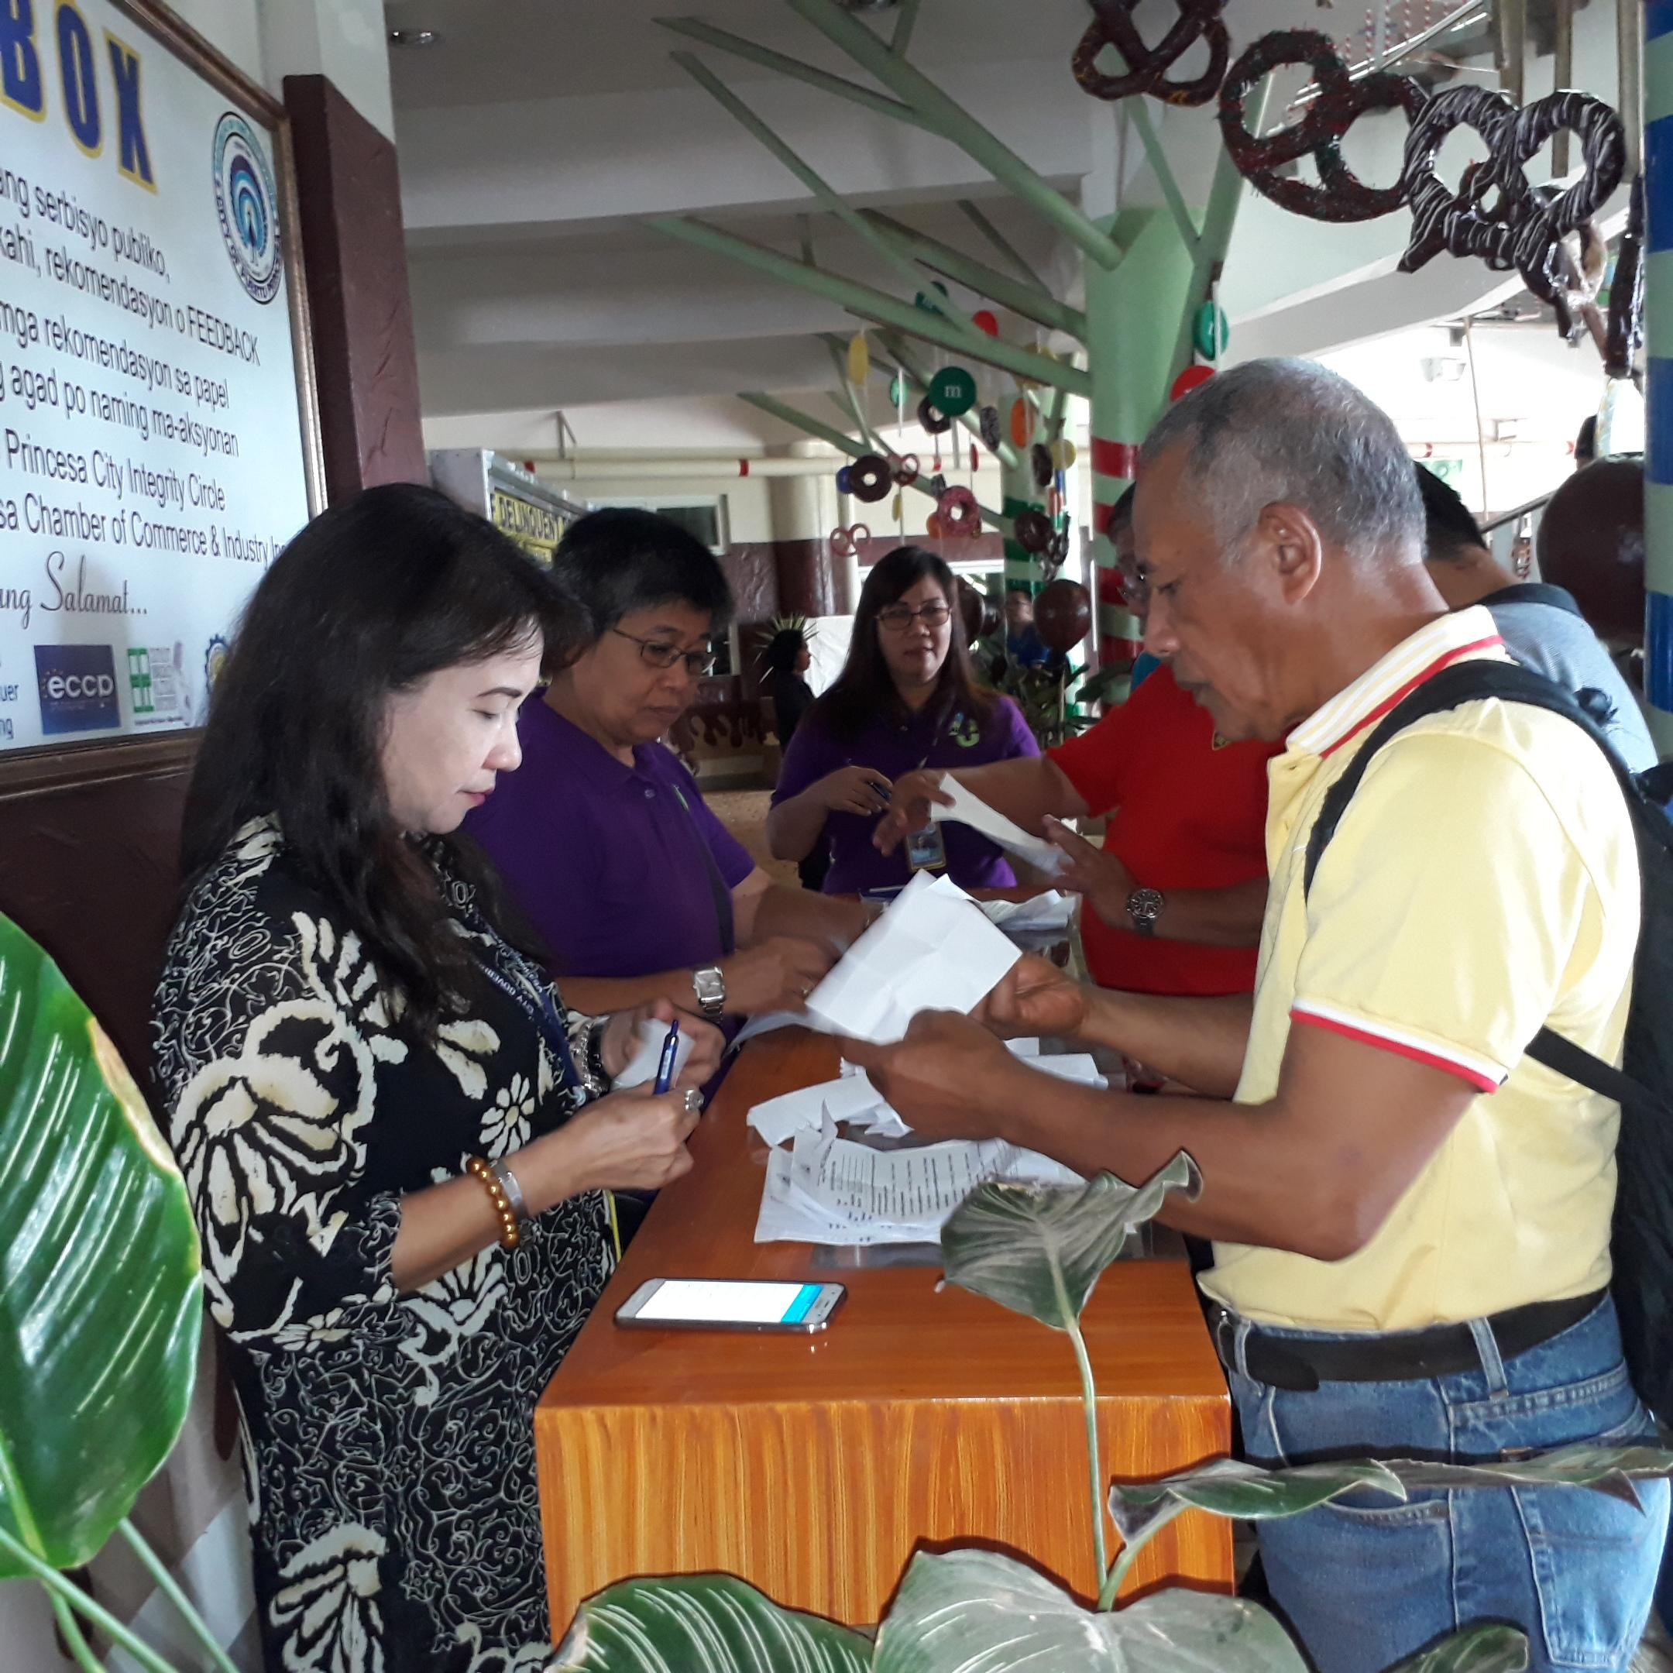
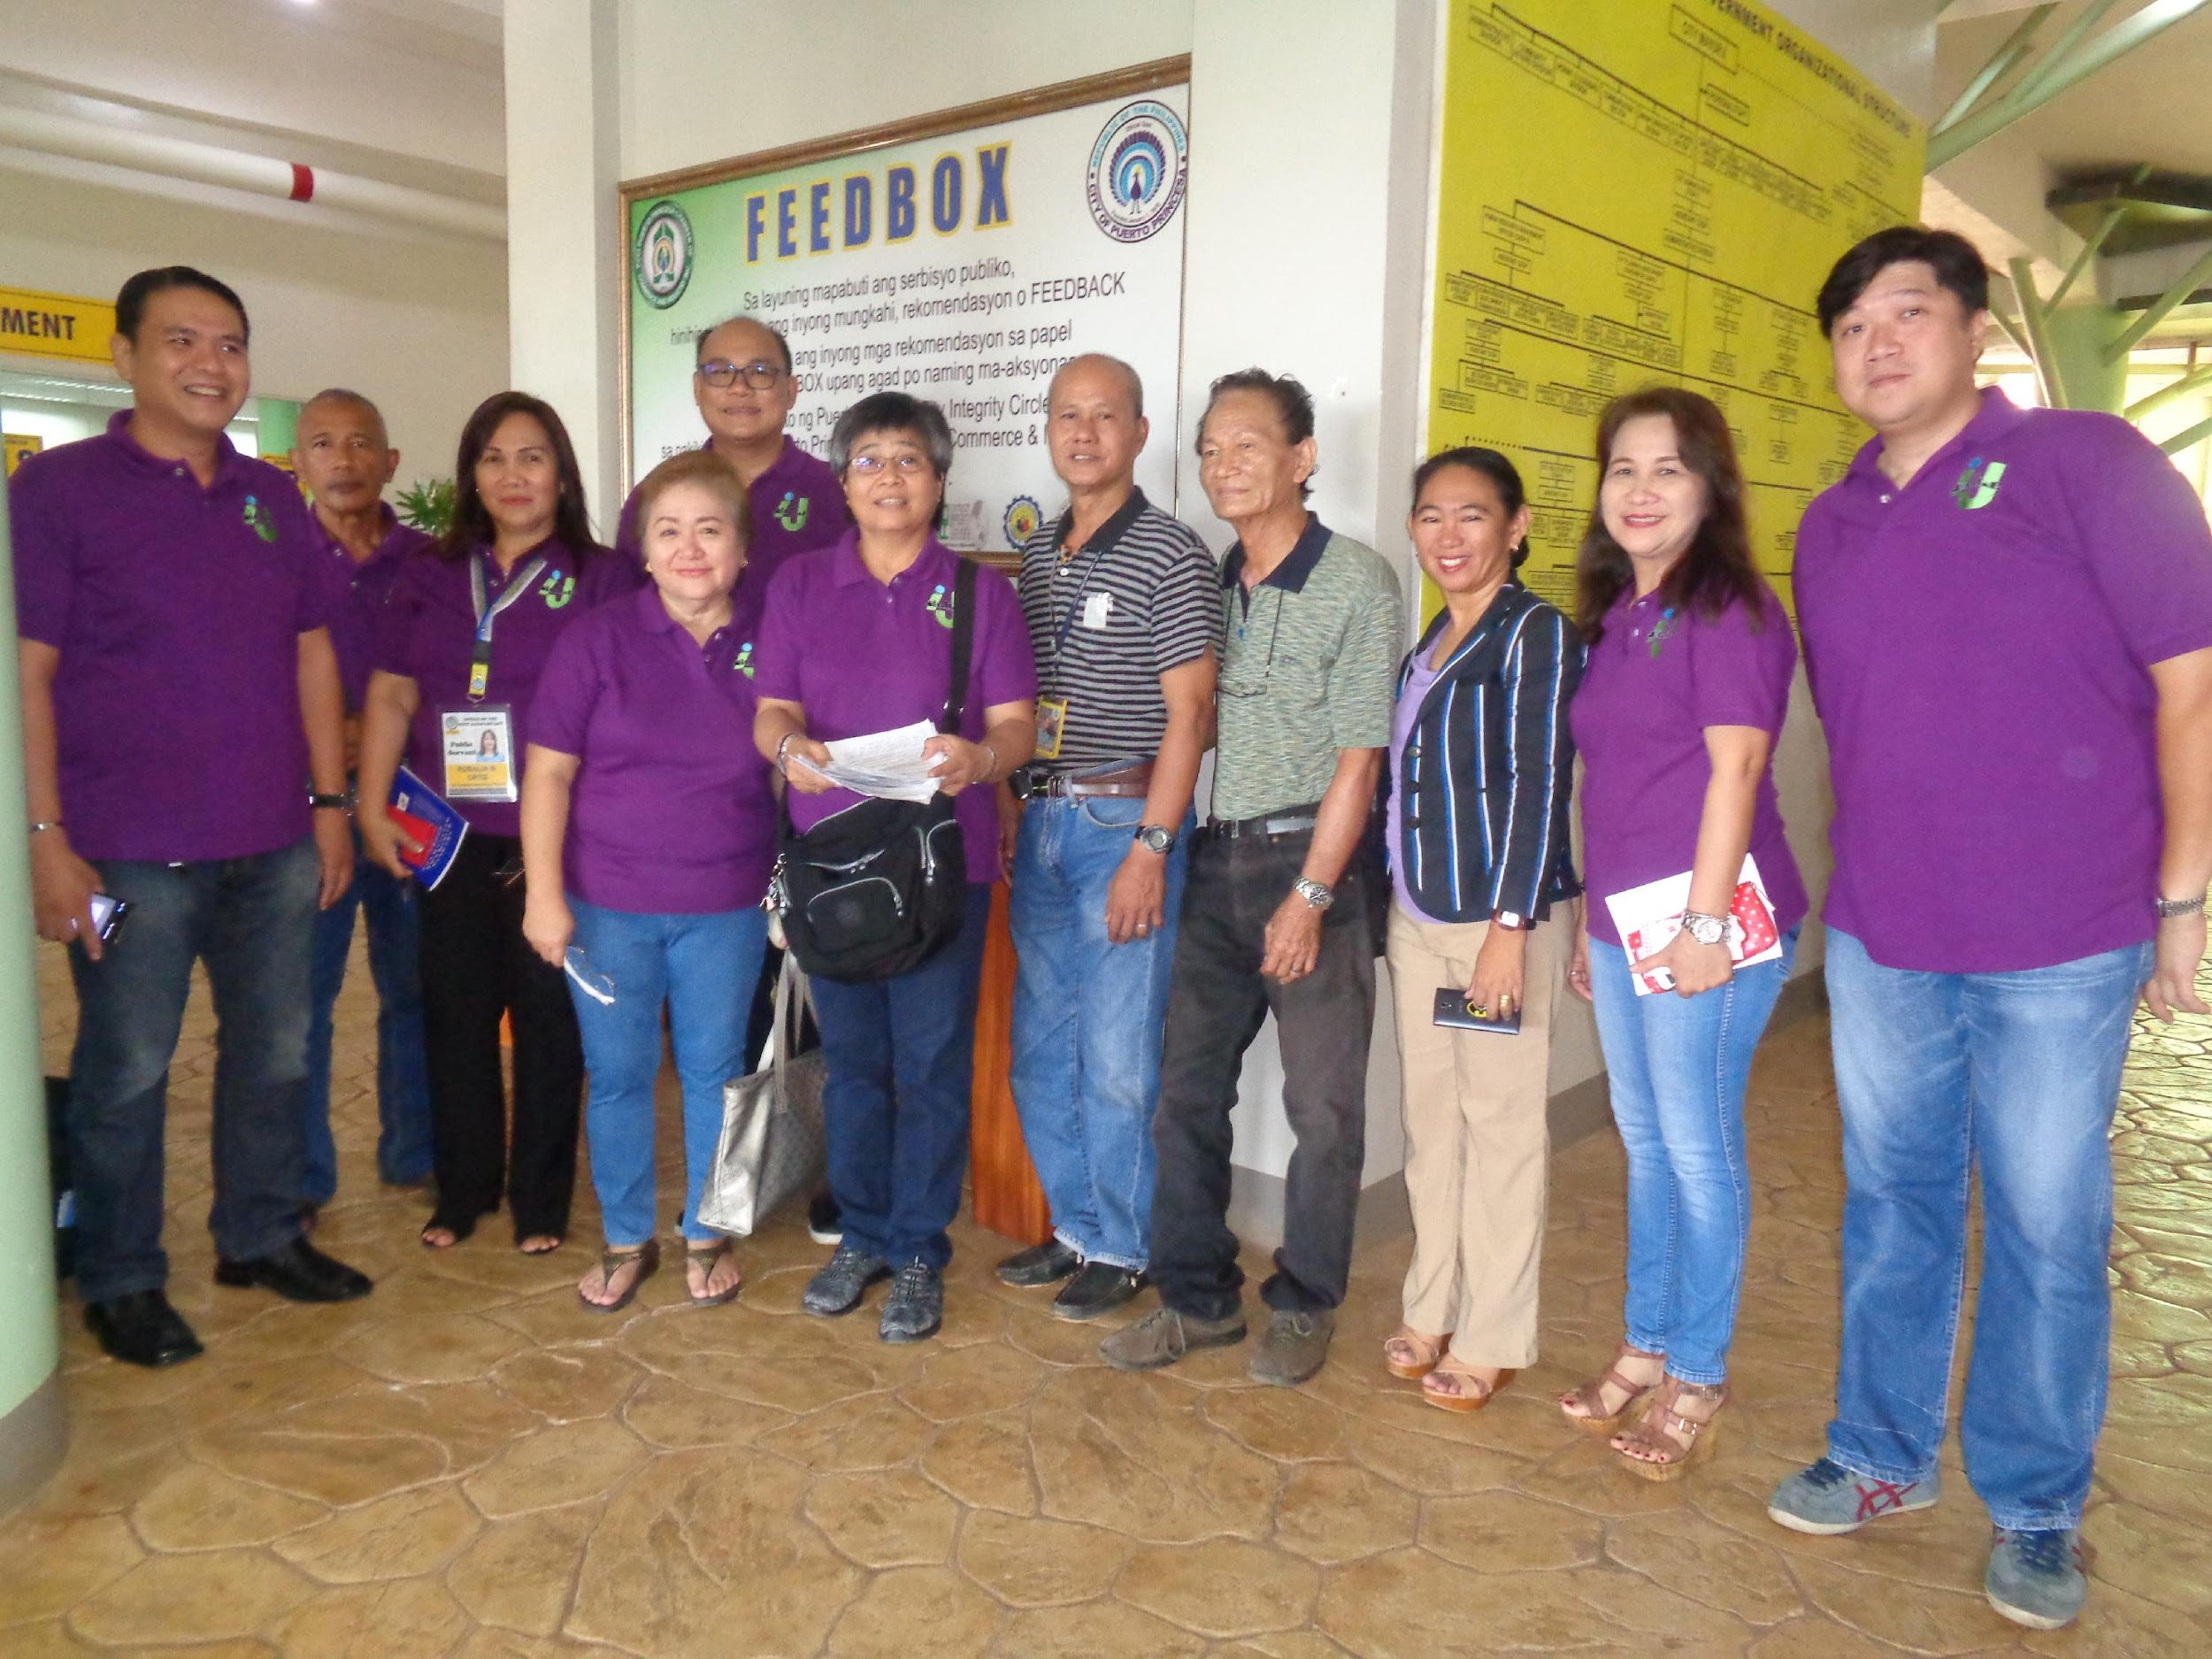
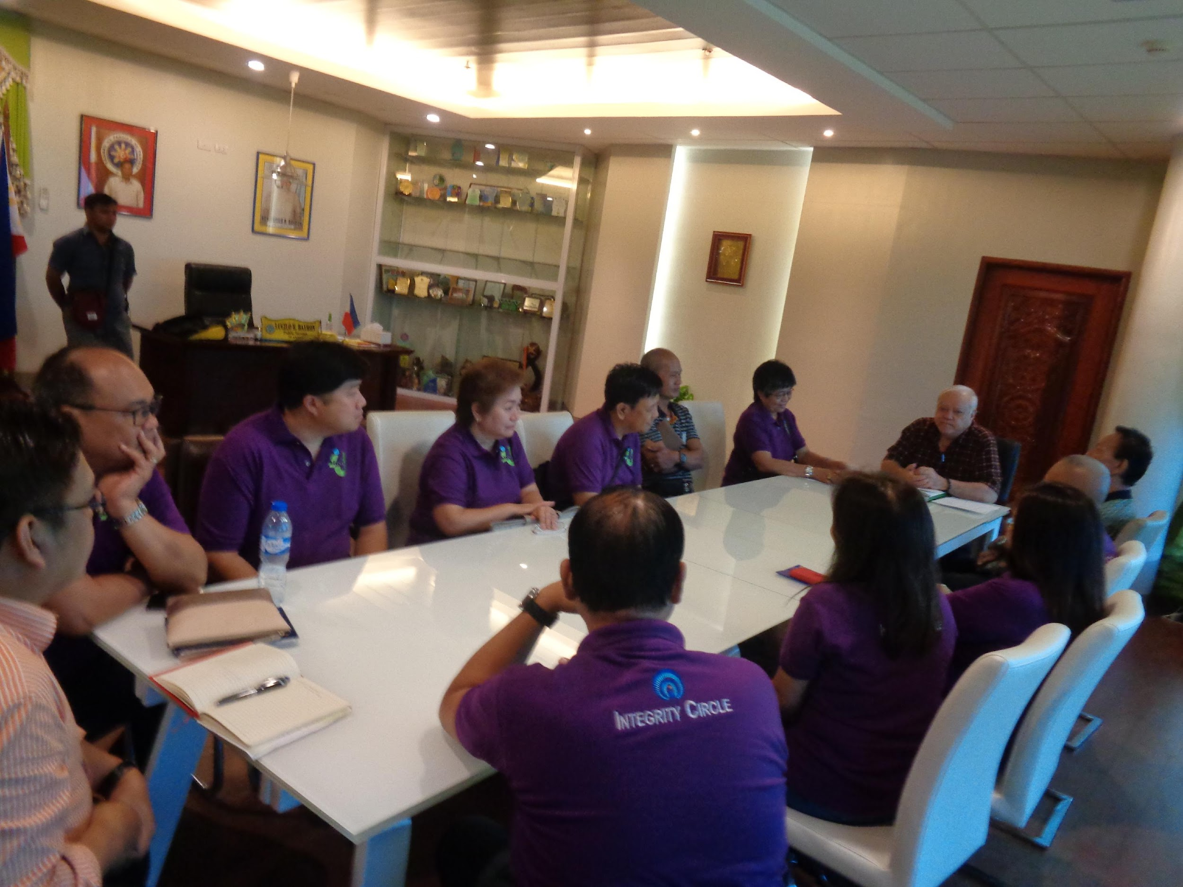
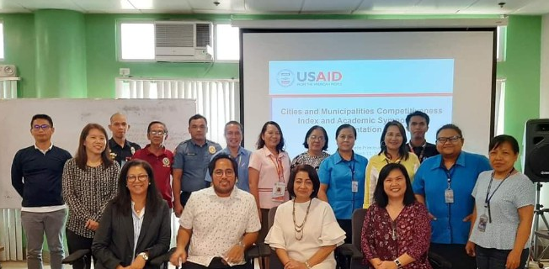
Results (Effect of Partnership)
Empowered LEIPO.
Business Processes Improved
Secured 31.5 B private sector investments
CMCI ranking improved to 17 (6 when adjusted)
Generated PhP817.6 million locally
Registered businesses increased from 9,284 in 2016 to 11,678 in 2020 generating PhP30.0 billion in gross sales.
New business registration from 2017 to 2020 was 11,790
IRA dependency dropped to 73.7% in 2020 from 80.0% in 2016
Notes:
Active participation of LEIPO in Chamber Meetings, SMEDC, Negosyo Center, Asset Council
Strengthened coordination between Business Sector and the City through the Investment Board, Investment Forum TWG and Feedback mechanism through the I4j
Secured 27.5B investments, bringing in more services in the city.
Strengthened coordination between Business Sector and the City through the Investment Board, Investment Forum TWG and Feedback mechanism through the I4j
Intensified role and conscious monitoring effort and immediate response to feedback on City reforms related to streamlining business permits, rationalizing investment priorities and incentives
1. Weak policy enforcement to support a better business environment such as the implementation of the investment and incentives code as well as sanitation policies. New ordinances to directly support and incentivize MSMEs are also needed.
2. The quality of business services and offices for investor relations and business support needs
further improvement. For one, the offices for investment promotion and LEIPO are not
institutionalized. The personnel in these offices are mostly seconded from the planning office and
skills are not adequately supported to ensure responsiveness to the needs of targeted investors
and business clients. Furthermore, the LEIPO and investment offices need to be linked with the
USAID Strengthening Urban Resilience for Growth with Equity (SURGE) Project Page 63
Assessment of the Business Enabling Environment
Negosyo Center including PESO. The linkage will enable sharing of physical, human and financial
resources to achieve greater coherence and dynamism. There has to be more training to help
the current personnel achieve competence in business planning, investor pitching, organization
of investment forums, preparation of investment briefs and primers, project feasibility, economic
profiling, investor relations, business matching and marketing. A competency- based process for
hiring manpower and staff needs to be in place to support the offices' programs for investor
assistance and relations.

Slide 17
5
Key Contributing and Hindering Factors

Slide 18
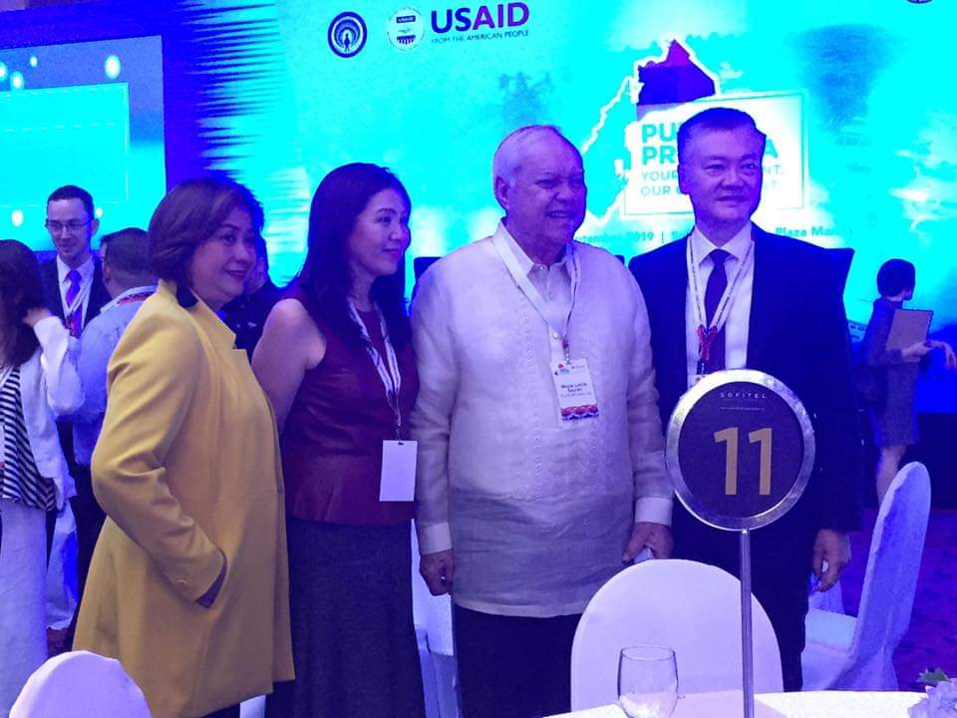
Key Contributing Factors in Private Sector Investment
Head-on and strong support of the Local Chief Executive and Sangguniang Panlungsod
Collaboration of private sector groups, academe, and national government agencies
Presence of a fully functional LEIPO
Available lands for Investments
Streamlined Business Processes.
Updated Local Investment and Incentive Code
Inroads in Data Sharing and Inter-Office Collaboration
TA of USAID-SURGE

Slide 19
Hindering Factors on Private Sector Investment Promotion
COVID19 Pandemic has slowed down investment activities for tourism towards food security, health, safety, response and recovery;
Inadequate budgets to implement immediate follow-through investment activities;
Lack of follow through capacity development plans, especially for second-line staff and city personnel.

Slide 20
6
Moving Towards Sustainability

Slide 21
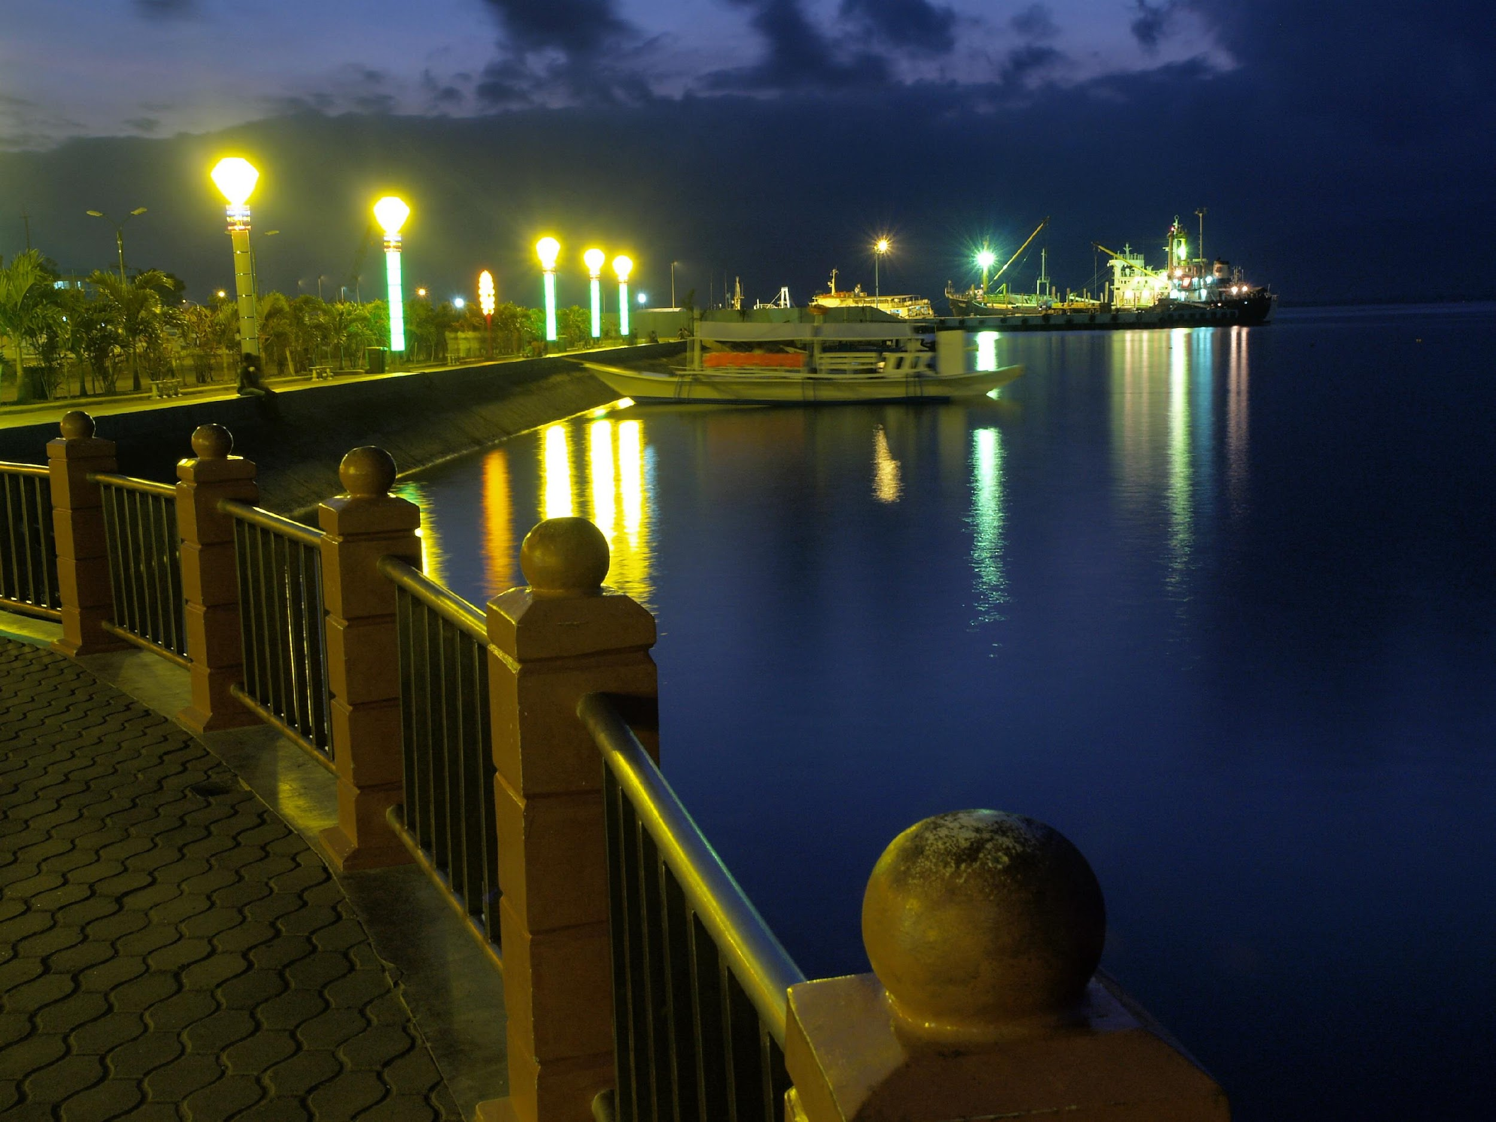
Moving Towards Sustainability
Provide continuous learning and development of LEIPO and City Partners;
Capture and retain investments in the City
Provide regular information drive on policies, programs, and incentives;
Continue to strengthen the SMED Council and the partnership with DTI for local businesses;
Improve and strategize on the City Expenditure Management program as well as identify and apply other revenue mobilization strategies;
Strengthen local policies;
Expand and provide stronger internet connectivity.

Slide 22
“We were co-existing before but it was the practices of USAID-SURGE which gave us the opportunity not only to co-exist but to work effectively in meaningful partnerships and in creating opportunities.”

