Slide 1
ENHANCING INSTITUTIONAL
CAPACITY FOR RESILIENT
AND INCLUSIVE LOCAL
URBAN DEVELOPMENT
SURGE PERFORMANCE EVALUATION:
FINDINGS, CONCLUSIONS AND RECOMMENDATIONS
Notes:
15 Minute presentation.
Working design: https://docs.google.com/document/d/1BUV9ONW8b8YhL4suNZ7vS_2gDNbtJXnk/edit?usp=sharing&ouid=100314050296542183112&rtpof=true&sd=true

Slide 2
ABOUT CLAIMDEV
CLAimDev aims to bolster the capacity of USAID/Philippines to effectively lead and practice collaborating, learning, and adapting (CLA). Improving practices in CLA has the broader goal of enhancing USAID’s development effectiveness. Susan Minushkin leads the CLAimDev as Chief of Party.
Panagora Group, the implementing partner, closely works with USAID/Philippines to integrate CLA principles into the Mission’s work. CLAimDev covers an implementation period of five years, 2020-2024.

Slide 3
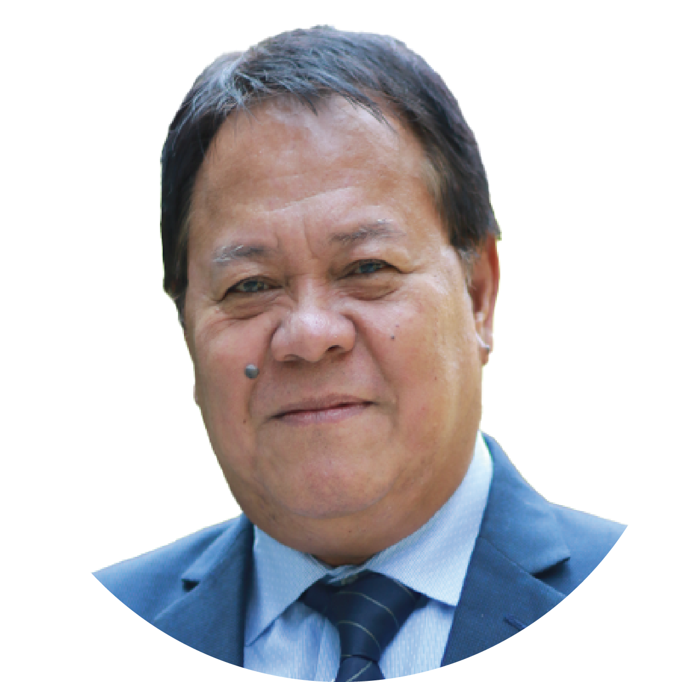
SURGE EXTERNAL AND INDEPENDENT PERFORMANCE EVALUATION TEAM
Dr. Nicasio Agustin
SURGE Performance Evaluation Team Leader
Professorial Lecturer
Engr. Rudini Nick Baoy
SURGE Performance Evaluation Team Member
M&E in Local Governance
Dr. Ginny Santiago
SURGE Performance Evaluation Team Member
Research in MSMEs
Engr. Senen Dizon
SURGE Performance Evaluation Team Member
Water Supply and Sanitation

Slide 4
EVALUATION CRITERIA
1
To what extent has SURGE contributed to addressing the development challenges that motivated the Partnership for Growth-Cities Development Initiative, the thrusts of the National Spatial Strategy (NSS)/Philippine Development Plan (PDP, 2017-2022), the USAID/Philippines Country Development Cooperation Strategy (CDCS) (previous and current), and USAID’s policies on urban resiliency and water, sanitation, and hygiene (WASH)? (Relevance)
2
To what extent did SURGE achieve its objectives on improving local urban development processes, promoting local economic development, and expanding connectivity and access between urban and rural areas? (Effectiveness)
3
What is the likelihood that initiatives and gains will continue after the completion of the project? (Sustainability)

Slide 5
METHODOLOGY MIXED METHODS
Participants
Implementing partner (ICMA)
Government agencies at the city level
National government agencies
Local chief executives
LGU department heads and personnel
Group representatives (private sector, business and farmers)
WASH service providers
Academe
Qualitative
Quantitative
Triangulation

Slide 6
FINDINGS ON RELEVANCE
Contributed to key outcomes of the Philippine Development Plan 2017-2022
Aligned with the National Spatial Strategy
Contributed to USAID’s priorities under CDI-PFG, CDCS and USAID’s policy on Sustainable Urban Services Delivery
Notes:
Enhancing urban resilience of target CDI cities contributed to the key outcomes of PDP, 2017-2022 (“individuals and communities are more resilient”), and
PDP 2017-2022 Chapter 11: Reducing vulnerability of individuals and families
PDP 2017-2022 Chapter 12: Building safe, resilient, and sustainable communities
PDP 2017-2022 Chapter 5: Ensuring People-Centered, Clean, and Efficient Governance
PDP 2017-2022 Chapter 10: Accelerating Human Capital Development (specially in the areas of urban development and management)
Improving institutional capacity of CDI cities in inclusive and resilient urban development contributed to USAID’s priorities under CDI-PFG, CDCS and USAID’s policy on Sustainable Urban Services Delivery
Improving rural-urban access and connectivity is aligned with the National Spatial Strategy particularly the strengthening of urban-rural linkages and promotion of regional agglomeration.

Slide 7
SURGE’s DEMAND-DRIVEN APPROACH
SURGE conducted baseline studies to inform its intervention plan for each CDI City
SURGE adopted participatory and consultative processes
SURGE created synergies with other USAID projects and other development partners
Notes:
What were SURGE’s (notable) interventions that empowered the CDI Cities to be more resilient and inclusive?
Strengthening Local Capacity in Urban Development
Context
National policies mandate LGUs to prepare various plans (CLUP, CDP, LCCAP and LDRRMP) and mainstream CCA and DRR into these plans
Weak technical and institutional capacities in climate-resilient and risk-sensitive urban planning and infrastructure development at the local level
Inadequate stakeholder engagement in local development planning

Slide 8
FINDINGS ON EFFECTIVENESS
Strengthening Local Capacity in Urban Development
Context
National policies mandate LGUs to prepare various plans and mainstream CCA and DRR
Weak technical and institutional capacities in climate-resilient and risk-sensitive urban planning and infrastructure development
Inadequate stakeholder engagement in local development planning
Notes:
What were SURGE’s (notable) interventions that empowered the CDI Cities to be more resilient and inclusive?
Strengthening Local Capacity in Urban Development
Context
National policies mandate LGUs to prepare various plans (CLUP, CDP, LCCAP and LDRRMP) and mainstream CCA and DRR into these plans
Weak technical and institutional capacities in climate-resilient and risk-sensitive urban planning and infrastructure development at the local level
Inadequate stakeholder engagement in local development planning

Slide 9
FINDINGS ON EFFECTIVENESS
Strengthening Local Capacity in Urban Development
Enhanced technical capacity of local planners
in mainstreaming CCA and DRR in local plans
Prepared climate-resilient and risk-sensitive local plans
Enhanced CDRA training modules of DHSUD
Strengthened linkage between LGUs and NGAs (CCC, DOST)
Established local knowledge sources through the Urban Development Learning Programs (UDLPs)
Notes:
What were SURGE’s (notable) interventions that empowered the CDI Cities to be more resilient and inclusive?
Strengthening Local Capacity in Urban Development
Enhancing technical capacity of local planners in mainstreaming CCA and DRR in local plans
Preparing climate-resilient and risk-sensitive CLUPs, CDPs, LCCAPs and LDRRMs
Enhancing CDRA training modules of DHSUD
Strengthening linkage between LGUs and NGAs (CCC, DOST)
Establishing local knowledge sources through the Urban Development Learning Programs (UDLPs)

Slide 10
FINDINGS ON EFFECTIVENESS
Improving Local Climate-resilient Infrastructure Planning, Financing
and Implementation
Context
Rapid urbanization
Climate change trends
Inadequate local capacity in climate-resilient infrastructure planning, financing and implementation
Notes:
What were SURGE’s (notable) interventions that empowered the CDI Cities to be more resilient and inclusive?
Context
Rapid urbanization has put significant pressure on infrastructure in CDI cities resulting in serious gaps in urban services
Climate change trends require urban infrastructure and services that are less vulnerable to disruption during climate-related disasters
Inadequate capacity in climate-resilient infrastructure planning, financing and implementation at the local level

Slide 11
FINDINGS ON EFFECTIVENESS
Improving Local Climate-resilient Infrastructure Planning, Financing
and Implementation
Built local capacity in Greenhouse Gas inventory
and management planning
Provided technical guidance in mainstreaming CCA and DRR in water safety planning
Strengthened partnership between CDI cities and Climate Change Commission
Notes:
What were SURGE’s (notable) interventions that empowered the CDI Cities to be more resilient and inclusive?
Key Interventions
Building local capacity in Greenhouse Gas (GHG) inventory and management planning
Technical guidance in mainstreaming CCA and DRR in water safety planning
Strengthened partnership between CDI cities and Climate Change Commission

Slide 12
FINDINGS ON EFFECTIVENESS
Improving Connectivity and Access Between Urban and Rural Areas
Context
Local and national policy and regulatory barriers
Poor connectivity between urban and rural areas
Need to strengthen the value chains of priority products
Notes:
What were SURGE’s (notable) interventions that empowered the CDI Cities to be more resilient and inclusive?
Context
Rapid urbanization has put significant pressure on infrastructure in CDI cities resulting in serious gaps in urban services
Climate change trends require urban infrastructure and services that are less vulnerable to disruption during climate-related disasters
Inadequate capacity in climate-resilient infrastructure planning, financing and implementation at the local level

Slide 13
FINDINGS ON EFFECTIVENESS
Improving Connectivity and Access Between Urban and Rural Areas
Reduced policy and regulatory barriers
Reduced connectivity and information costs
Strengthened supply chain linkages between urban and rural areas
Developed metropolitan arrangements
Notes:
What were SURGE’s (notable) interventions that empowered the CDI Cities to be more resilient and inclusive?
Key Interventions
Reducing policy and regulatory barriers to productive urban and rural linkages
Reducing connectivity and information costs that inhibit the flow of goods and services
Strengthening supply chain linkages between urban and rural areas
Developing metropolitan arrangements to improve coordination and exchanges between cities and adjacent rural areas

Slide 14
FINDINGS ON EFFECTIVENESS
 | Strengthening Local Capacity In Urban Development | Improving Local Climate-Resilient Infrastructure Planning, Financing And Implementation | Improving Connectivity And Access Between Urban And Rural Areas
Capacity Building | Enhanced technical capacity of local planners in mainstreaming CCA and DRR in local plans Established local knowledge sources through the Urban Development Learning Programs (UDLPs) Enhanced CDRA training modules of DHSUD | Improved local capacity in Greenhouse Gas inventory and management planning | Strengthened supply chain linkages between urban and rural areas
Policy Development | Prepared climate-resilient and risk-sensitive local plans (mainstreamed CCA and DRR in CLUP) | Provided technical guidance in mainstreaming CCA and DRR in water safety planning | Reduced policy and regulatory barriers Reduced connectivity and information costs
Partnership Development | Strengthened linkage between LGUs and NGAs (CCC, DOST) | Strengthened partnership between CDI cities and Climate Change Commission | Developed metropolitan arrangements
Notes:
What were SURGE’s (notable) interventions that empowered the CDI Cities to be more resilient and inclusive?
Technical Assistance and guidance by SURGE
Preparing climate-resilient and risk-sensitive CLUPs, CDPs, LCCAPs and LDRRMs
Enhancing CDRA training modules of DHSUD
Technical guidance in mainstreaming CCA and DRR in water safety planning
Reducing policy and regulatory barriers to productive urban and rural linkages
Reducing connectivity and information costs that inhibit the flow of goods and services
Strengthening supply chain linkages between urban and rural areas
Partnership Development
Strengthening linkage between LGUs and NGAs (CCC, DOST)
Strengthening partnership between CDI cities and Climate Change Commission
Developing metropolitan arrangements to improve coordination and exchanges between cities and adjacent rural areas

Slide 15
SUSTAINABILITY FACTORS
Strengthening Local Capacity in Urban Development
Policies are in place to ensure mainstreaming of CCA and DRR
Enhanced knowledge and skills of key LGU planning staff
UDLPs have been established to address training needs
Partnerships forged with DHSUD
Adequate financial capacity of LGUs
11/29/21
‹#›
Notes:
What enabled these accomplishments? How can they be continued and maintained?
Policies are in place to ensure mainstreaming of CCA and DRR in local development plans
Enhanced knowledge and skills of key LGU planning staff on climate-resilient and risk-sensitive urban development planning
UDLPs have been established to address training needs of local stakeholders
Partnerships forged with DHSUD to ensure adoption of enhanced CDRA methodology
Adequate financial capacity of LGUs to fund the PPAs identified in their local development plans

Slide 16
SUSTAINABILITY FACTORS
Improving Local Climate-resilient Infrastructure Planning, Financing and Implementation
National local policies
Enhanced skills of key climate and disaster planners
Partnerships forged between CDI cities and NGAs (CCC and DOST)
Willingness of LGUs to invest
11/29/21
‹#›
Notes:
National and local policies support planning, financing and implementation of climate-resilient PPAs
Enhanced skills of key climate and disaster planners at the local level
Partnerships forged between CDI cities and NGAs (CCC and DOST) to ensure continuity of capacity building and data sharing
Willingness of LGUs to invest in PPAs contributing to climate change adaptation and mitigation

Slide 17
SUSTAINABILITY FACTORS
Improving Connectivity and Access Between Urban and Rural Areas
Market-led, market-driven nature of SURGE intervention
Strong private sector participation
Policy issuances adopting project initiatives
11/29/21
‹#›
Notes:
National and local policies support planning, financing and implementation of climate-resilient PPAs
Enhanced skills of key climate and disaster planners at the local level
Partnerships forged between CDI cities and NGAs (CCC and DOST) to ensure continuity of capacity building and data sharing
Willingness of LGUs to invest in PPAs contributing to climate change adaptation and mitigation

Slide 18
SUSTAINABILITY FACTORS
 | Strengthening Local Capacity in Urban Development | Improving Local Climate-resilient Infrastructure Planning, Financing and Implementation | Improving Connectivity and Access Between Urban and Rural Areas
Policy Environment | Policies are in place to ensure mainstreaming of CCA and DRR | National and local policies that support climate resilient PPAs | Policy issuances adopting project initiatives
Capacity Building | Enhanced knowledge and skills of key LGU planning staff UDLPs have been established to address training needs | Enhanced skills of local and key climate and disaster planners | Recognizing Market-led, market-driven opportunities that were practiced in SURGE intervention
Partnerships and stakeholder participation | Partnerships forged with DHSUD Adequate financial capacity of LGUs | Partnerships forged between CDI cities and NGAs (CCC and DOST) Willingness of LGUs to invest | Strong private sector participation
Notes:
Policy Environment
Policies are in place to ensure mainstreaming of CCA and DRR in local development plans
National and local policies support planning, financing and implementation of climate-resilient PPAs
Policy issuances adopting project initiatives (e.g., tourism code, mariculture zone expansion, etc.)
Capable implementers
Enhanced knowledge and skills of key LGU planning staff on climate-resilient and risk-sensitive urban development planning
UDLPs have been established to address training needs of local stakeholders
Enhanced skills of key climate and disaster planners at the local level
Market-led, market-driven nature of SURGE intervention (e.g., seaweed, cassava, etc.)
Stronger Partnerships forged
Partnerships forged with DHSUD to ensure adoption of enhanced CDRA methodology
Partnerships forged with DHSUD to ensure adoption of enhanced CDRA methodology
Strong private sector participation (e.g., seaweed, tourism planning, air services expansion, etc.)
LGU Fiscal Priority
Adequate financial capacity of LGUs to fund the PPAs identified in their local development plans
Willingness of LGUs to invest in PPAs contributing to climate change adaptation and mitigation

Slide 19
HINDERING FACTORS
Re-assignment of SURGE-trained personnel to other departments
Lack of follow-up capacity building activities
Inadequate stakeholder engagement
Changes in political leadership
Notes:
Changes in political leadership in 2022, which may result in a shift of LGU priorities and derail the implementation of some PPAs identified in local plans
Re-assignment of SURGE-trained personnel to other departments
Lack of follow-up capacity building activities
Inadequate stakeholder engagement and follow-through activities (e.g., Bohol seaweed network and PADTEC)

Slide 20
RECOMMENDATIONS
Develop project proposals for bankable projects identified in local development plans
Mobilize internal and external resources for climate change adaptation and mitigation
Strengthen capacity of local DRRMC to respond to climate-related disasters and risks
Establish mechanisms for sustaining stakeholder engagement
Formulate and adopt post-project capacity development roadmap
Notes:
What were the challenges encountered? How can they be addressed?
Need to build local capacity to develop project proposals for bankable projects identified in LCCAP for local and international funding. This entails building climate focused project preparation skills at the local level including technical, financial and due diligence studies
Need to strengthen capacity of CDI cities to mobilize both internal and external resources for climate change adaptation and mitigation
Need to further capacitate CDI cities in responding to climate-related disasters and risks including strengthening of local DRRMCs not only in disaster response but also in disaster preparedness
Need to establish mechanisms for sustaining stakeholder engagement especially for project activities that could not be completed due to the pandemic. This entails identifying partner agencies willing to continue the SURGE initiatives
Need to formulate and adopt post-project capacity development roadmap to enhance LGU skills in accessing and using climate change data for use in developing climate-resilient and risk-sensitive development plans and communicating climate change impacts to local stakeholders

Slide 21
Thank you

