Slide 1
BUILDING THE CAPACITY
OF LOCAL CITIES TO MANAGE
WATER AND SANITATION SYSTEMS
SURGE PERFORMANCE EVALUATION:
FINDINGS, CONCLUSIONS AND RECOMMENDATIONS
Notes:
15 Minute presentation.
Working design: https://docs.google.com/document/d/1BUV9ONW8b8YhL4suNZ7vS_2gDNbtJXnk/edit?usp=sharing&ouid=100314050296542183112&rtpof=true&sd=true

Slide 2
ABOUT CLAIMDEV
Panagora Group, the implementing partner, closely works with USAID/Philippines to integrate CLA principles into the Mission’s work. CLAimDev covers an implementation period of five years, 2020-2024.
CLAimDev aims to bolster the capacity of USAID/Philippines to effectively lead and practice collaborating, learning, and adapting (CLA). Improving practices in CLA has the broader goal of enhancing USAID’s development effectiveness. Susan Minushkin leads the CLAimDev as Chief of Party.
Notes:
Panagora Group contracted with the USAID to integrate CLA in the Mission’s work through CLAimDev - Collaborating, Learning, Adapting for Improved Development. The project will be implemented from 2020 - 2023.

Slide 3
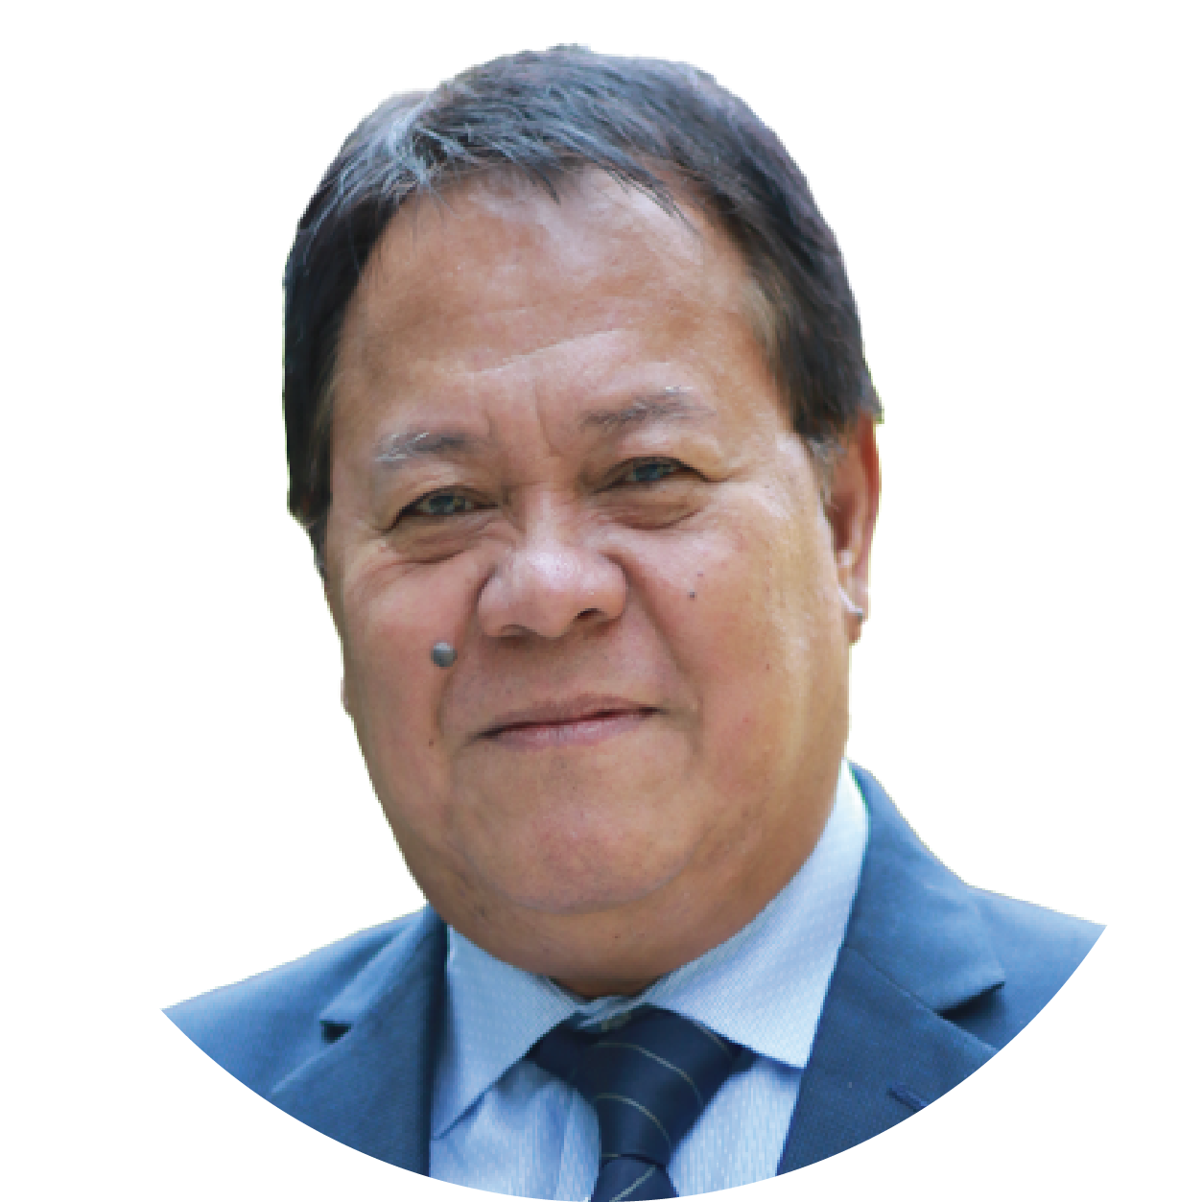
SURGE EXTERNAL AND INDEPENDENT PERFORMANCE EVALUATION TEAM
Dr. Nicasio Agustin
SURGE Performance Evaluation Team Leader
Professorial Lecturer
Eng. Rudini Baoy
SURGE Performance Evaluation Team Member
M&E in Local Governance
Dr. Ginny Santiago
SURGE Performance Evaluation Team Member
Research in MSMEs
Engr. Senen Dizon
SURGE Performance Evaluation Team Member
Water Supply and Sanitation

Slide 4
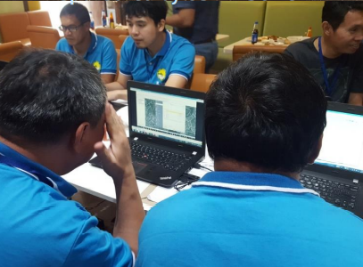
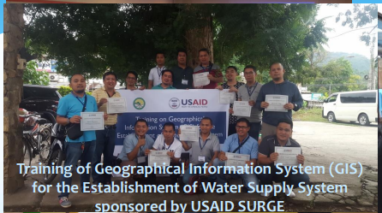
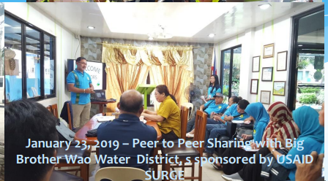
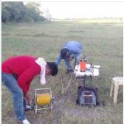
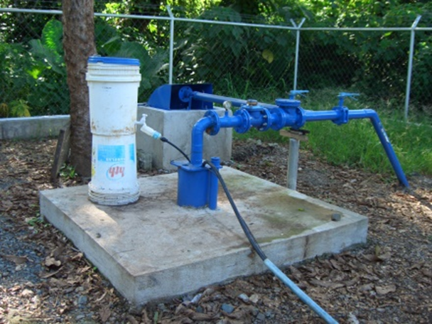
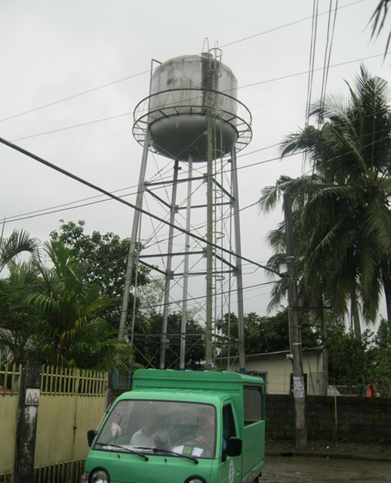
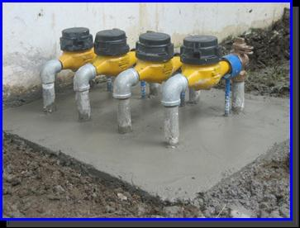
USAID/SURGE Interventions in Partnership with the CDI Cities
Soft and Hard Component Interventions
SOFT Component Interventions are non-physical structure activities contributing to the improvement of basic operation and management practices.
Provided personnel capacity-building activities
Conducted engineering studies
Assisted the preparation of plans and programs
HARD Component Interventions are activities on the improvement of existing facilities and development of additional physical structure/facilities.
Notes:
•SOFT Component Intervention: Refers to non-physical structure activities contributing to the improvement of basic operation and management practices, such as personnel capacity building, engineering studies and preparation of short/ long-term plans and programs following engineering standards, among others.
•HARD Component Intervention: Refers to the improvement of existing facilities and development of additional physical structure/facilities, such as water sources, water treatment facilities, reservoir, main and distribution pipe lines, control valves and other ancillary facilities.
What were SURGE’s (notable) interventions that empowered the CDI Cities to be more resilient?
Provided personnel capacity-building activities
Through a series of workshops facilitated by SURGE Technical Specialists, Service Providers were able to assess hazards and risks that threaten their water supply system.
Conducted engineering studies
Hazard Maps were prepared showing exposure to hazards and initial vulnerability and risk assessments of water supply systems. Map outputs were then integrated in the Water Safety Plan (WSP) and Business Continuity Plan (BCP) of the Service Providers.
Assisted the preparation of plans and programs
DRR-CCA was mainstreamed in the Water Safety and Business Continuity Planning of Service Providers.
—------------------------
WASH AREAS OF CONSIDERATION FOR USAID INTERVENTIONS:
SOFT Component Intervention: Refers to non-physical structure activities contributing to the improvement of basic operation and management practices, such as personnel capacity building, engineering studies and preparation of short/ long-term plans and programs following engineering standards, among others.
HARD Component Intervention: Refers to the improvement of existing facilities and development of additional physical structure/facilities, such as water sources, water treatment facilities, reservoir, main and distribution pipe lines, control valves and other ancillary facilities.
---------------------------------------------------------------------------------------------------------------
SURGE PROJECT INTERVENTIONS ON WASH ARE ANCHORED ON THE ESTABLISHED “THEORY OF CHANGE” INVOLVING FIVE MAJOR AREAS OF CONCERN, vis:
Institutional Strengthening for Mainstreaming Climate and Disaster-risk Resilience
Institutional Strengthening for Water.
Institutional Strengthening for Sanitation.
Creating an Environment for Private Sector Participation (PSP) in Water and Sanitation
Water Resources Management (through ground Georesistivity Survey)
USAID interventions were designed to address a descriptive-based “CAUSE-and-EFFECT” questions reflecting interventions towards mainly on WASH’s Soft Component (with minimal intervention on Hard Component) envisaged to enhance an Effective and Efficient system Operation and Management practices according to WASH international standards and in consideration of Climate Change and Disaster Risks Resiliency.
The USAID Standard Outcome Indicators which mention “Existing Safely Managed Drinking Services” does not necessarily mean to Increase in Service Coverage”, which requires interventions on Hard Component.

Slide 5
SERVICE PROVIDERS Assisted by SURGE
Soft Component Interventions
Assisted CDI Partners with established Water Districts:
Batangas City Water District (CCC No. 8),
Cagayan de Oro City Water District (CCC No. 1),
Metro Iloilo Water District (CCC No. 71),
Legazpi City Water District (CCC No. 173),
Puerto Princesa City Water District (CCC No. 26),
General Santos City Water District (CCC No. 370)
Zamboanga City Water District (CCC No. 6).
All established Water Districts were issued Conditional Certificates of Conformances (CCCs) by LWUA (P.D. 198).
.
Tagbilaran City has not been able to establish its Water District, thus operating and managing its WASH systems through the Tagbilaran City Water System (TCWS) (R.A. 7160),
Other assisted Service Providers are the Rural Water and Sanitation Association (RWSA). (E.O 577)
Notes:
•SOFT Component Intervention: Refers to non-physical structure activities contributing to the improvement of basic operation and management practices, such as personnel capacity building, engineering studies and preparation of short/ long-term plans and programs following engineering standards, among others.
•HARD Component Intervention: Refers to the improvement of existing facilities and development of additional physical structure/facilities, such as water sources, water treatment facilities, reservoir, main and distribution pipe lines, control valves and other ancillary facilities.
What were SURGE’s (notable) interventions that empowered the CDI Cities to be more resilient?
Provided personnel capacity-building activities
Through a series of workshops facilitated by SURGE Technical Specialists, Service Providers were able to assess hazards and risks that threaten their water supply system.
Conducted engineering studies
Hazard Maps were prepared showing exposure to hazards and initial vulnerability and risk assessments of water supply systems. Map outputs were then integrated in the Water Safety Plan (WSP) and Business Continuity Plan (BCP) of the Service Providers.
Assisted the preparation of plans and programs
DRR-CCA was mainstreamed in the Water Safety and Business Continuity Planning of Service Providers.
—------------------------
WASH AREAS OF CONSIDERATION FOR USAID INTERVENTIONS:
SOFT Component Intervention: Refers to non-physical structure activities contributing to the improvement of basic operation and management practices, such as personnel capacity building, engineering studies and preparation of short/ long-term plans and programs following engineering standards, among others.
HARD Component Intervention: Refers to the improvement of existing facilities and development of additional physical structure/facilities, such as water sources, water treatment facilities, reservoir, main and distribution pipe lines, control valves and other ancillary facilities.
---------------------------------------------------------------------------------------------------------------
SURGE PROJECT INTERVENTIONS ON WASH ARE ANCHORED ON THE ESTABLISHED “THEORY OF CHANGE” INVOLVING FIVE MAJOR AREAS OF CONCERN, vis:
Institutional Strengthening for Mainstreaming Climate and Disaster-risk Resilience
Institutional Strengthening for Water.
Institutional Strengthening for Sanitation.
Creating an Environment for Private Sector Participation (PSP) in Water and Sanitation
Water Resources Management (through ground Georesistivity Survey)
USAID interventions were designed to address a descriptive-based “CAUSE-and-EFFECT” questions reflecting interventions towards mainly on WASH’s Soft Component (with minimal intervention on Hard Component) envisaged to enhance an Effective and Efficient system Operation and Management practices according to WASH international standards and in consideration of Climate Change and Disaster Risks Resiliency.
The USAID Standard Outcome Indicators which mention “Existing Safely Managed Drinking Services” does not necessarily mean to Increase in Service Coverage”, which requires interventions on Hard Component.

Slide 6
EVALUATION CRITERIA
1
To what extent has SURGE contributed to addressing the development challenges that motivated the Partnership for Growth-Cities Development Initiative, the thrusts of the National Spatial Strategy (NSS)/Philippine Development Plan (PDP, 2017-2022), the USAID/Philippines Country Development Cooperation Strategy (CDCS) (previous and current), and USAID’s policies on urban resiliency and water, sanitation, and hygiene (WASH)? (Relevance)
2
To what extent did SURGE achieve its objectives on improving local urban development processes, promoting local economic development, and expanding connectivity and access between urban and rural areas? (Effectiveness)
3
What is the likelihood that initiatives and gains will continue after the completion of the project? (Sustainability)

Slide 7
METHODOLOGY MIXED METHODS
Qualitative
Participants
Implementing partner (ICMA)
Government agencies at the city level
National government agencies
Local chief executives
LGU department heads and personnel
Group representatives (private sector, business and farmers)
WASH service providers
Quantitative
Triangulation

Slide 8
FINDINGS ON RELEVANCE
Alignment To Policies And Strategies
Contributed to the key outcomes of the Philippine Development Plan 2017-2022 on improving water system
Contributed to USAID’s Policy on Water and Development
Contributed to the key reform agenda of the Philippine Water Supply and Sanitation Master Plan
Conformed with water utilities standards of national water and sanitation governing bodies
Notes:
How did SURGE align with National Policies and USAID Strategies?
PHILIPPINE POLICIES:
Trends show that overall access of water consumers to improved water supply service quality and Sanitation services being provided by the existing Service Providers has been observed to be way below the desired Level of Services (LOS).
The ability of Service Providers to improve the operation and management practices as well as expansion of services to unserved water consumers, of all categories, became the main thrust of the Philippine Government, both on National and Local levels, in its effort to promote health and sanitation programs and improve economic activities in the partner CDI cities.
Contributed to the key outcomes of the Philippine Development Plan 2017-2022 on improving water systems
PDP 2017-2022 Chapter 19: Accelerating Infrastructure Development (including water supply infrastructure facilities)
PDP 2017-2022 Chapter 20: Ensuring Ecological Integrity, Clean and Healthy Environment
Contributed to the key reform agenda of the Philippine Water Supply and Sanitation Master Plan
USAID STRATEGIES:
Contributed to USAID’s Policy on Water and Development: water and watershed management toward conflict management, climate change adaptation, and promotion of economic growth
The US Agency for International Development’s (USAID) first global Water and Development Strategies are intended to provide a clear understanding of USAID's approach to water and sanitation programming. The USAID Strategies emphasize how sustainable use of water is critical to save lives, promote sustainable development, and achieve humanitarian goals.
The Strategies provide an increased focus for USAID’s water programs that is sustainable, works through host country systems, uses emerging science and technology, and learns from past experiences.
Assisted CDI Partners with established Water Districts
Batangas City Water District (CCC No. 8),
Cagayan de Oro City Water District (CCC No. 1),
Metro Iloilo Water District (CCC No. 71),
Legaspi City Water District (CCC No. 173),
Puerto Princesa City Water District (CCC No. 26),
General Santos City Water District (CCC No. 370)
Zamboanga City Water District (CCC No. 6).
All established Water Districts were issued Conditional Certificates of Conformances (CCCs) from LWUA (P.D. 198).
Tagbilaran City has not been able to establish its Water District, thus operating and managing its WASH systems through the Tagbilaran City Water System (TCWS) (R.A. 7160),
Other assisted Service Providers are the Rural Water and Sanitation Association (RWSA). (E.O 577)
-------------------------------------------------------------------------------------------------------------------------------------------------
SURGE assisted its partner CDI cities to become more competitive and more resilient. The elements that guided its assistance correspond exactly to each of the USAID Intermediate Results for this project.
SURGE is part of the Cities Development Initiative (CDI), a part of the broader Partnership for Growth, and seeks to assist its partner CDI cities to improve local capacity to manage and sustain urban and rural growth, increase local economic development by fostering business enabling measures, and expand urban-rural connectivity and access to improved water supply and sanitation service quality.

Slide 9
SURGE’s DEMAND-DRIVEN APPROACH
SURGE conducted baseline assessment of the service providers within the partner CDI cities to serve as the basis in formulating the Project’s Work Plan
SURGE identified the service providers needing service quality improvement characterized by:
Lack of personnel’s technical knowledge on system operation and management practices
Limited potable water supply
Lack of local government ordinances/ policies on WASH
Inadequate individual and institutional capacity on septage/wastewater management at the local level
SURGE extended technical assistance to capacitate technical and support personnel
Notes:
How did SURGE enrich implementation through its demand driven approach?
USAID Standard Outcome Indicator No. HL.8.1.3 emphasizes: “Number of people receiving Improved Service Quality from an existing basic or safely managed drinking service as a result of USG assistance”
SURGE Project conducted “Baseline Assessment” of the Service Providers within the partner CDI cities aimed at providing an overview of the Service Providers’ needs with reference to the status of water, sanitation and hygiene (WASH) operations and management which served as the basis in the formulation of SURGE Project Work Plan.
Based on the results of the Project’s Baseline Assessment, SURGE Project identified Service Providers with varied glaring needs for the improvement of service quality, basically anchored on the following findings, among others:
Lack of personnel’s technical knowledge on system operation and management practices of the Service Providers remain a serious challenge even in those CDI cities that are somehow enjoying an acceptable level of service coverages, i.e. Large Service Provider category.
Potable water in the supply system have been recorded to be relatively limited due to inadequate facilities, contaminated surface water, and under exploitation of water resources.
Lack of local government ordinances/ policies on WASH.
Inadequate individual and institutional capacity at the local level on septage/wastewater management has been a major barrier to creating effective new local policies and programs.
Thus, in addressing the pressing needs of the Service Providers, SURGE Project extended technical assistance to capacitate Technical and Support Personnel in the application of the internationally accepted operation and management practices as well as in the development of plans and programs in consideration of Climate Change and Disaster Risks with implications to water sources, water distribution and water quality for socially inclusive delivery of water and sanitation service.

Slide 10
FINDINGS ON EFFECTIVENESS
Maximize effectiveness and efficiency of system operation and management practices
Through workshops facilitated by SURGE, the Water Service Providers were able to assess hazards and risks that threaten their water supply system.
USAID Standard Outcome Indicators: People receiving improved service quality
Notes:
What were SURGE’s (notable) interventions that empowered the CDI Cities to be more resilient?
Provided personnel capacity-building activities
Through a series of workshops facilitated by SURGE Technical Specialists, Service Providers were able to assess hazards and risks that threaten their water supply system.
Conducted engineering studies
Hazard Maps were prepared showing exposure to hazards and initial vulnerability and risk assessments of water supply systems. Map outputs were then integrated in the Water Safety Plan (WSP) and Business Continuity Plan (BCP) of the Service Providers.
Assisted the preparation of plans and programs
DRR-CCA was mainstreamed in the Water Safety and Business Continuity Planning of Service Providers.
—------------------------
WASH AREAS OF CONSIDERATION FOR USAID INTERVENTIONS:
SOFT Component Intervention: Refers to non-physical structure activities contributing to the improvement of basic operation and management practices, such as personnel capacity building, engineering studies and preparation of short/ long-term plans and programs following engineering standards, among others.
HARD Component Intervention: Refers to the improvement of existing facilities and development of additional physical structure/facilities, such as water sources, water treatment facilities, reservoir, main and distribution pipe lines, control valves and other ancillary facilities.
---------------------------------------------------------------------------------------------------------------
SURGE PROJECT INTERVENTIONS ON WASH ARE ANCHORED ON THE ESTABLISHED “THEORY OF CHANGE” INVOLVING FIVE MAJOR AREAS OF CONCERN, vis:
Institutional Strengthening for Mainstreaming Climate and Disaster-risk Resilience
Institutional Strengthening for Water.
Institutional Strengthening for Sanitation.
Creating an Environment for Private Sector Participation (PSP) in Water and Sanitation
Water Resources Management (through ground Georesistivity Survey)
USAID interventions were designed to address a descriptive-based “CAUSE-and-EFFECT” questions reflecting interventions towards mainly on WASH’s Soft Component (with minimal intervention on Hard Component) envisaged to enhance an Effective and Efficient system Operation and Management practices according to WASH international standards and in consideration of Climate Change and Disaster Risks Resiliency.
The USAID Standard Outcome Indicators which mention “Existing Safely Managed Drinking Services” does not necessarily mean to Increase in Service Coverage”, which requires interventions on Hard Component.

Slide 11
SUSTAINABILITY FACTORS
Stakeholder forums and action plans suited to the needs of the assisted service providers
Assistance and support of partner water operators and concerned government offices in the capacity-building activities
Full support and cooperation from the service providers, partner CDI cities’ officials, and participants
Conduct of a georesistivity survey to identify potential water sources
Notes:
What enabled these accomplishments? How can they be continued and maintained?
SURGE Project interventions were consisted of two distinct means of accomplishing Project’s assistance, vis:
Stakeholder Forums
Action Plans that Suit the Needs of assisted Service Providers
For the Capacity Building activities, SURGE Project sought the assistance and support from relatively successful Water Operators from the GOCCs (i.e., Water Districts); Private Water Operators with PPP Agreement with Water Districts and LGUs (i.e. MPIC); along with the National and Local Government concerned Offices (i.e. DPWH, LWUA, MPDO, etc.).
SURGE Project observed full support and cooperation from the Management of the assisted Service Providers and Officials of partner CDI cities, as well as the strong desire of participants of the capacity building activities to acquire the internationally accepted technical strategies for an effective and efficient system operation and management practices and policy making.
SURGE Project facilitated the participation of the Service Providers and City Officials of the partner CDI cities in the Local and International Water Forum designed to provide an opportunity for participants to collaborate for possible partnerships with successful Water Operators in sharing their success stories and provide technical assistance that focuses on NRW reduction; water supply distribution and water quality; and sewerage/ septage management.
For the identification of potential future water sources, the conduct of Georesistivity Survey was carried out by SURGE Project with the support of Private Georesistivity Survey Specialist using their sophisticated instrument.

Slide 12
GAPS between interventions and desired outcomes
The level of service quality improvements cannot be determined due to the absence of records on the actual application of acquired technical knowledge by the service providers.
Assessment on the Level of Services (LOS) of the assisted Service Providers was not given utmost attention.
Undetermined efforts to provide advice/guidance on the following:
Application of Water Permits from NWRB for all potential water sources (groundwater)
Importance of DMA formation within the assisted Service Providers’ service areas.
Non-Revenue Water (NRW) reduction activities
Creation of a dedicated Group within the Service Providers’ organization for the much-needed special applications of “Water Asset Management (WAM)” supported by the Geographic Information System (GIS)
Notes:
What were the challenges observed that highlights the gap between interventions and desired outcomes?
Sustainability mechanism integrated into the design and implementation of SURGE Project interventions (i.e., mainly on capacity building), SURGE Project, to some extent, was unable to determine if the participants from Service Providers were able to record the extent of actual application of the acquired technical knowledge into the day to day system operation and management practices to determine the level of service quality improvements.
While Baseline Assessment of the assisted Service Providers was conducted, in terms of the system operation and management, assessment on the Level of Services (LOS) of the assisted Service Providers that can be measured by the established Key Performance Indicators (KPIs) was, somehow, not given utmost attention.
SURGE Project’s undetermined efforts to provide advice/guidance on the following, vis:
Application of Water Permits from NWRB for all potential water sources (Groundwater), identified through the Georesistivity Survey, for future development.
- “Water extractions from sources with issued Water Permit guarantees a life-cycle operation of the entire system”.
Importance of DMA formation within the assisted Service Providers’ service areas.
- “Development of sub-system, denominated as DMAs, should be throughout the entire distribution system of the Service
Providers, specially in areas where water distribution network are highly complicated.
Non-Revenue Water (NRW) reduction programs activities, i.e., Minimum Night Flow Measurements, Step Testing activities, Leak
Detection using appropriate instruments, establishment of Economic Level of Leakage (ELL) within the established DMAs, etc.
- “The regular implementation of NRW Reduction Program within the DMAs guarantees accurate monitoring of the level of
NRW within each DMA.”
Creation of dedicated Group within the Service Providers’ organization for the much-needed special applications of “Water Asset Management (WAM)” supported by the Geographic Information System (GIS).
- Water Asset Management (WAM) with the aid of Geographic Information System (GIS) guarantees effective management
decision making on technical, financial as well as on the organizational and institutional aspects.

Slide 13
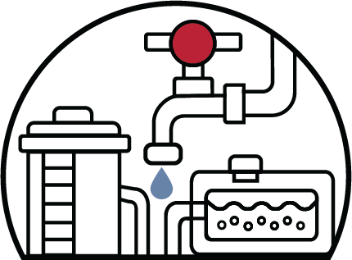
RECOMMENDATIONS
Consider having a centralized system in the provision of WASH services to promote the competitiveness of the assisted partner CDI cities
Notes:
How can these be addressed?
In terms of promoting “competitiveness” of the assisted partner CDI cities, the provision of WASH services following the concept of a “Centralized System” has been proven more effective and efficient when compared to the “Decentralized System”.

Slide 14
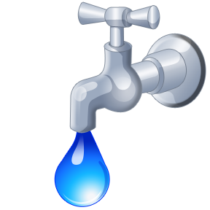
Thank you

