Slide 1
STRENGTHENING THE
ENABLING ENVIRONMENT FOR
LOCAL ECONOMIC DEVELOPMENT
SURGE PERFORMANCE EVALUATION:
FINDINGS, CONCLUSIONS AND RECOMMENDATIONS
JULY 14, 2022
Notes:
15 Minute presentation.
Working design: https://docs.google.com/document/d/1BUV9ONW8b8YhL4suNZ7vS_2gDNbtJXnk/edit?usp=sharing&ouid=100314050296542183112&rtpof=true&sd=true

Slide 2
ABOUT CLAIMDEV
CLAimDev aims to bolster the capacity of USAID/Philippines to effectively lead and practice collaborating, learning, and adapting (CLA). Improving practices in CLA has the broader goal of enhancing USAID’s development effectiveness. Susan Minushkin leads the CLAimDev as Chief of Party.
Panagora Group, the implementing partner, closely works with USAID/Philippines to integrate CLA principles into the Mission’s work. CLAimDev covers an implementation period of five years, 2020-2024.

Slide 3
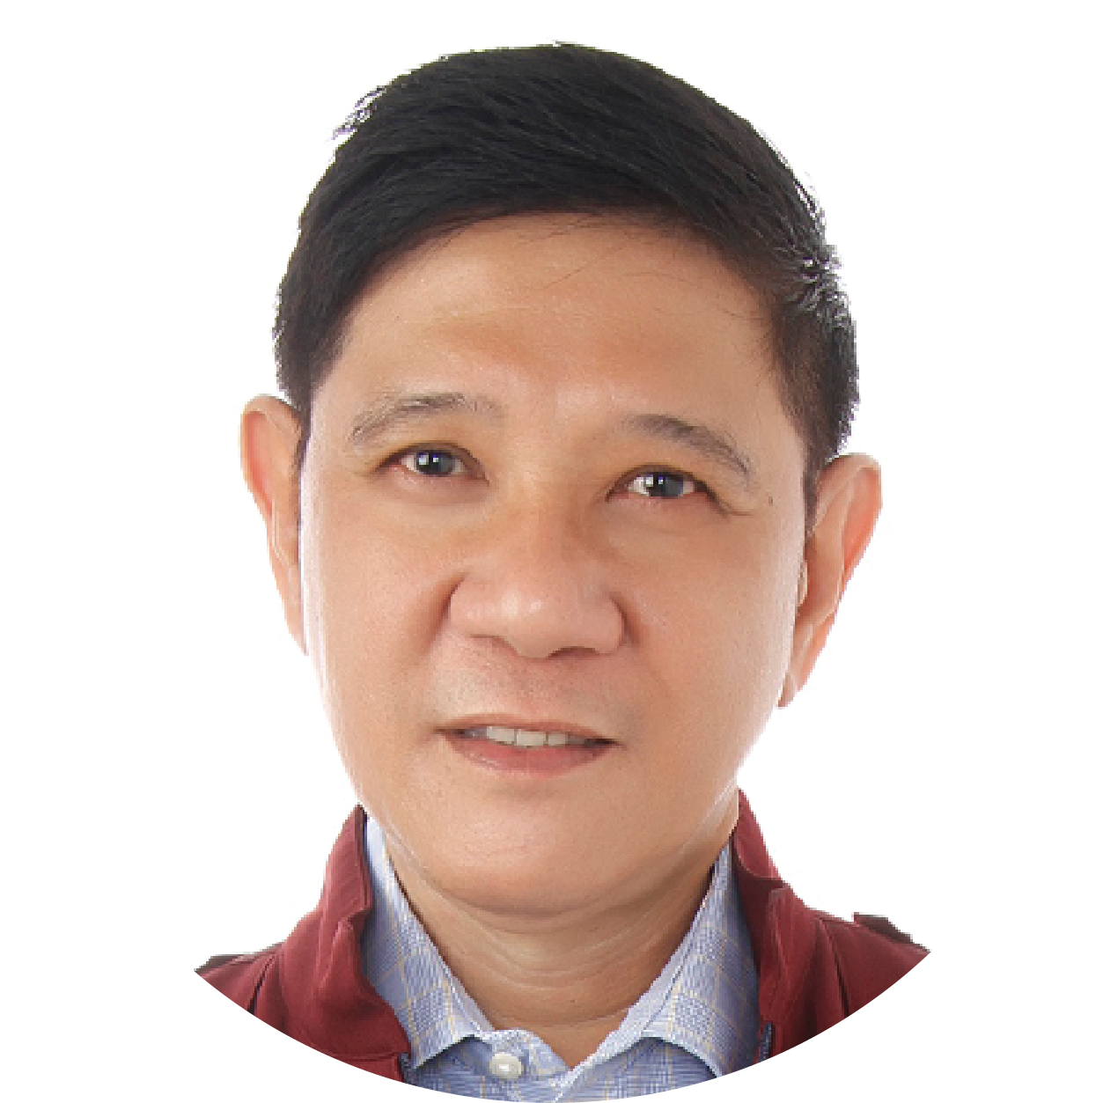
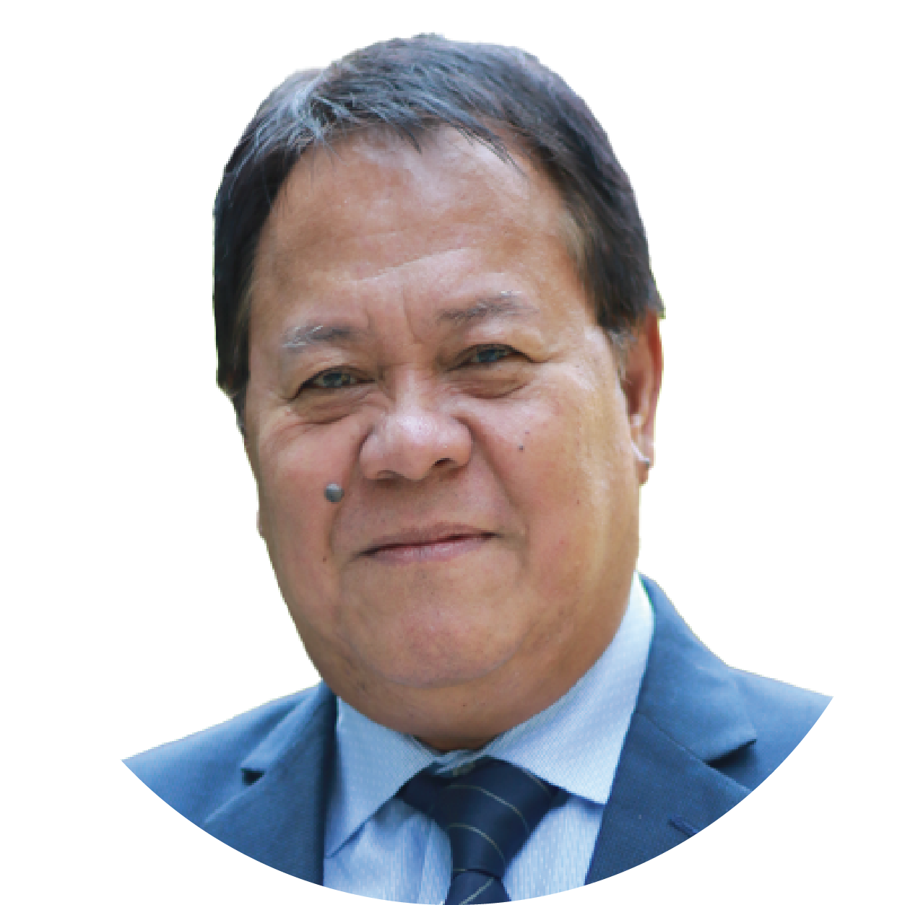
SURGE EXTERNAL AND INDEPENDENT PERFORMANCE EVALUATION TEAM
Dr. Nicasio Agustin
SURGE Performance Evaluation Team Leader
Professorial Lecturer
Eng. Rudini Baoy
SURGE Performance Evaluation Team Member
M&E in Local Governance
Dr. Ginny Santiago
SURGE Performance Evaluation Team Member
Research in MSMEs
Engr. Senen Dizon
SURGE Performance Evaluation Team Member
Water Supply and Sanitation

Slide 4
EVALUATION CRITERIA
1
To what extent has SURGE contributed to addressing the development challenges that motivated the Partnership for Growth-Cities Development Initiative, the thrusts of the National Spatial Strategy (NSS)/Philippine Development Plan (PDP, 2017-2022), the USAID/Philippines Country Development Cooperation Strategy (CDCS) (previous and current), and USAID’s policies on urban resiliency and water, sanitation, and hygiene (WASH)? (Relevance)
2
To what extent did SURGE achieve its objectives on improving local urban development processes, promoting local economic development, and expanding connectivity and access between urban and rural areas? (Effectiveness)
3
What is the likelihood that initiatives and gains will continue after the completion of the project? (Sustainability)
11/29/21
4

Slide 5
METHODOLOGY MIXED METHODS
Participants
Implementing partner (ICMA)
Government agencies at the city level
National government agencies
Local chief executives
LGU department heads and personnel
Group representatives (private sector, business and farmers)
WASH service providers
Academe
Qualitative
Quantitative
Triangulation

Slide 6
FINDINGS ON RELEVANCE
Alignment To Policies And Strategies
Contributed to national policies and strategies on improving the city’s competitiveness
Contributed to national and USAID policies and strategies related to resilient and inclusive growth
Contributed to USAID’s priorities under CDI-PFG, and Policy on Sustainable Service Delivery in an Increasingly Urbanized World
Notes:
How did SURGE align with National Policies and USAID Strategies?
Contributed to national policies and strategies on improving competitiveness
Philippine Development Plan 2017-2022
Ease of Doing Business and Efficient Government Service Delivery Act of 2018 (RA 11032)
Anti-Red Tape Act of 2007 (RA 9484)
National Urban Development and Housing Framework
Contributed to USAID’s priorities under CDI-PFG, and policy on Sustainable Service Delivery in an Increasingly Urbanized World
Chapter 5: Ensuring People-Centered, Clean, and Efficient Governance
Chapter 9: Expanding Economic Opportunities in Industry and Services
Chapter 10: Accelerating Human Capital Development (Inclusion and empowerment of women, communities, marginalized and vulnerable sectors, and MSME Development)
Chapter 16: Competitive Environment for Growth and Development
Contributed to national and USAID policies and strategies related to resilient and inclusive growth
PDP Framework: Inclusive Growth, as well as Gender and Development
Government policy in the provision of services during the pandemic
USAID’s W-GDP: women prospering in the workforce, women succeeding as entrepreneurs, and women enabled in the economy
Gender and development
Equality and social inclusion
Empowerment (women, community, marginalized, MSMEs)
Resilience in time of pandemic
_________
The primary indicator used to assess the achievement of the Project’s goals is competitiveness of a city. When cities are competitive, investments are expected to be forthcoming. When new investment comes in, local economy growth is spurred. Achievement of competitiveness is measured through a city’s CMCI rank. The higher the CMCI rank is among similarly categorized city, the more competitive the city is perceived to be.
As economic competitiveness is enhanced, the Missions’ Development Objective (DO) 1 - Broad-Based and Inclusive Growth Accelerated and Sustained, is consequently achieved. DO1 is consistent with the updated Philippine Development Plan (PDP) 2017-2022, that reinforces the Philippine Competition Act. The Project is thus supportive of the bilateral Partnership for Growth with Equity (PFG) on a localized application of anti-corruption measures, competitiveness, and human capital development.

Slide 7
SURGE’s DEMAND-DRIVEN APPROACH
Identified the gaps through a stakeholders need analysis
Realigned its activities to be more responsive (e.g. shifting to online platform for W-GDP)
Notes:
How did SURGE enrich implementation through its demand driven approach?
To achieve sub IR 1.1.1, the Project assisted eight CDI cities from eight different regions in crafting, reviewing, finalizing, and advocating for laws, policies, and procedures that support good governance as well as gender and social inclusion. The legislation and its implementing rules and regulations institutionalizes changes in the city that are geared towards helping the CDI cities become more competitive. The Project strengthened the capacities of three original CDI cities and guided the efforts of five extension CDI cities to comply with the mandates of Anti-Red Tape Act (ARTA) 2007 as well as the Ease of Doing Business(EODB) Act 2018. By the end of the activity implementation, all eight CDI cities had complied with the Department of the Interior and Local Government (DILG)-Department of Trade and Industry (DTI)-Department of Information and Communications Technology (DICT) Joint Memorandum Circular (JMC) 1, s. 2016 (JMC 2016) and DILG-Department of Public Works and Highways (DPWH)-DICT-DTI JMC 1, s. 2018 (JMC 2018). Compliance with business permitting and licensing system (BPLS) standards as well as compliance with national directives are two indicators of the government efficiency pillar of the CMCI.
To achieve Sub IR 1.1.4, the Project introduced capacity-building activities that helped the CDI cities to develop their Strategic Asset Management Plans (SAMPs) and Strategic Financial Management Plans (SFMPs). In developing their SAMPs and SFMPs, it is helpful if the CDI cities are able to institute their Unified Land Information System (ULIS).
The establishment of a ULIS aids in the guarantee of ownership and security, reduces land dispute, and serves as basis of real property tax (RPT) collection. With a ULIS, the CDI cities are also able to identify land assets that may become sources of additional city revenues. Improvement of revenue generation, and concomitantly, the proper management of expenditures, helps support improved public service delivery and planned economic growth. As the Project closed, the CDI cities were at different stages of their ULIS as well as their SAMPs and SFMPs. The SAMPs and SFMPs were delayed since the documents had to be removed following the Mandanas ruling, that effectively increases internal revenue allotment (IRA) download. The cities were briefed about the Mandanas ruling in May 2021.
An equally important aspect of the Project is helping the CDI cities strengthen their LEIPO, alternatively referred to as Local Economic Development and Investment Promotions Office (LEDIPO) after the issuance of Memorandum Circular 2020-167 by the DILG The LEDIPO has the responsibility of overseeing the city’s commitment to improving its competitiveness as a way to increasing investment. It is, thus, incumbent to the eight CDI cities to ensure that their LEDIPO is a distinct office with clear mandates. In this manner, the LEDIPO is able to better facilitate the preparation, coordination, and execution of local economic and investment promotion policies, projects, and activities of the city. Without a well-functioning LEIPO/LEPIDO, the gains from improved competitiveness may not be harnessed to the fullest.

Slide 8
FINDINGS ON EFFECTIVENESS
Improving the Environment for Local Economic Development
Enhanced revenue generation and expenditure management
of the selected CDI cities
Streamlined and automated business permitting and construction permitting processes
Improved land tenure security and land information management
Built competencies of LEIPO and business support organizations
Notes:
What were SURGE’s (notable) interventions that empowered the CDI Cities to be more competitive and inclusive?
Competitiveness
SURGE enhanced revenue generation and expenditure management of the selected CDI cities
Streamlined and automated business permitting and construction permitting processes
Improved land tenure security and land information management
Built competencies of LEIPO and business support organizations
SUB-COMPONENT 2.1: IMPROVING LOCAL REVENUE GENERATION AND EXPENDITURES MANAGEMENT
There were two aspects in this component – revenue generation and expenditure management. To help the cities with revenue generation, the documents show that SURGE provided assistance in asset management, including the creation of an asset registry (AR), so that the CDI cities can develop their Strategic Asset Management Plan (SAMP). Further, the city was guided on how to intensify tax collection efforts on businesses, real estate, and enterprises. On the other hand, to manage its expenditures, cities were introduced to public financial management and had as its goal the development of a Strategic Financial Management Plan (SFMP). As part of its assistance, the Project was able to release its Real Property Asset Management Manual for Local Governments in the Philippines in 2017 and its Revenue Management Manual in 2018.
SUB-COMPONENT 2.2: STREAMLINING AND AUTOMATING OF CONSTRUCTION PERMITTING PROCESSING
As a consequence of an automated BPLS, the cities were able to keep better track of the business establishments. In Puerto Princesa and in Tagbilaran, the monitoring team in the respective City Treasurer’s Office (CTO) combed the city to enforce business permit requirement. As a result, these cities were able to transition some of the informal sector to the formal sector.
SUB-COMPONENT 2.3: IMPROVING LOCAL LAND TENURE SECURITY AND LAND INFORMATION MANAGEMENT
The establishment of a ULIS that connects different city units to a central digital cadastral database (DCDB) is important for economic development. A ULIS serves many purposes. It guarantees ownership and security of tenure, reduces land disputes, and supports real property taxation. A ULIS that uses Geographic Information System (GIS) is able to link the tax map, DCDB, and real property records, that could lead to higher collections on real estate property tax. In some cities the Enhanced Tax Revenue and Collection System (ETRACS) is one such GIS that is used by several LGUs in the Philippines. The development of ETRACS was funded through the Australian Agency for International Development (AusAID).
SUB-COMPONENT 2.4: BUILDING COMPETENCIES OF LOCAL ECONOMIC AND INVESTMENT PROMOTION OFFICE AND BUSINESS SUPPORT ORGNIZATIONS
The focal unit within the city to facilitate investments is the LEIPO. When the Project started there was only one city with a distinct LEIPO but the staff were assessed not to be competent in investment promotions. Despite the deficiencies, the workplans reflect TA for the cities of Puerto Princesa and Tagbilaran. When General Santos, and Legazpi were included in the Project, similar assistance was provided to these two CDI cities. In year 4, Iloilo city was included, and then Batangas, CDO, and Zamboanga in year 5.
The Project assisted Puerto Princesa, Tagbilaran, and CDO create permanent structures with permanent staff who had the necessary competencies . The project also assisted CDO, Puerto Princesa, and Legazpi in creating their Investment Promotions Committee or Board

Slide 9
FINDINGS ON EFFECTIVENESS
Women’s Global Development and Prosperity (W-GDP) Initiative
Encouraged multi-sector participation in all its activities
Used online platforms to spread the
reach of women training activities
Notes:
What were SURGE’s (notable) interventions that empowered the CDI Cities to be more competitive and inclusive?
Competitiveness
SURGE enhanced revenue generation and expenditure management of the selected CDI cities
Streamlined and automated business permitting and construction permitting processes
Improved land tenure security and land information management
Built competencies of LEIPO and business support organizations
SUB-COMPONENT 2.1: IMPROVING LOCAL REVENUE GENERATION AND EXPENDITURES MANAGEMENT
There were two aspects in this component – revenue generation and expenditure management. To help the cities with revenue generation, the documents show that SURGE provided assistance in asset management, including the creation of an asset registry (AR), so that the CDI cities can develop their Strategic Asset Management Plan (SAMP). Further, the city was guided on how to intensify tax collection efforts on businesses, real estate, and enterprises. On the other hand, to manage its expenditures, cities were introduced to public financial management and had as its goal the development of a Strategic Financial Management Plan (SFMP). As part of its assistance, the Project was able to release its Real Property Asset Management Manual for Local Governments in the Philippines in 2017 and its Revenue Management Manual in 2018.
SUB-COMPONENT 2.2: STREAMLINING AND AUTOMATING OF CONSTRUCTION PERMITTING PROCESSING
As a consequence of an automated BPLS, the cities were able to keep better track of the business establishments. In Puerto Princesa and in Tagbilaran, the monitoring team in the respective City Treasurer’s Office (CTO) combed the city to enforce business permit requirement. As a result, these cities were able to transition some of the informal sector to the formal sector.
SUB-COMPONENT 2.3: IMPROVING LOCAL LAND TENURE SECURITY AND LAND INFORMATION MANAGEMENT
The establishment of a ULIS that connects different city units to a central digital cadastral database (DCDB) is important for economic development. A ULIS serves many purposes. It guarantees ownership and security of tenure, reduces land disputes, and supports real property taxation. A ULIS that uses Geographic Information System (GIS) is able to link the tax map, DCDB, and real property records, that could lead to higher collections on real estate property tax. In some cities the Enhanced Tax Revenue and Collection System (ETRACS) is one such GIS that is used by several LGUs in the Philippines. The development of ETRACS was funded through the Australian Agency for International Development (AusAID).
SUB-COMPONENT 2.4: BUILDING COMPETENCIES OF LOCAL ECONOMIC AND INVESTMENT PROMOTION OFFICE AND BUSINESS SUPPORT ORGNIZATIONS
The focal unit within the city to facilitate investments is the LEIPO. When the Project started there was only one city with a distinct LEIPO but the staff were assessed not to be competent in investment promotions. Despite the deficiencies, the workplans reflect TA for the cities of Puerto Princesa and Tagbilaran. When General Santos, and Legazpi were included in the Project, similar assistance was provided to these two CDI cities. In year 4, Iloilo city was included, and then Batangas, CDO, and Zamboanga in year 5.
The Project assisted Puerto Princesa, Tagbilaran, and CDO create permanent structures with permanent staff who had the necessary competencies . The project also assisted CDO, Puerto Princesa, and Legazpi in creating their Investment Promotions Committee or Board

Slide 10
SUSTAINABILITY FACTORS
Improving The Environment For Local Economic Development
Adequate skills to improve the crafting of SAMPs, SFMPs, and business plans
Continuous technical guidance through the produced manuals (e.g., Real Property Asset Management Manual for Local Governments in the Philippines in 2017, Revenue Management Manual in 2018)
Improved Land Information System
Established relationships with business support organizations in developing the investment code
Notes:
What enabled these accomplishments? How can they be continued and maintained?
City officials and personnel were equipped with skills to improve the crafting of SAMPs, SFMPs, and business plans
SURGE released a Real Property Asset Management Manual for Local Governments in the Philippines in 2017 and a Revenue Management Manual in 2018 to guide LGUs in the management of their assets and in revenue generation.
Improved LIS also helped identify government property that could be utilized for revenue generation.
Cities established relationships with BSO in the development of the investment code and who will benefit from the implementation of the code.
For WGDP-
Established online marketing system for products
Enhanced capacity on entrepreneurship
Established business centers at the local level
—--------------------------
City officials and personnel were empowered to maximize revenue generation particularly on business tax collection, real property tax collection, and receipts from local economic enterprises
City officials and personnel were equipped with skills to improve the crafting of SAMPs, SFMPs, and business plans
SURGE was able to release a Real Property Asset Management Manual for Local Governments in the Philippines in 2017 and a Revenue Management Manual in 2018. Both documents are able to guide LGUs in the management of their assets and in revenue generation.
Improved LIS also helped identify government property that could be utilized for revenue generation.
Cities have begun to draft legislation in support of a unified LIS.
The cities have established relationships with BSO who have helped in the development of the investment code and who will benefit from the implementation of the code.

Slide 11
SUSTAINABILITY FACTORS
Women’s Global Development And Prosperity (W-GDP) Initiative
Established online marketing system for products
Enhanced capacity on entrepreneurship
Established business centers at the local level
Notes:
What enabled these accomplishments? How can they be continued and maintained?
City officials and personnel were equipped with skills to improve the crafting of SAMPs, SFMPs, and business plans
SURGE released a Real Property Asset Management Manual for Local Governments in the Philippines in 2017 and a Revenue Management Manual in 2018 to guide LGUs in the management of their assets and in revenue generation.
Improved LIS also helped identify government property that could be utilized for revenue generation.
Cities established relationships with BSO in the development of the investment code and who will benefit from the implementation of the code.
For WGDP-
Established online marketing system for products
Enhanced capacity on entrepreneurship
Established business centers at the local level
—--------------------------
City officials and personnel were empowered to maximize revenue generation particularly on business tax collection, real property tax collection, and receipts from local economic enterprises
City officials and personnel were equipped with skills to improve the crafting of SAMPs, SFMPs, and business plans
SURGE was able to release a Real Property Asset Management Manual for Local Governments in the Philippines in 2017 and a Revenue Management Manual in 2018. Both documents are able to guide LGUs in the management of their assets and in revenue generation.
Improved LIS also helped identify government property that could be utilized for revenue generation.
Cities have begun to draft legislation in support of a unified LIS.
The cities have established relationships with BSO who have helped in the development of the investment code and who will benefit from the implementation of the code.

Slide 12
HINDERING FACTORS
Need for will power and guidance to properly execute SAMPs and SFMPs among city personnel
Technical concerns on the digitalization of business processes (e.g., hardware issues, limited bandwidth, poor internet connectivity, power failures)
Effect of changes in city leadership to business relations
Pandemic-induced challenges
Notes:
What were the challenges observed that highlights the gap between interventions and desired outcomes? How can these be addressed?
City personnel may need the will power and guidance to properly execute their SAMPS and SFMPs.
Digitalization of business processes and the digital linkage of different units in the city may be affected by computers that are not powerful to handle the data, limited bandwidth, poor internet connectivity, and power failures.
The improved relations with the business sector may be affected by changes in city leadership.
For W-GDP, the late start of the program that coincided with community lockdowns hampered effective monitoring of activities.
—-------
W-GDP was an addition to the 6-year SURGE project. It was implemented virtually in 2020, shortly after restrictions were imposed on the movement of people due to COVID-19. Due to its late implementation, it is difficult to measure the sustainability of interventions with respect to the women entrepreneurs who attended the various capacity-building activities. In its June 2021 report, ICMA reported that 74% of women participants were first-time participants. There was no indication whether there were attempts to follow-up with the participants or monitor their entrepreneurial activities after the first encounter. There was also insufficient information to determine whether webinars on topics such as digital marketing, had any impact on their businesses.

Slide 13
Thank you

