Slide 1
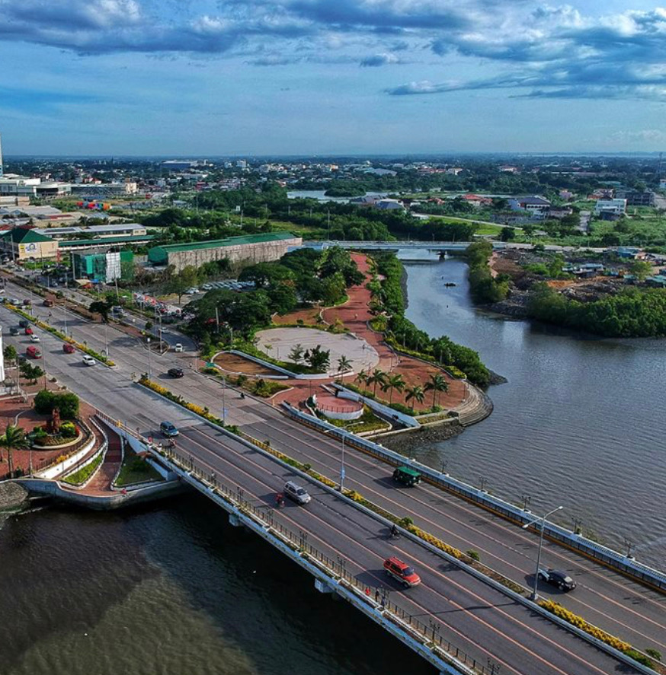
BREAKOUT SESSION 1: July 14, 2022
Enhancing Institutional Capacity for Resilient and Inclusive Local Urban Development
Mainstreaming Disaster Risk Reduction and Climate Change Adaptation in Iloilo City Development Planning
Jose Roni S.J. Penalosa
City Planning and Development Coordinator
City Government of Iloilo

Slide 2
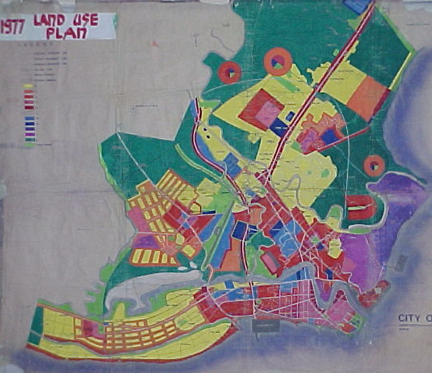
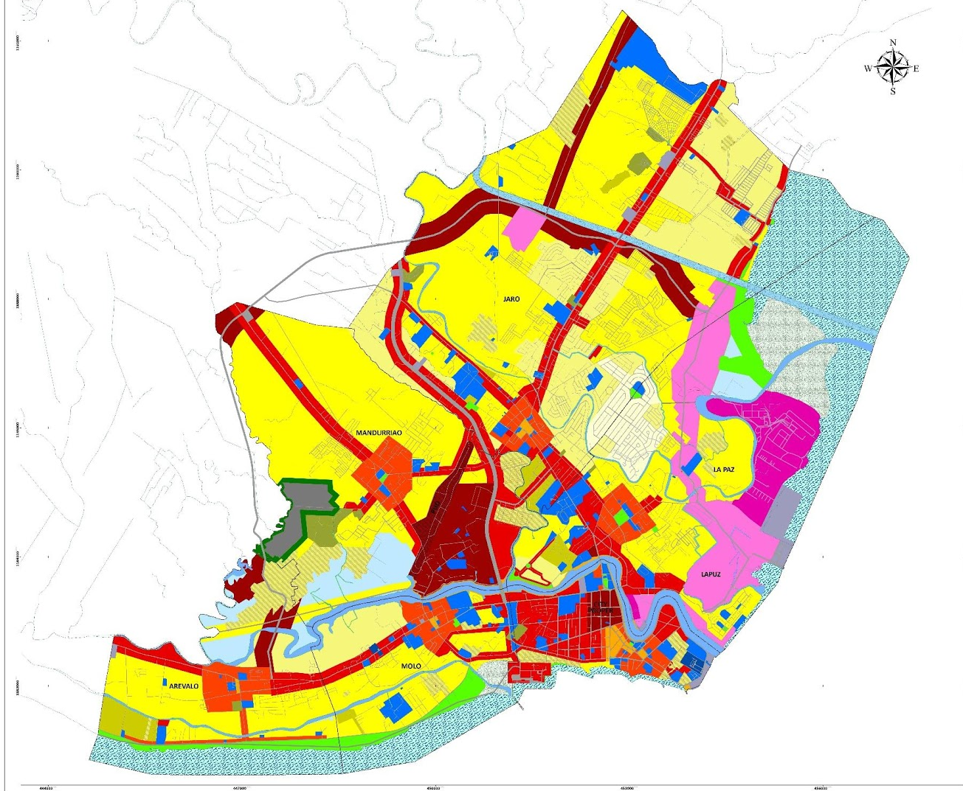
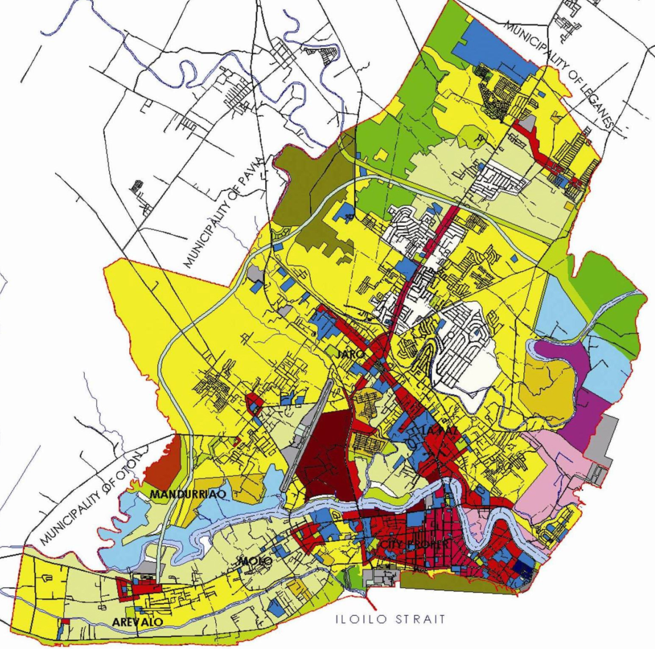
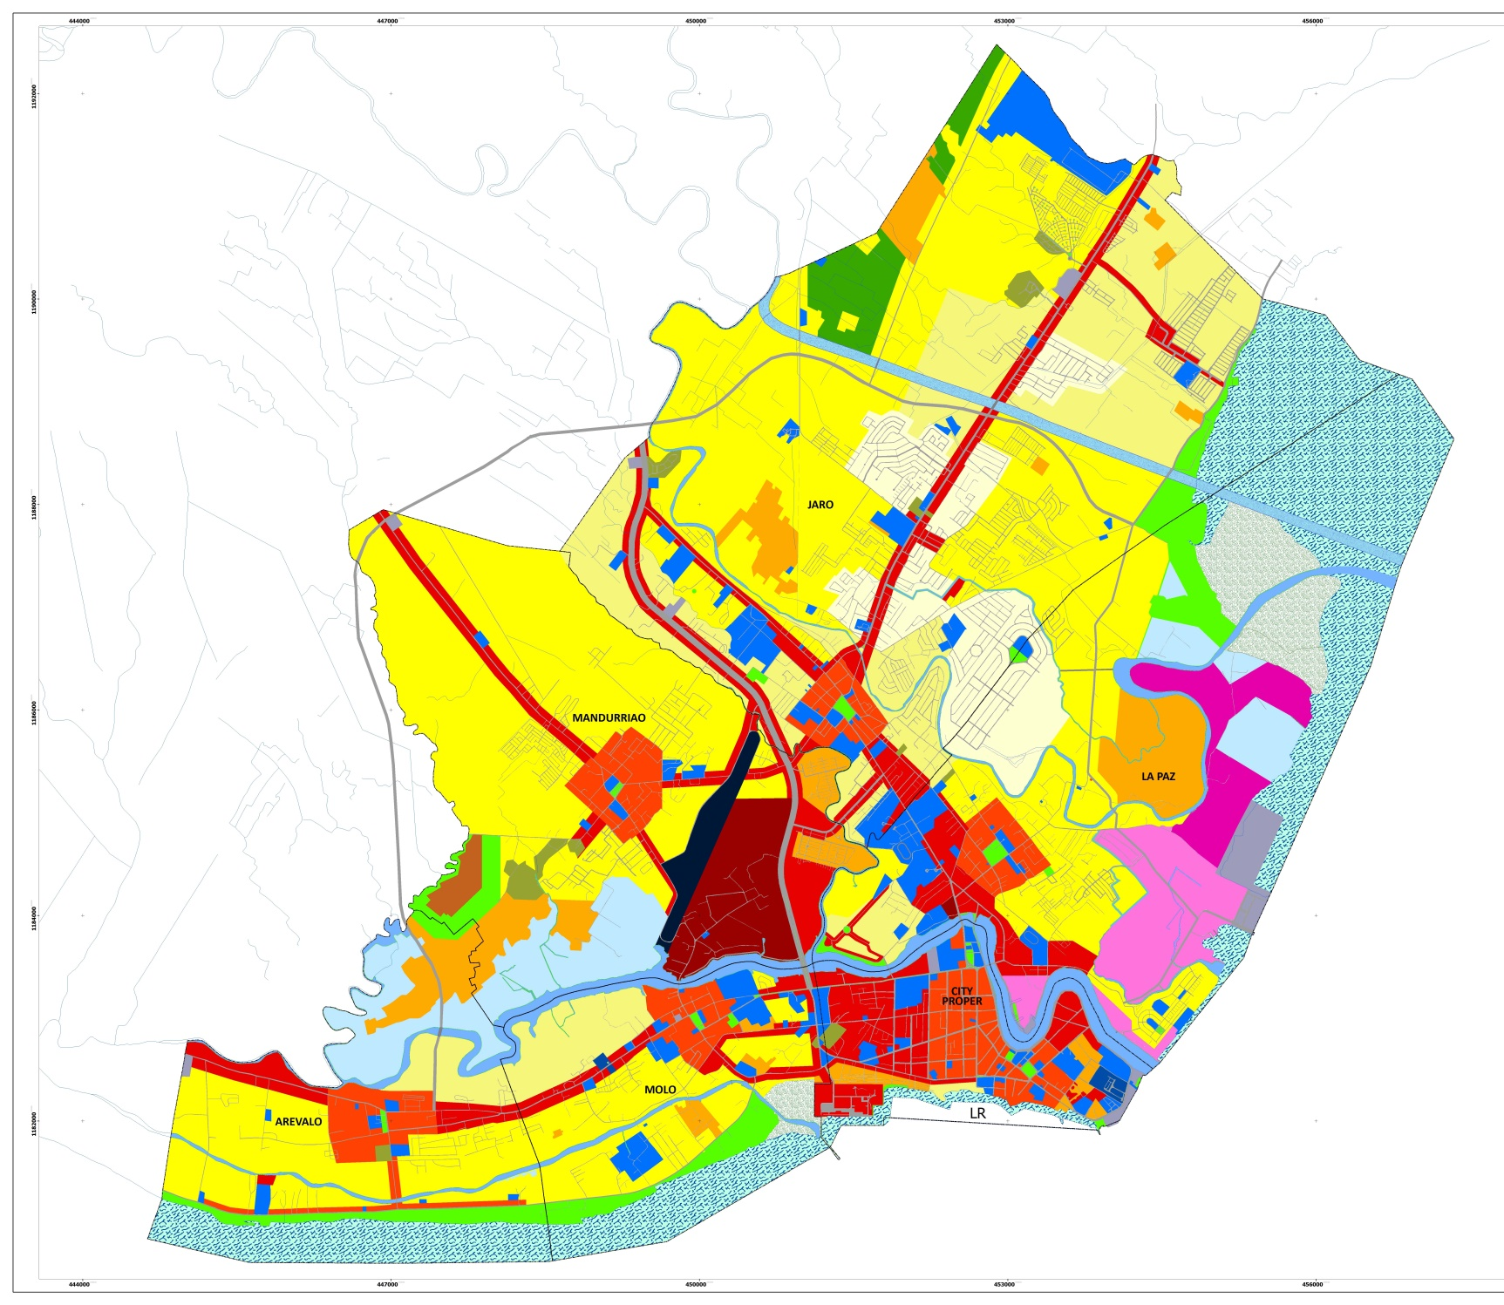
Enhancing Institutional Capacity for Resilient and Inclusive Local Urban Development
Mainstreaming Disaster Risk Reduction and Climate Change Adaptation in Iloilo City Development Planning:
BACKGROUND
Challenges
How it reshaped the city
Rapid Urbanization
Development Trend
1977 Iloilo City Land Use Plan
2021-2029 Iloilo City CLUP
CC and DR Vulnerability
How it affected people
Factor Affecting Trend
poor climate
& risk-sensitive planning & infra dev’t.
Management of Trends and Factors affecting them
How it affected its neighbors
1998-2011 Iloilo City CLUP
2011-2020 Iloilo City CLUP

Slide 3
Enhancing Institutional Capacity for Resilient and Inclusive Local Urban Development
Mainstreaming Disaster Risk Reduction and Climate Change Adaptation in Iloilo City Development Planning:
BACKGROUND
Challenges
Effects on the city, its people
and neighbors
Rapid Urbanization
loss of agri lands, fishponds, open spaces, etc.
poor health, perennial illnesses
saltwater intrusion and groundwater contamination
out migration
growing daytime population
loss of agricultural lands and fishponds
spillover and encroachments
diseases from air pollution from traffic jams
changing moral values, beliefs, practices
CC and DR Vulnerability
increased demand for expanded urban services
urban heat from asphalted roads, buildings
unavoidable post disaster household expenditures
destruction of properties
drugs, criminality,
etc.
poor climate
& risk-sensitive planning & infra dev’t.
inefficient, ineffective use of resources
informal settlements along waterways
change in consumption & spending patterns
garbage everywhere and other eyesores

Slide 4
Enhancing Institutional Capacity for Resilient and Inclusive Local Urban Development
Mainstreaming Disaster Risk Reduction and Climate Change Adaptation in Iloilo City Development Planning:
BACKGROUND
Opportunities
Benefits to the city and its constituents
(before SURGE)
quality human resources
studies and researches that can be used for urban growth and development planning and decision-making
urban and bio-regional planning with CC and DRR lenses
City as Regional Hub for Education (with urban planning and development course offerings)
Net GHG emissions of 1,006,133 tons of CO2e
relatively clean air
low air pollution-related illnesses
reduced household expenditures for medical bills, hospitalization, etc.
Good CLUP and zoning regulations (but needs revising)
livability due to mixed-use development
increased land values and emergence of new growth areas and business corridors
leisure and recreation at public open spaces

Slide 5
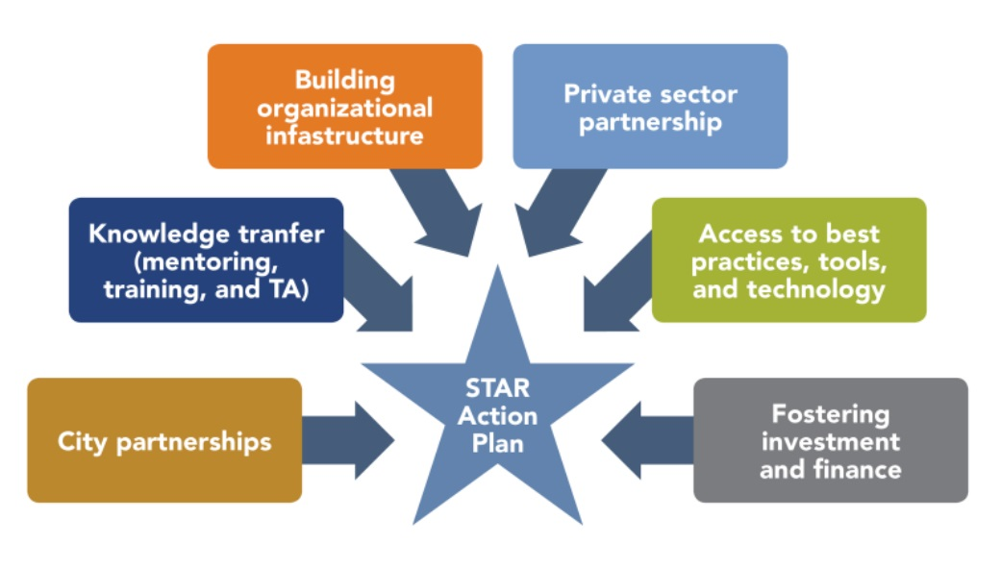
Enhancing Institutional Capacity for Resilient and Inclusive Local Urban Development
Mainstreaming Disaster Risk Reduction and Climate Change Adaptation in Iloilo City Development Planning:
SURGE PROGRAM IN ILOILO CITY
Initiatives
SURGE Tailored Assistance for Results (STAR) Action Planning July 2016
SURGE leverages and works with other USAID projects (“whole of nation approach”)

Slide 6
Enhancing Institutional Capacity for Resilient and Inclusive Local Urban Development
Mainstreaming Disaster Risk Reduction and Climate Change Adaptation in Iloilo City Development Planning:
SURGE PROGRAM IN ILOILO CITY
Program Objectives
Key Deliverables
Assessment Reports and Studies
Improve urban development and planning
Updated CDP
Promote low-emission local economic development
CDRA Compilation
Promote greater connectivity and access between urban and rural areas
Revised CLUP

Slide 7
Enhancing Institutional Capacity for Resilient and Inclusive Local Urban Development
Mainstreaming Disaster Risk Reduction and Climate Change Adaptation in Iloilo City Development Planning:
SURGE PROGRAM IN ILOILO CITY: CCA-DRR Integration in city development planning
Initiatives
Lessons Learned
Good Lessons Bad Lessons
Other Lessons
sustainability, livability and resiliency planning skills from CT BUILD
adoption of Puerto Princesa’s tree park initiatives
CDRA for the CLUP and other plans (from Gen San visit)
5 years may not be enough for a good program
capacity-building efforts towards policy-making was inadequate
Capacity-building
Technical Assistance
handholding for the CDP, CLUP, FMP, AMP preparation
improved work systems (GIS, risk mapping, financial mgt. asset management systems
improved work structures from benchmarking (LEDIPO, OBO,)
as the city grows more complex, associated complex problems do too, hence the need for special assistance
Partnership Building
empowered private sector
city-sharing through the USAID-CDI City partnership, ICMA network, etc.
strengthened MIGEDC bio-regional planning and management
USAID-SURGE partnership raised the bars for future work partnerships
MIGEDC wants more (SURGE’s rural-urban link initiative was inadequate)

Slide 8
Effects on Development Planning
Enhancing Institutional Capacity for Resilient and Inclusive Local Urban Development
Mainstreaming Disaster Risk Reduction and Climate Change Adaptation in Iloilo City Development Planning:
SURGE PROGRAM GAINS
Initiatives
Initiatives
enhanced capacity of local planners on climate-resilient and risk-sensitive urban development planning
updated CLUP/ZO, CDP and LDRRMP (soon, LCCAP, ESWMP) based on mainstreamed CCA and DRR using Climate and Disaster Risk Assessment (CDRA) findings
including leveraged investments, the total amount mobilized for climate change adaptation PPAs in Iloilo is $142,233
Capacity-building
Technical Assistance
Effects on Peoples’ Lives
Sustainability: job security, good health, public safety and security due to a stable local economy, good environment, and good urban governance
Livability: wider and safer options for living, working, playing, worshiping, learning, resting, socializing, etc.
Resilience: confidence and trust on community-based disaster preparedness and adaptation, response, recovery and bouncing forward
Partnership Building

Slide 9
Opportunities Opened
Enhancing Institutional Capacity for Resilient and Inclusive Local Urban Development
Mainstreaming Disaster Risk Reduction and Climate Change Adaptation in Iloilo City Development Planning:
SURGE PROGRAM GAINS
Infrastructure and Utilities
Medical Services
IT and Telecom
Professional Services
Education Services
Sustainable, Livable and Resilient Iloilo City
CLUP, CDP and other Dev’t. Plans
CCA/DRR-mainstreamed
Mice, Heritage and Festival Tourism
Commerce, Trade and Industry
SURGE Program
Capacity-building
Tech. Assistance
Partnership Bldg.
Housing, Real Estate Development
Logistics and Shipping

Slide 10
Contributing Factors
Enhancing Institutional Capacity for Resilient and Inclusive Local Urban Development
Mainstreaming Disaster Risk Reduction and Climate Change Adaptation in Iloilo City Development Planning:
SURGE PROGRAM IN ILOILO CITY
Supportive Private Sector
CLUP, CDP and other Dev’t. Plans
CCA/DRR-mainstreamed
Good Political Climate
Supportive Academe
Good Business Climate
Good Leadership
SURGE Program
3-pronged capacity- building, partnership, TA
Whole of Nation approach
Available Planning Tools/
Technologies
Trained Staff
Policy Support
Available Counterpart Funds

Slide 11
Enhancing Institutional Capacity for Resilient and Inclusive Local Urban Development
Mainstreaming Disaster Risk Reduction and Climate Change Adaptation in Iloilo City Development Planning:
Plans
SUSTAINABILITY OF ACHIEVEMENTS / MANAGEMENT OF FUTURE
Climate-Ready and Disaster-Prepared Iloilo City
Needed Tasks
development of proposals for bankable climate-focused projects for domestic and international funding
mobilization of both internal and external resources for CCAM-DRR (harness increased NTA share) climate-linked funding mechanisms
adoption of a capacity development roadmap (w/ skills enhancement in accessing and using climate change data for climate-resilient and risk-sensitive planning
city-barangay development plan harmonization integrating GIS-ICT in strategic planning and implementation, participatory monitoring and evaluation of local plans, among others.
Policies
Work Structures and Systems
SURGE-Learned Initiatives
Partnership Building
Technical Assistance
Capacity-building

Slide 12
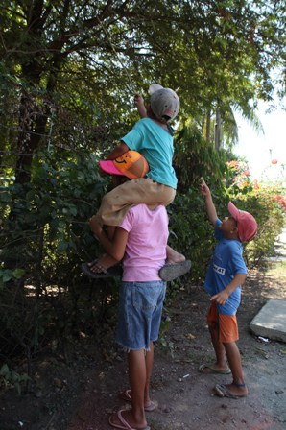
Partnerships work!
THANK YOU VERY MUCH.

