Slide 1
THE MARAWI RESPONSE PROJECT (MRP)
Findings, Conclusions and Recommendations

Slide 2
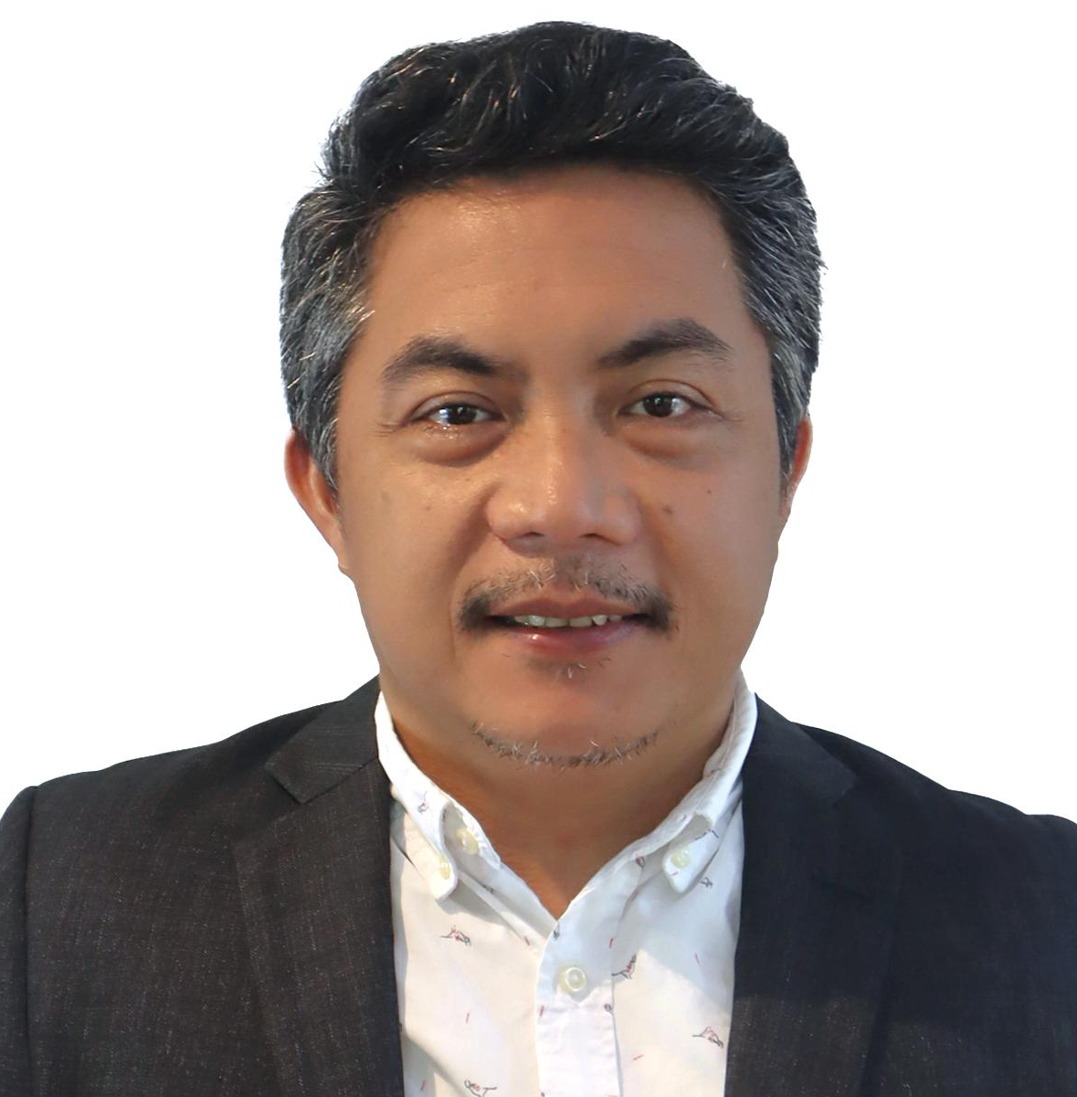
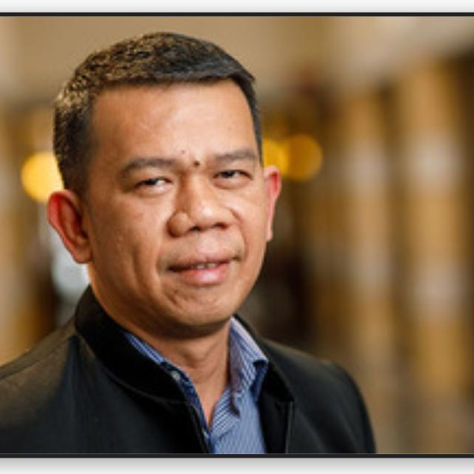
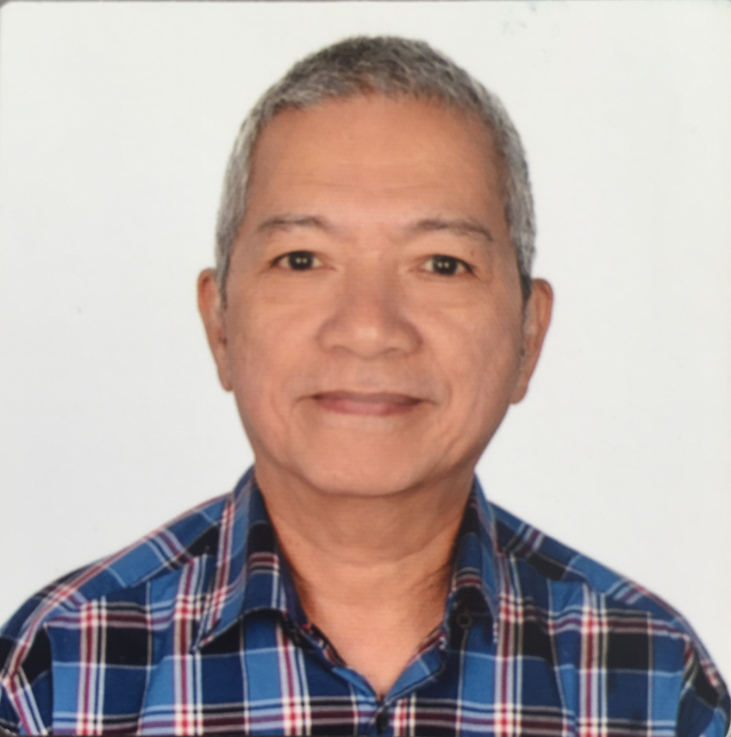
MRP EXTERNAL AND INDEPENDENT PERFORMANCE EVALUATION TEAM
JOHN STEPHEN CURADA
Team Leader
ORSON SARGADO
Member
ROBERTO PALO
Member

Slide 3
MRP RESULTS
LOGIC | STATEMENTS
HIGH-LEVEL IMPACT | Durable solution: Local integration of IDPs
MANAGEABLE IMPACT | Self-reliance of IDPs and host community members improved.
INTERMEDIATE RESULTS AND OUTCOMES | IR 1: Economic conditions of IDPs and host communities improved.
 | IR 2: Social cohesion of IDPs and host communities strengthened.

Slide 4
EVALUATION CRITERIA
Were MRP’s development interventions relevant to the needs of the IDPs and Host Communities and adaptive to the complex and changing external environment in Mindanao, especially in the project areas? (Relevance)
Did MRP accomplish the project’s expected outcomes of improving self-reliance and strengthening social cohesion among IDPs and HCMs? (Effectiveness)
Did MRP establish mechanisms to promote sustainable improved economic conditions and strengthen social cohesions between IDPs and HCMs? (Sustainability)

Slide 5
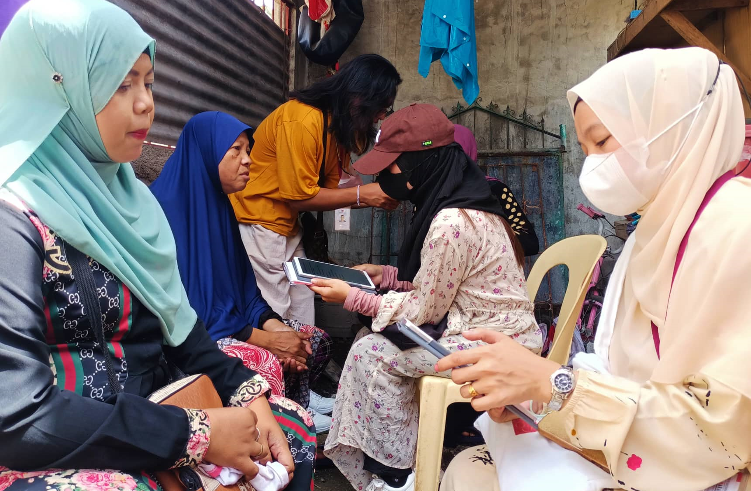
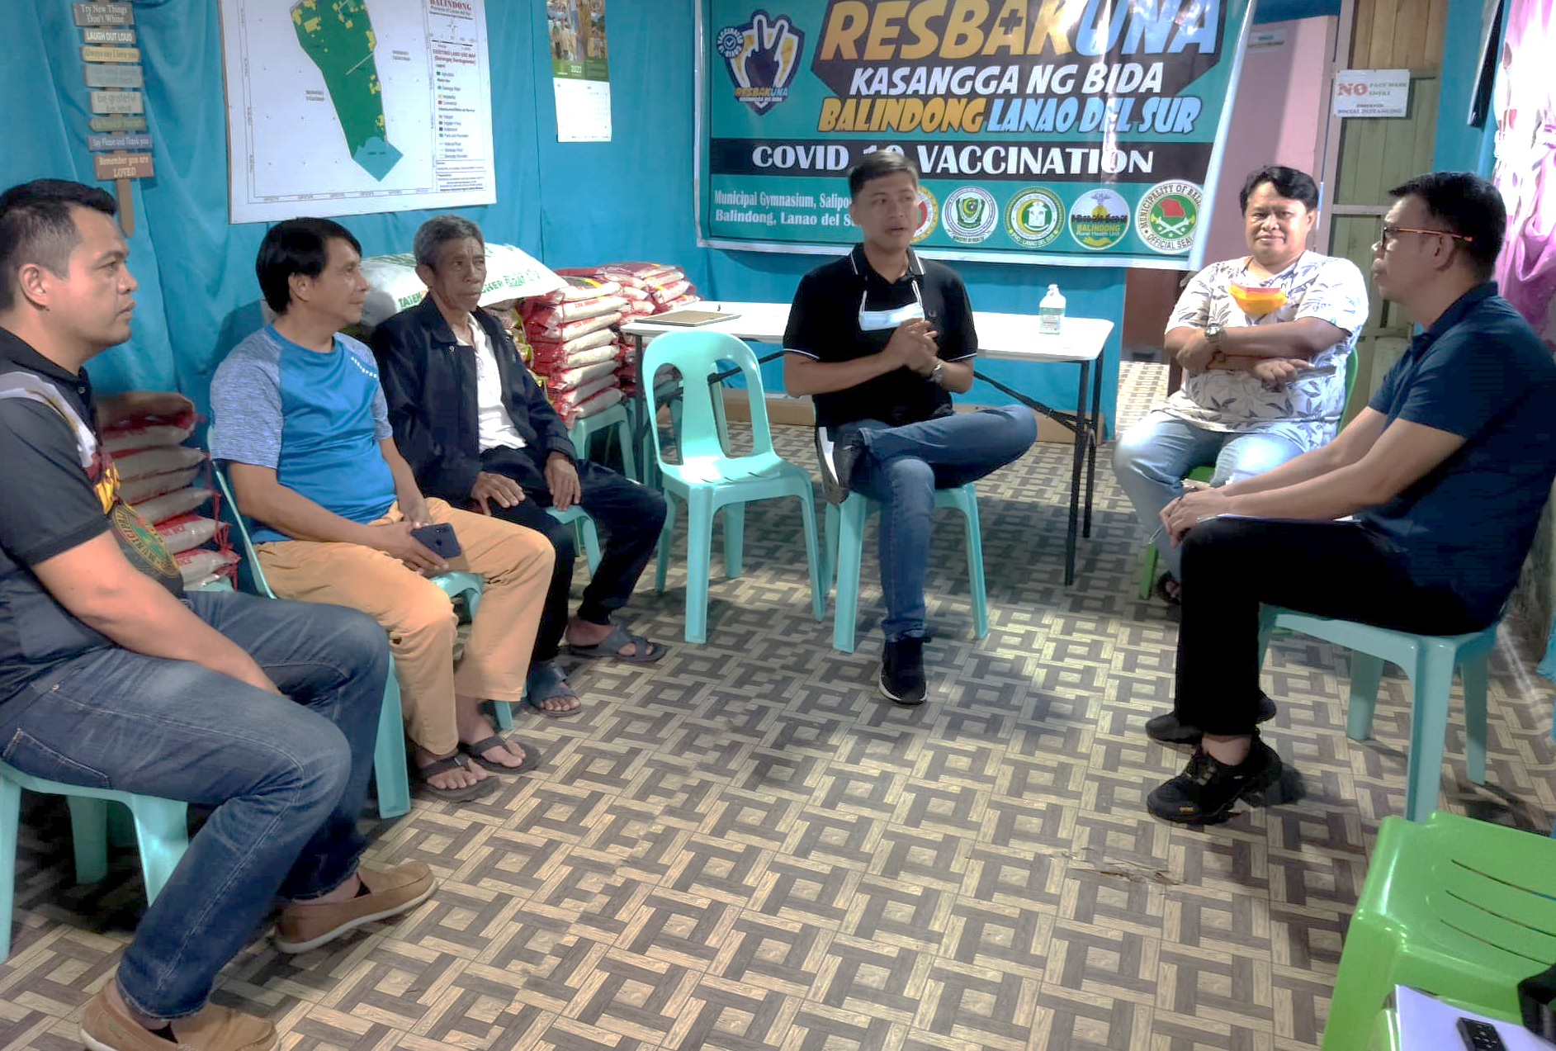
EVALUATION CRITERIA
Mixed-methods evaluation approach
Sampling
Survey = 684
FGD = 87
KII = 37
Data analysis
Descriptive and inferential tools
Content analysis

Slide 6
FINDINGS ON
RELEVANCE

Slide 7
Co-creation, adaptive management, and locally-led partnership helped ensure that MRP interventions addressed relevant needs of the CSGs
Development of gender-specific CSGs and community champions in various sectors helped address social inclusion issues
“They [Plan International] did a lot consultations at the outset such as what program is best, who are the intended beneficiaries, and how to go about it. What’s good with MRP is that from the start we already talked. We consider Plan International as a significant partner a especially on the business and livelihood.”
(KII, Task Force Bangon Marawi)
“I think they [women] used to be at home, now they have something to work on. The women helped the children's education. If before only their husbands were the earners, they were dependent on their husbands, but now they have helped too.”
(FGD, MARADECA)

Slide 8
MRP interventions on gender-based violence (GBV) and Youth Empowerment addressed social inclusion issues
Community Solidarity Groups (CSG) as effective mechanism for grants, trainings, and other activities
“MRP has helped a lot in providing programs for the IDPs and HCMs. They did a great job in addressing the needs of the beneficiaries. They worked with us closely in the implementation of the programs.”
(KII, LGU Buadiposo Buntong)
“I like MRP’s approach of CSG organizing. They included both IDPs and the members of the host communities. I believe that such organization is appropriate for socio-economic intervention.”
(KII, DTI, Lanao del Norte)

Slide 9
FINDINGS ON
EFFECTIVENESS

Slide 10
IMPROVING THE ECONOMIC CONDITIONS OF IDPS AND HCMS: INCOME-RELATED OUTCOMES
INTERVENTION | 44.5% | 15.3%
COMPARISON | 38.0% | 11.3%
“They [MRP] did a good job. Before, only a few here knew sewing. I observed many are interested in sewing because we were taught how to do it during the training. The women would make money. And I'm happy too. They bought fabrics, made bedsheets, and sold them to earn an income. Something has changed in them now, especially the IDPs. Before they didn't seem to have anything. I'm not saying they don't have anything to eat, but now they are interested in the project and their lives have improved.”
(KII, Barangay Captain, Ditsaan Ramain)

Slide 11
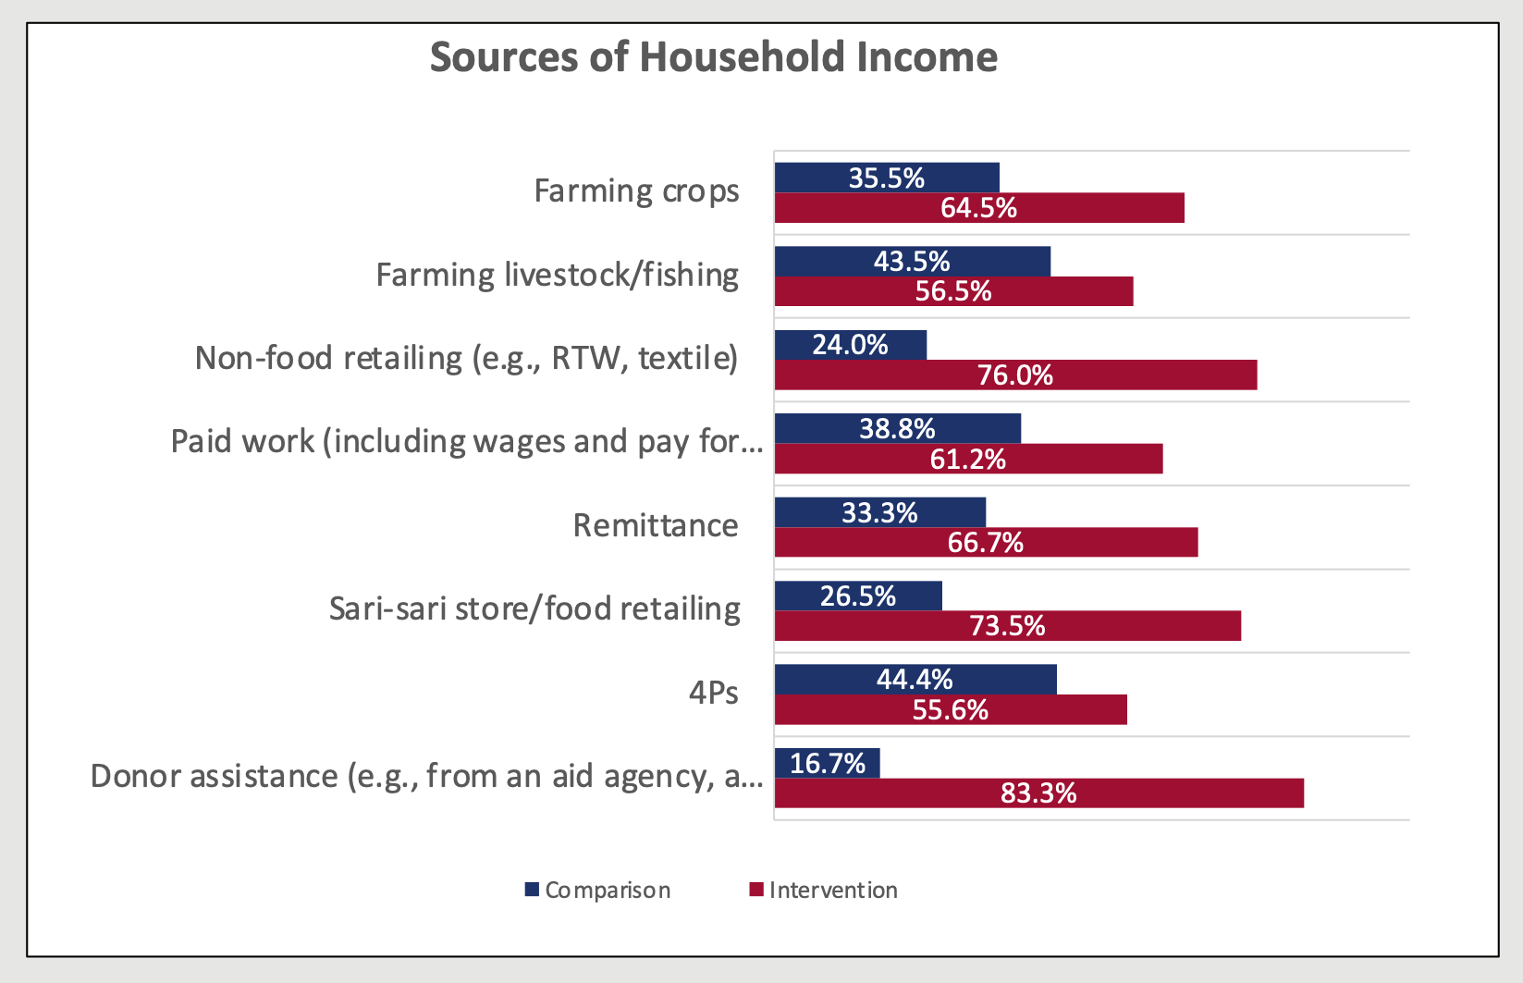
Paid work (including wages and
pay for service/labor)
Donor assistance (e.g., from an aid agency, a religious institution)

Slide 12
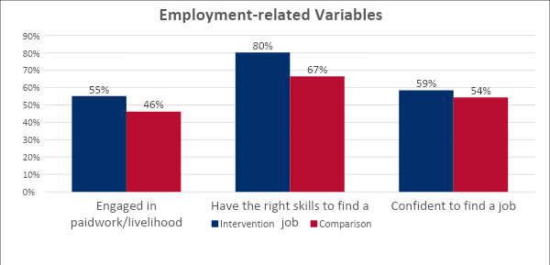
IMPROVING THE ECONOMIC CONDITIONS OF IDPS AND HCMS: EMPLOYMENT-RELATED OUTCOMES
When I evacuated in this place I had no job. I was hanging out for almost three years.
But when the machines arrived from MRP, that’s when I got a job. I started earning a bit small like Php 5,000 in every three months. But it’s a big help because I get to receive something every cycle as an extra income. (FGD, Poona Bayabao CSG)

Slide 13
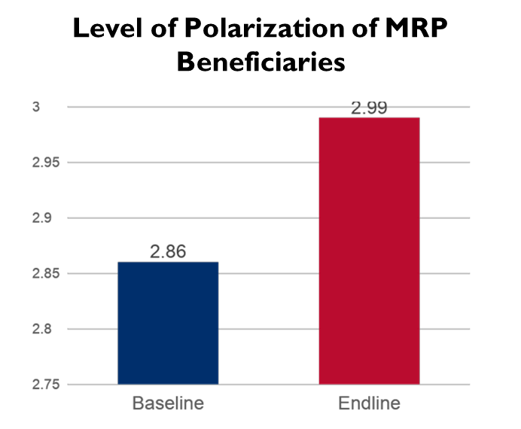
STRENGTHENING THE SOCIAL COHESION
OF IDPS AND HCMS: POLARIZATION
MRP beneficiaries’ perception of the existence of polarization in their community has significantly decreased at the endline (p=0.020).
“The beauty of MRP is that not only the IDPs from Marawi were targeted, but also the members of the host community. They made sure that the host community and IDPs can work together. I think this approach is important – that they both benefit from the projects.”
(KII, Municipal Administrator, Bubong)

Slide 14
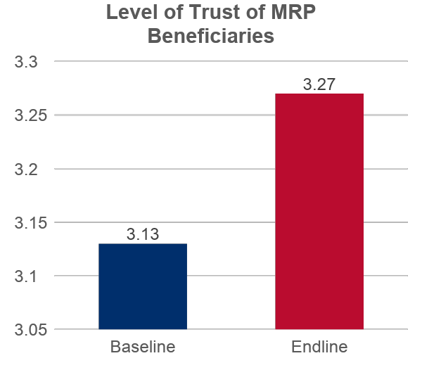
MRP beneficiaries’ level of trust has significantly increased at the endline (p=0.046).
“Before MRP, we didn't pay much attention with each other, especially since I just evacuated here, I don't know them, I'm ashamed to talk to them, my house is just at the end there, I really don't have any friends. I just go here when I want to buy in the store. I really don't know anyone. Then, when MRP started, there were meetings, and we became close. Now, we help and support one another.
(KII, IDP Leader, Ditsaan Ramain)

Slide 15
STRENGTHENING THE SOCIAL COHESION
OF IDPS AND HCMS: PUBLIC PARTICIPATION
The beneficiaries have high level of participation, while the non-MRP respondents have low.
Level of Public Participation Between Intervention and Comparison Group
2.64
“The IDPs and HCMs are even more eager to participate because they know that they are already part of the community and they are being targeted of a certain project. When the LGU or the barangay have programs and projects they are really attending. They [MRP] made sure that the host community and IDPs can work together. IDPs who evacuated here have already settled in our place, and they are already members of the community.”
(KII, MLGU, Bubong)
2.04
Intervention
Comparison

Slide 16
REDUCING SOCIAL INCLUSION GAPS: BETWEEN MEN AND WOMEN
Self-reliance
Women and men beneficiaries have comparable level of self-reliance, polarization
and public representation
at the endline.
p=0.205
2.43
2.53
Polarization
p=0.868
POLARIZATION
3.05
“Before, only my husband had a source of income. With the livelihood support I got from MRP, I am earning Php 300.00 to 500.00. I used it for medicine and food. This has helped a lot.
(FGD, Woman CSG Member, Buadiposo Buntong)
POLARIZATION
3.07
Public Participation
p=0.094
2.60
2.71
0 |  | 1 |  | 2 |  | 3

Slide 17
REDUCING SOCIAL INCLUSION GAPS: IDP/HCM
IDPs
Self-reliance
IDP and HCM beneficiaries have comparable polarization and public participation appraisals.
p=0.004
HCMs
2.44
2.63
Polarization
p=0.303
3.00
“The good thing is that we are not being discriminated because we are evacuees. Overall, I don’t see anything that can cause separation among the IDPs and the people who are from here.”
(FGD, Poona Bayabao CSG)
2.97
Public Participation
p=0.450
2.68
2.74
0 |  | 1 |  | 2 |  | 3

Slide 18
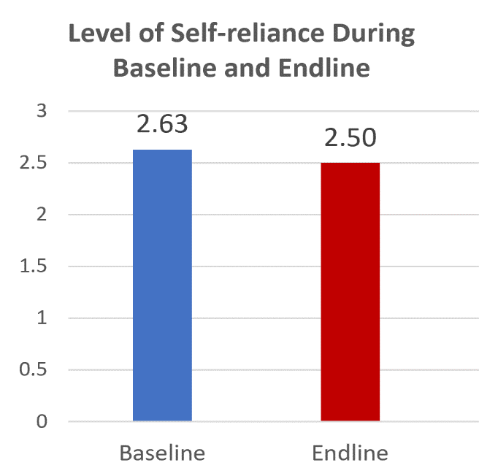
CONTRIBUTION TO THE SELF-RELIANCE OF IDPS AND HCMS
The self-reliance of MRP beneficiaries remained high despite the adverse effects of the COVID-19.
“Yes, I have observed that they have increased their capacity to be self-reliant because they already have newly acquired skills, and then, the others already have skills, they say they sew at home but it's even more enhanced, they are now accepting uniforms. It’s good, they have acquired the skills, and they have the tools to do whatever their skills are.”
(KII, MLGU, Bubong)

Slide 19
FINDINGS ON
SUSTAINABILITY

Slide 20
ESTABLISHED POLICIES AND STRATEGIES FOR SUSTAINABILITY
Instituted value chain approach (e.g. aquaculture, horticulture, and weaving products) involving the CSGs
Assisted CSGs to be become associations and cooperatives
“We at the LGU are also encouraging them because when we federated those organizations, they are not yet registered in CDA or now CBS. For those youth, they are not registered with the National Youth Commission, so we are extending our helping hands through our cooperative officer so that we can register them to have a legal entity that is their organization. If there are gender and development programs, then we will target them.” (KII, MLGU, Bubong)

Slide 21
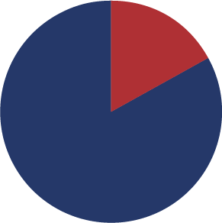
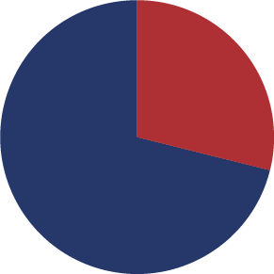
EMPOWERED COMMUNITY SOLIDARITY GROUPS
Majority (139 of 193 assessed CSGs) have organizational capacities that are considered functional to effective
Majority (552 of 665) are active CSGs
Inactive 17%
Formative 29%
Active 83%
Functional or effective 71%
Note: 552 of 665 CSGs
Note: 132 of 183 CSGs assessed

Slide 22
MRP provided strategies to
sustain our business or livelihood
I will continue to be active in
our CSG even if MRP ends.
For the LGU, it's not that only verbally saying to beneficiaries that you're being monitored. The LGU really need to be able to provide support for their project or guidance to them so that their project won't be lost. The LGU closely monitor the progress of their projects so that they can maintain what they're doing.
(KII, MLGU, Buadiposo Buntong)
“The intention of forming the group [CSG] is really not for it to become a formal organization immediately. As it turns out, because the groups are composed of people, some have evolved to more formal groups. They now have a formal platform to pursue their aspirations. The grant served as anchor for that design.”
(KII, Plan International)

Slide 23
IMPLEMENTED INTENTIONAL SOCIAL INCLUSION APPROACH
Endeavored to be socially inclusive in implementing grants and trainings through the CSGs
Required joint analyses and planning sessions between IDP and HCMs
MRP helped a lot on the ground, because they are really coming to the beneficiaries. A big change for the beneficiaries is knowing that someone helped them. Those who want to change their lives really adhered to the program because they know there is the MRP, there is the governor, there is the LGU that will really help and assist them.
(KII, MLGU, Buadiposo Buntong)
I believe the beneficiaries can sustain their endeavors because they are not only provided with the tools but also the skills. The knowledge that we have imparted to them will not be lost, it is really there. I also saw that the monitoring was very rigid. They hired people to provide trainings like TESDA, but Maradeca is always present to check if the projects are being done or in performed in full compliance.
(KII, MLGU, Balindong)

Slide 24
CONCLUSIONS

Slide 25
Application of co-creation processes, adaptive management, and local partnerships contributed to the relevance and adaptability of the interventions the the needs of the CSGs
Adaptive community-based approaches contributed to improving self-reliance, narrowing social gaps, and providing enabling conditions for IDPs’ local integration
Were MRP’s development interventions relevant to the needs of the IDPs
and Host Communities
and adaptive to the
complex and changing external environment in Mindanao, especially in
the project areas?

Slide 26
Did MRP accomplish the project’s expected outcomes of improving self-reliance and strengthening social cohesion among IDPs and HCMs?
Cushioned beneficiaries’ self-reliance from the adverse effects of external challenges
Created a stimulus for the restoration of individual and community capacities to engage in economic activities
Improved IDPs and HCMs’ social relations, connectedness, and orientation towards the common good
Contributed to the reduction of gender and social gaps

Slide 27
Formalization, consolidation, and social network expansion of the CSGs laid the building blocks for them to continue to operate, serve their members, even scale-up their livelihoods
Social inclusivity in targeting established social fabric for the harmonious involvement, participation and interaction of the CSGs as they scale up their ventures
Did MRP establish mechanisms to promote sustainable improve economic conditions and strengthen social cohesions between IDPs and HCMs?

Slide 28
RECOMMENDATIONS

Slide 29
LGUs to continue the partnerships with implementing partners and other CSOs in undertaking peace and development efforts in communities covered by MRP
LGUs to provide continuing support, accompaniment, and greater space for CSGs’ public participation
LGUs to follow through on their commitments to foster sustainability of the project’s economic and social cohesion outcomes among the CSGs

Slide 30
Framework of MRP’s emerging practice of social inclusion

Slide 31
Thank you

