Slide 1
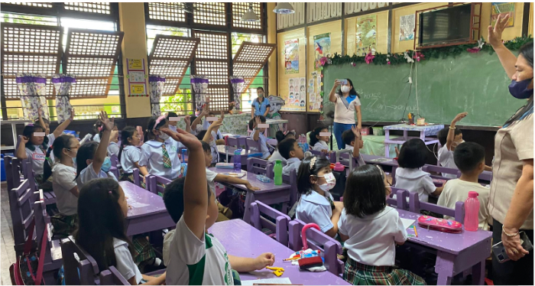
Mid-term Performance Evaluation of Advancing the Basic Education (ABC+) in the Philippines
Ivy Mejia, PhD Romylyn Metila, PhD
Arlyne Marasigan, PhD

Slide 2
Ivy Mejia, PhD
Evaluation Advisor/Team Leader
Romylyn Metila, PhD
Technical Specialist MTB-MLE
Arlyne Marasigan, PhD
Technical Specialist Policy and Planning

Slide 3
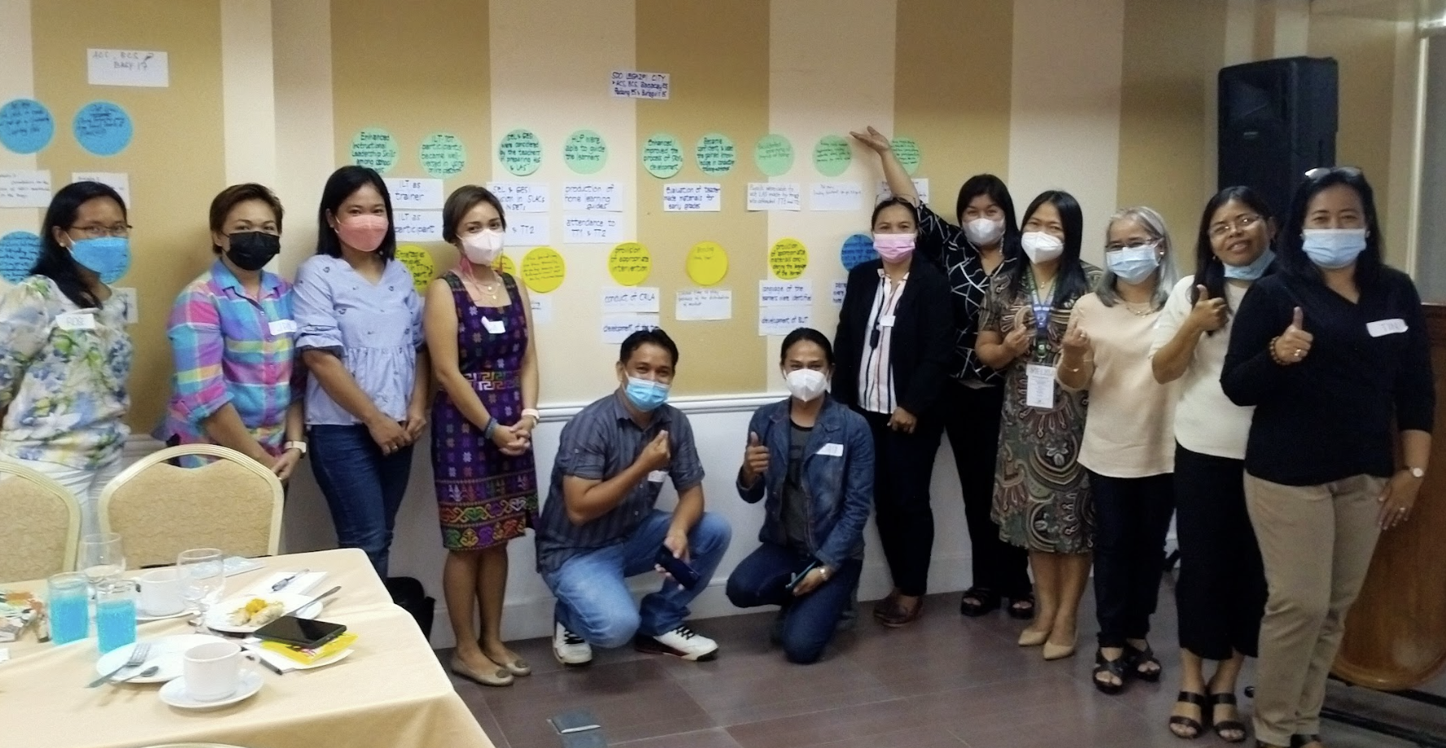
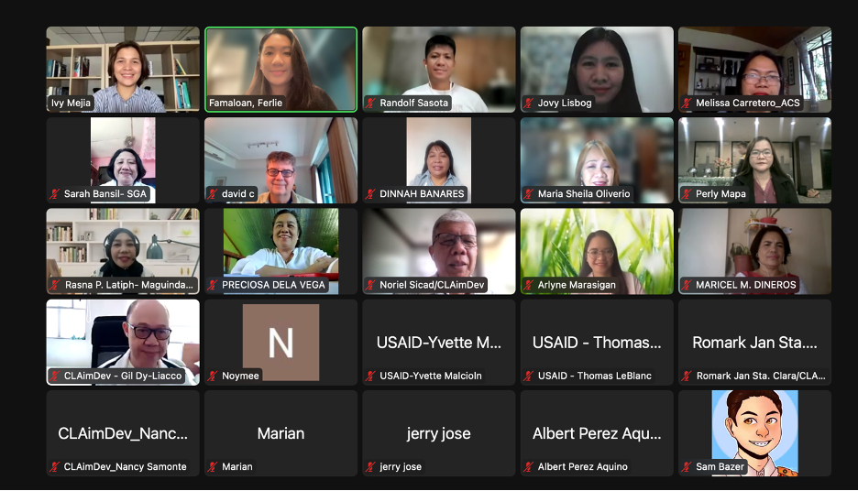
Methodology
METHODOLOGY
Outcome Harvesting Workshop (N= 84 )
Validation Workshop
(N = 25)

Slide 4
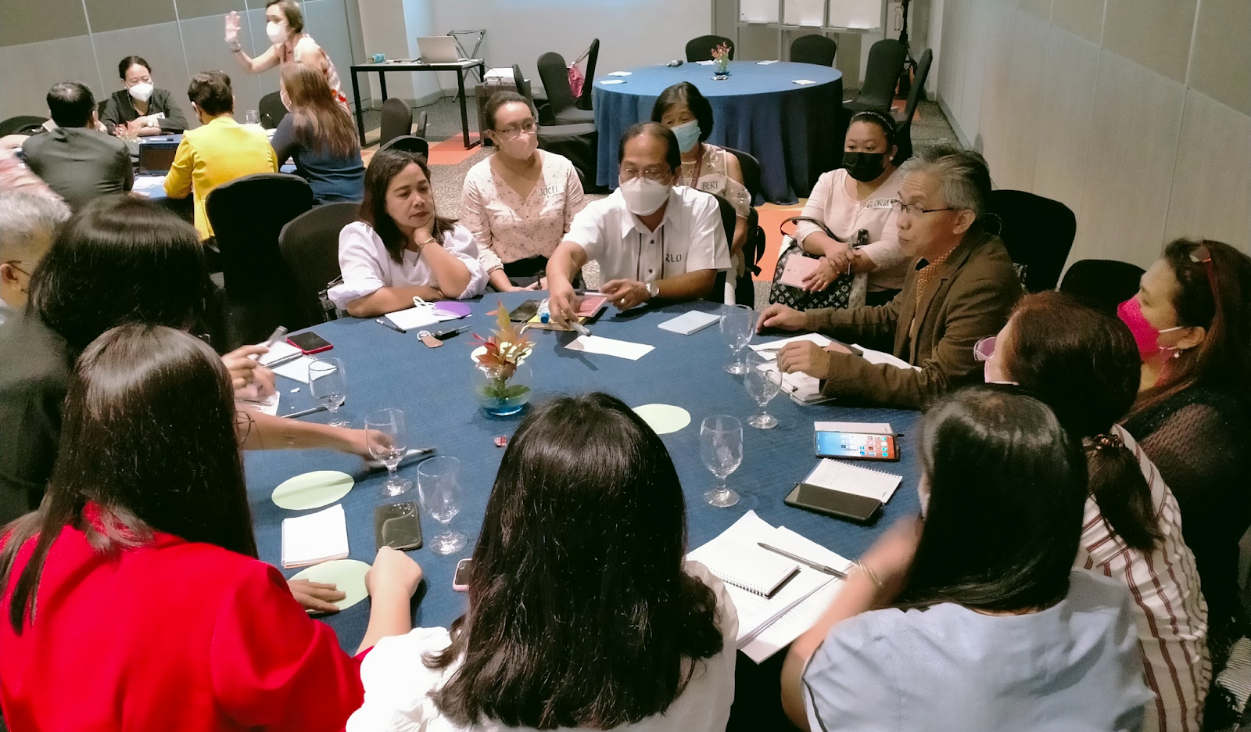
Methodology
METHODOLOGY
Most Significant Change Technique (N = 66)

Slide 5
Methodology
EVIDENCE OF IMPROVED EARLY-GRADE READING
6 out of 10 teachers in recipient schools reported that ABC+ training helped them with literacy instruction to a great extent.
34.3 percent Filipino non-readers reduced to 11 percent, and 14.8 percent English non-readers reduced to 6.6 percent
From an 8-week recovery plan, learners were catching up on their reading delays on the 5th week of the program
Learners as the indirect beneficiaries benefited the most (KII respondents = 55, 100%) as a result of their access to supplementary reading materials
Improved reading skills because of 11,634,849 SRMs produced and distributed to 750,479 learners.
Notes:
Six out of ten teachers in recipient schools in the regions reported that ABC+ training helped them with literacy instruction to a great extent.
From 34.3% for Filipino non-readers then reduced to 11%. English has 14.8% non-readers and reduced to 6.6% (RO6 Focal Person)
From an 8-week recovery plan, learners were catching up in their reading delays on the 5th week of the program (Albay Central School Focal Person)
Learners as the indirect beneficiaries benefited the most (KII respondents = 55, 100%) as a result of their access to supplementary reading materials (SRMs)
Improved reading skills because of 11, 634, 849 SRMs produced and distributed to 750, 479 learners.

Slide 6
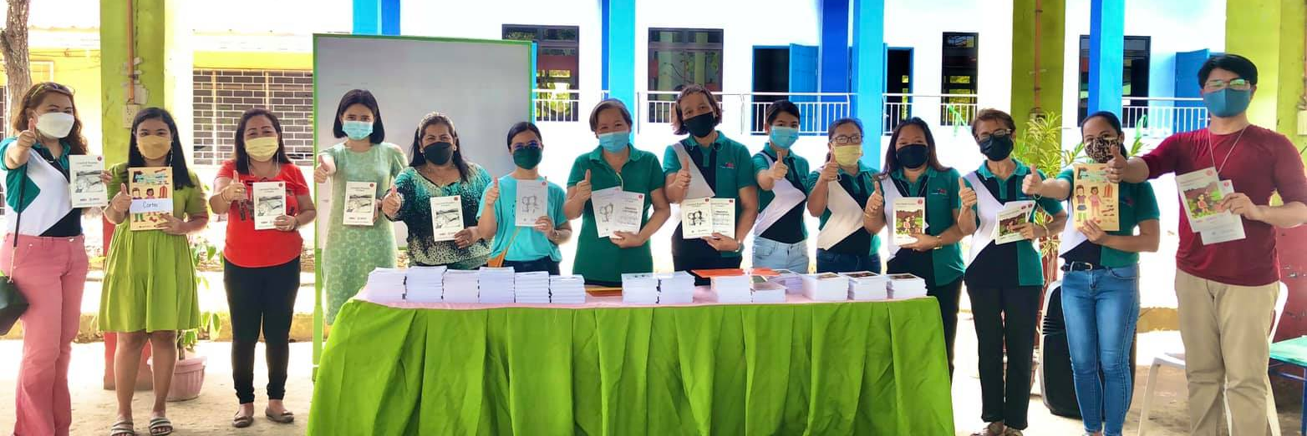
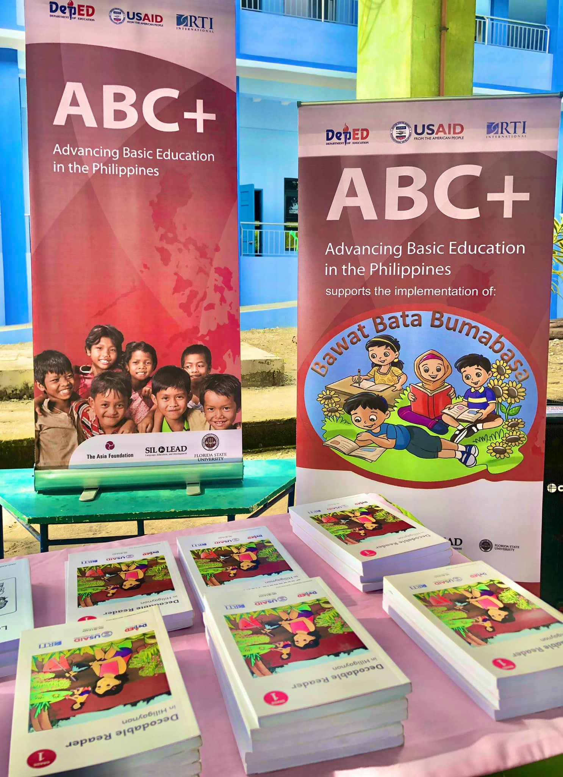
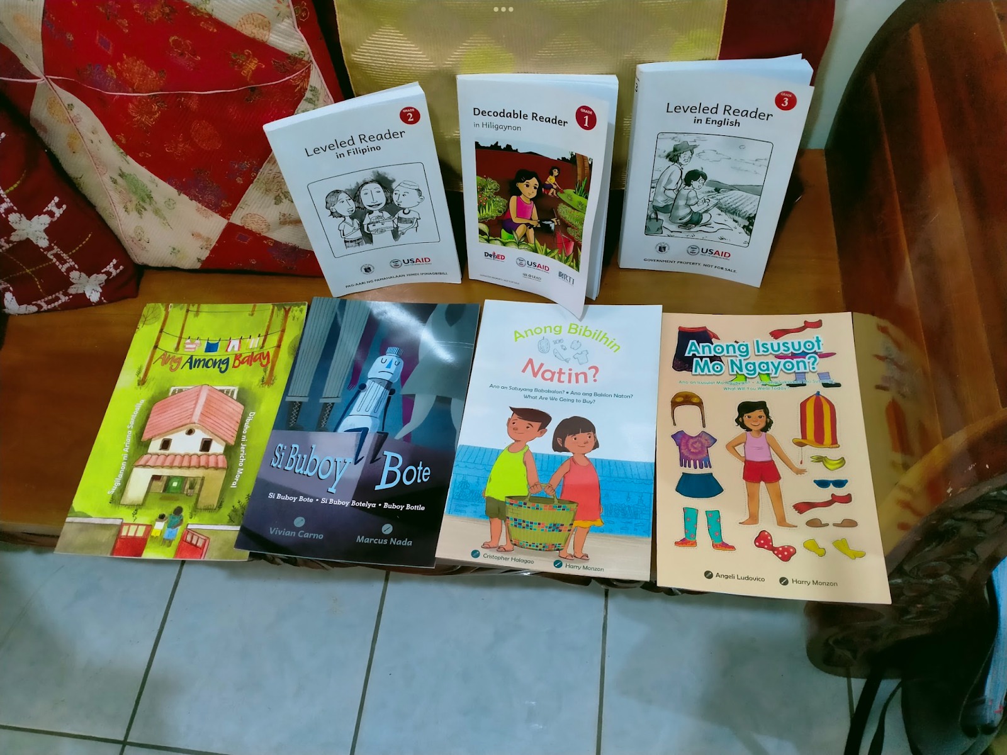
Methodology
SUPPLEMENTARY READING MATERIALS (SRMs)
Findings
ABC+ locally developed age and developmentally-appropriate reading materials for learning continuity and recovery programs
ABC+ training helped teachers become story and materials writers and materials quality assurers/evaluators.
496.5% of the number of primary learners targeted have already received decodable, leveled SRMs against a target of 95 percent
Notes:
ABC+ has exceeded its program targets in terms of SRM development and improving the capacity of partners to ensure the provision of materials.
ABC+ locally developed age and developmentally appropriate reading materials for the K-3 levels that were used in learning continuity and recovery programs which helped learners read in their mother tongue and Filipino language.
ABC+ training helped teachers become story and materials writers and materials quality assurers/evaluators. With these acquired capacities, they will be more capable in sustaining the materials development process that they have learned from ABC+.
For primary learners, the report states that as of Quarter 4 of Year 3 of program implementation, 496.5 percent of the number of learners targeted have already received decodable, leveled SRMs against a target of 95 percent.
ABC+’s SRMs contributed to literacy because they are in the local language, which parents could understand and explain to their children
Harvested outcomes showed that learners’ have increased their love for reading
Creative commons as the license attribution, where program recipients may distribute copyrighted SRMs freely, were helpful to many teachers and parents

Slide 7
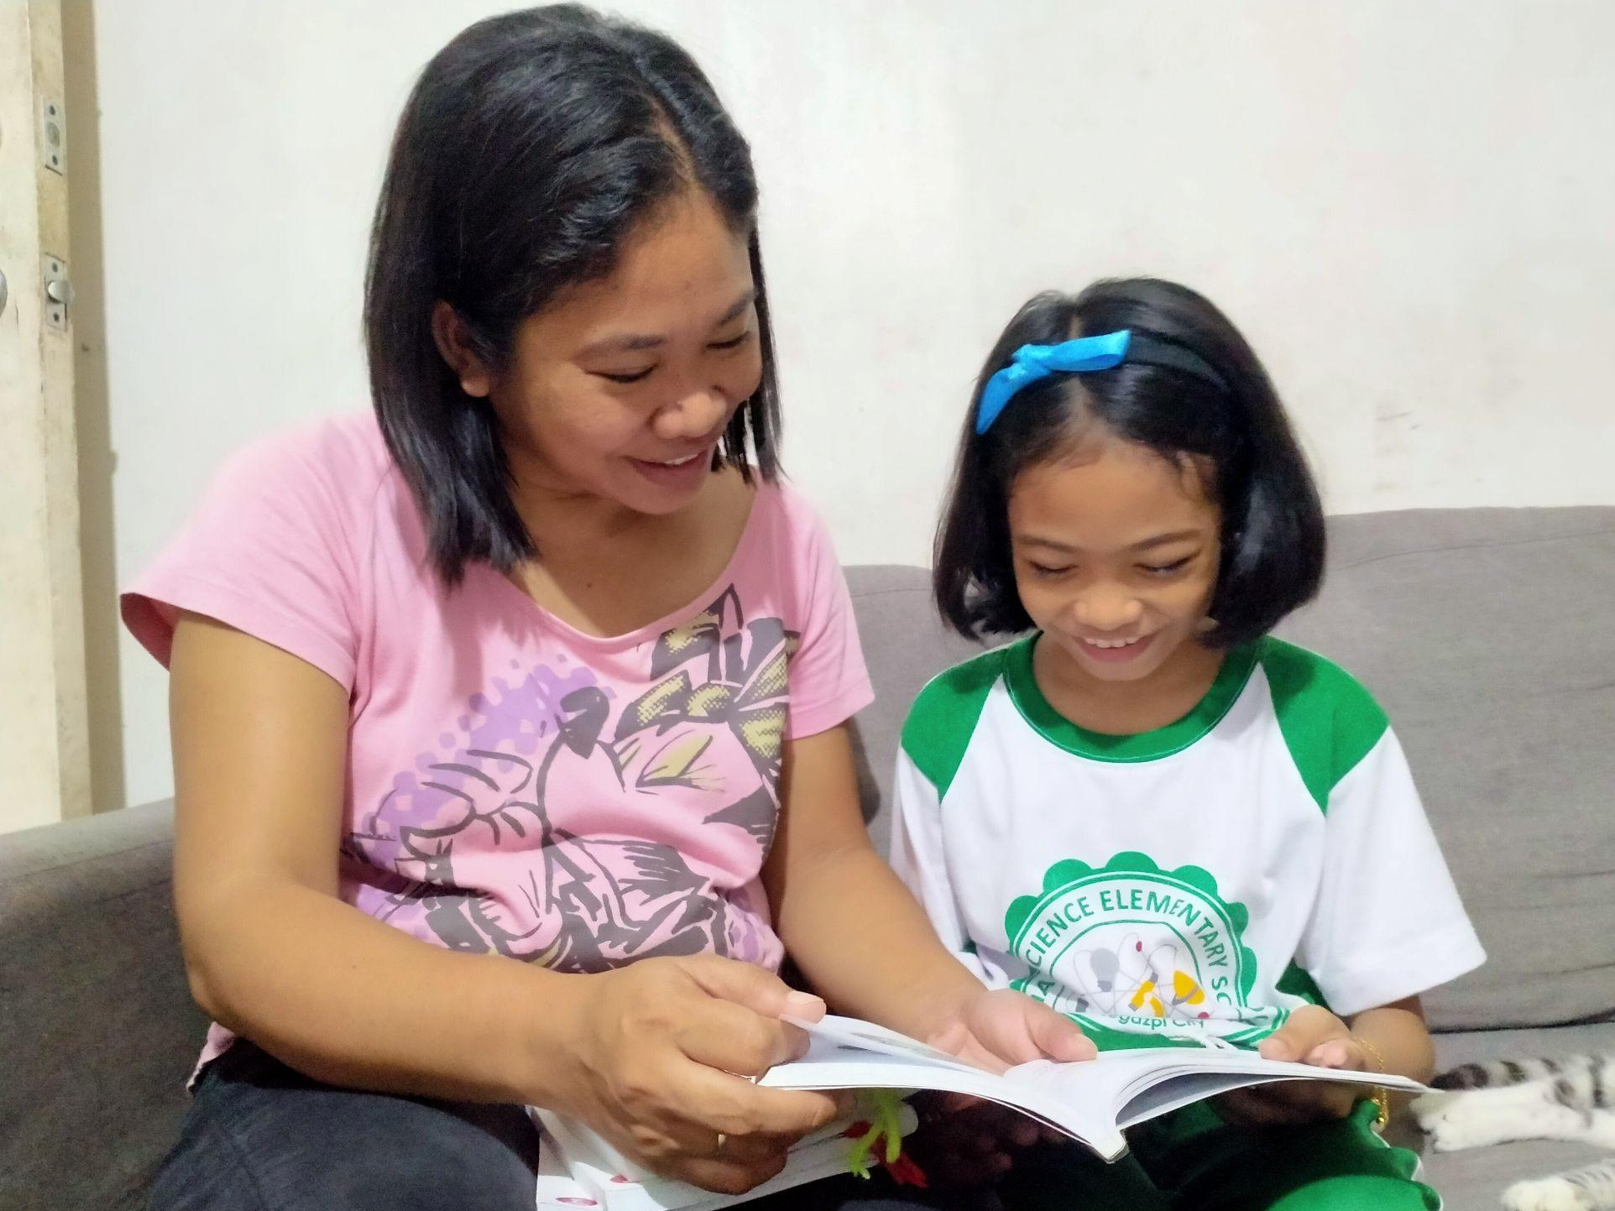
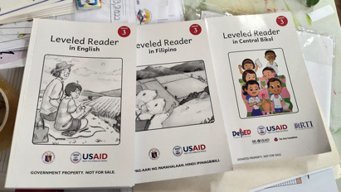
Methodology
SUPPLEMENTARY READING MATERIALS (SRMs)
Findings
ABC+’s SRMs contributed to literacy because they are in the local language, which parents could understand and explain to their children.
Harvested outcomes showed that learners’ have increased their love for reading.
Creative commons as the license attribution were helpful to many teachers and parents
Notes:
ABC+ has exceeded its program targets in terms of SRM development and improving the capacity of partners to ensure the provision of materials.
ABC+ locally developed age and developmentally appropriate reading materials for the K-3 levels that were used in learning continuity and recovery programs which helped learners read in their mother tongue and Filipino language.
ABC+ training helped teachers become story and materials writers and materials quality assurers/evaluators. With these acquired capacities, they will be more capable in sustaining the materials development process that they have learned from ABC+.
For primary learners, the report states that as of Quarter 4 of Year 3 of program implementation, 496.5 percent of the number of learners targeted have already received decodable, leveled SRMs against a target of 95 percent.
ABC+’s SRMs contributed to literacy because they are in the local language, which parents could understand and explain to their children
Harvested outcomes showed that learners’ have increased their love for reading
Creative commons as the license attribution, where program recipients may distribute copyrighted SRMs freely, were helpful to many teachers and parents

Slide 8
Methodology
SUPPLEMENTARY READING MATERIALS (SRMs)
Opportunities for DepEd
Central Office | Regional Office
Setting up a platform to store the digital version of SRMs for wider access | Alloting space for storage of SRMs Collaboration of several sectors to address challenges in keeping quality SRMs Schools without printers or copy machines (to produce SRMs) should be given a more significant budget by their LGU Private sectors and LGUs could help transport SRMs for remote storage Application of some ABC+ practices in materials development

Slide 9
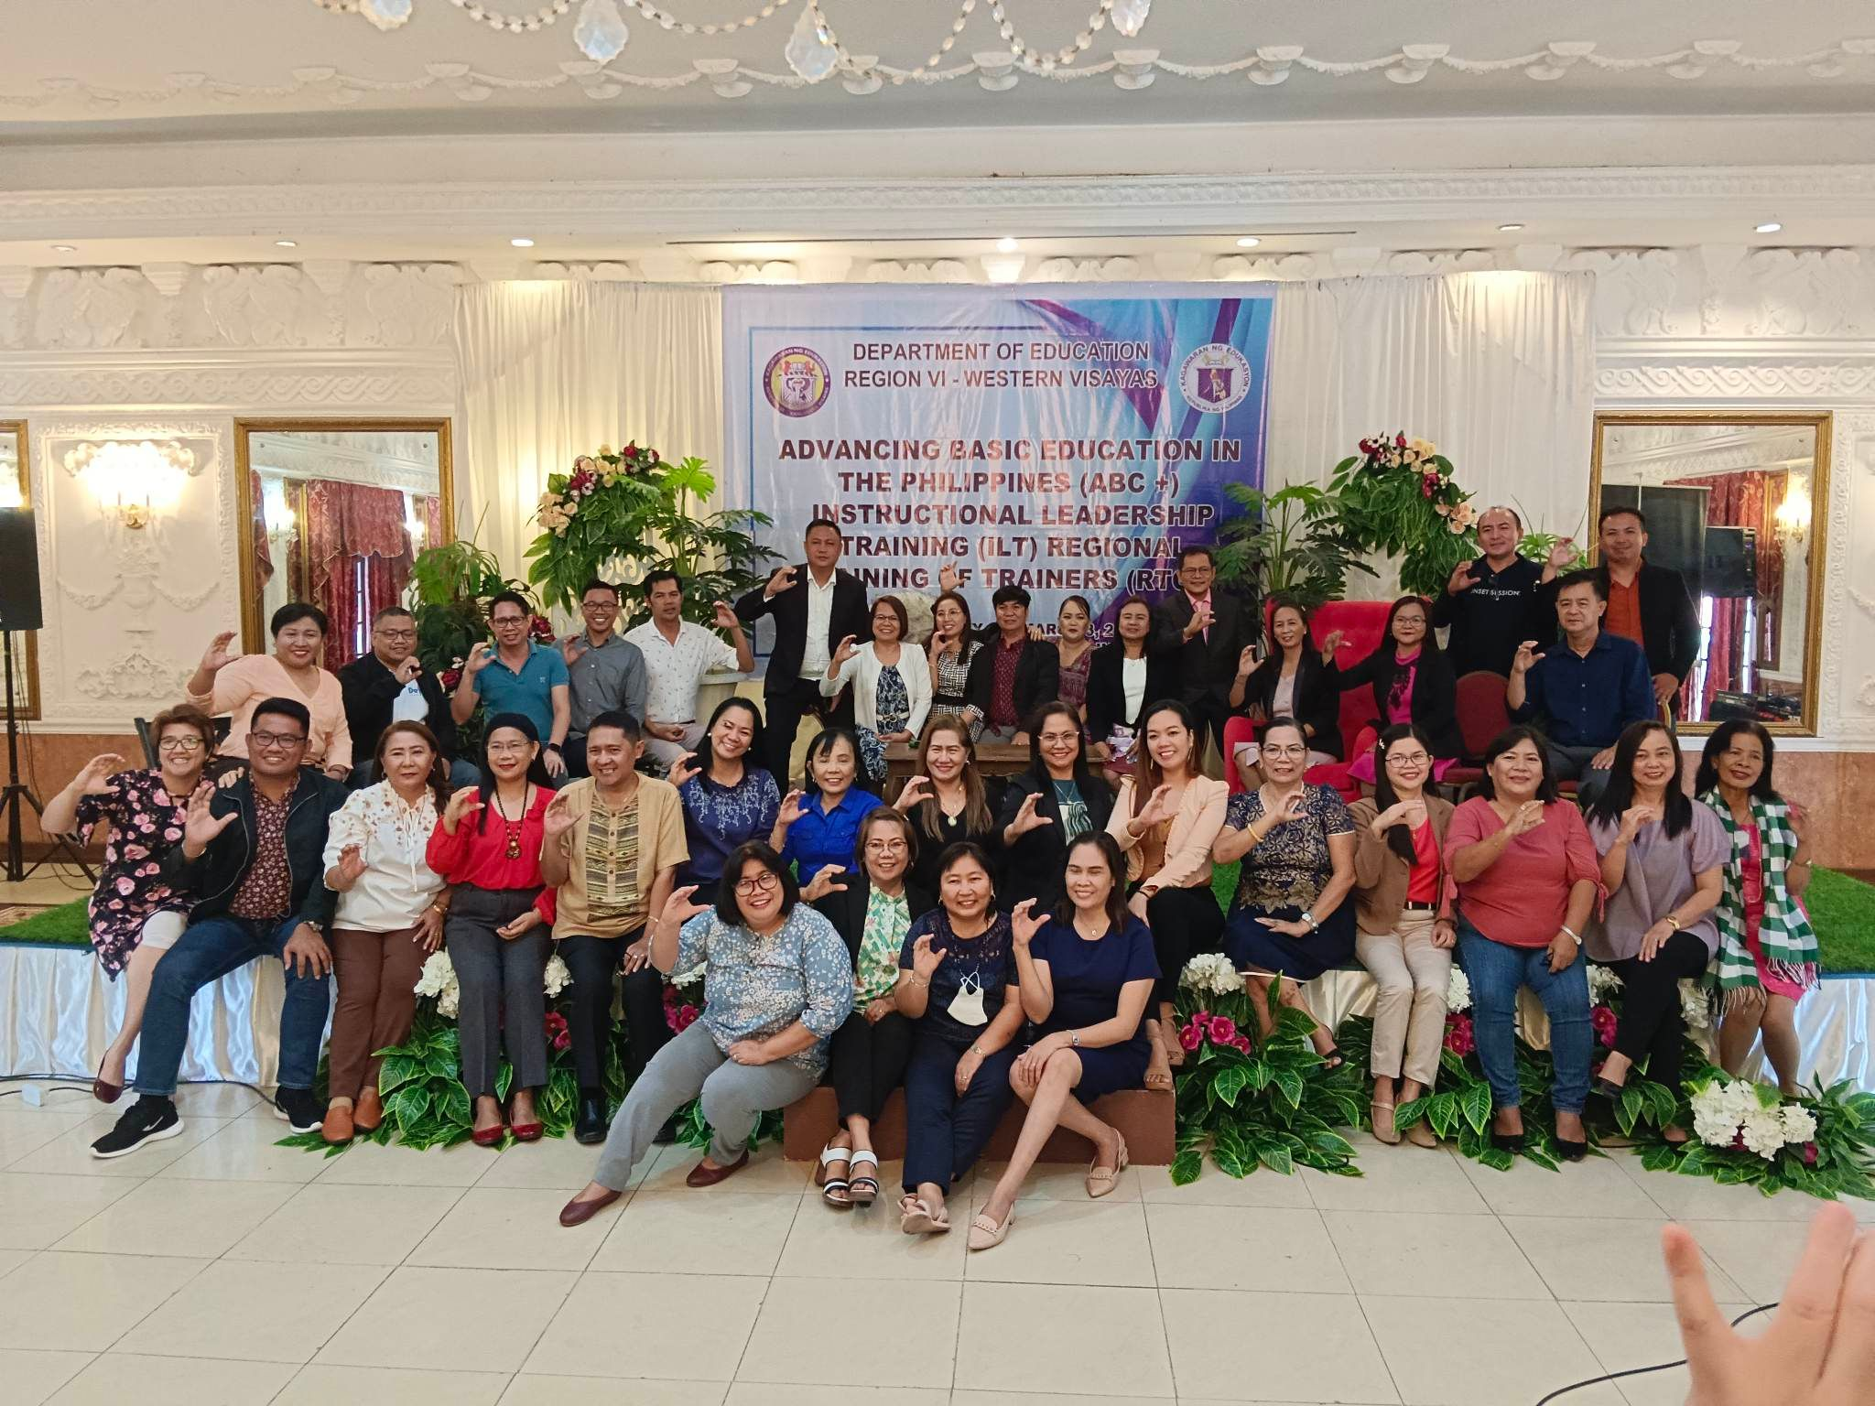
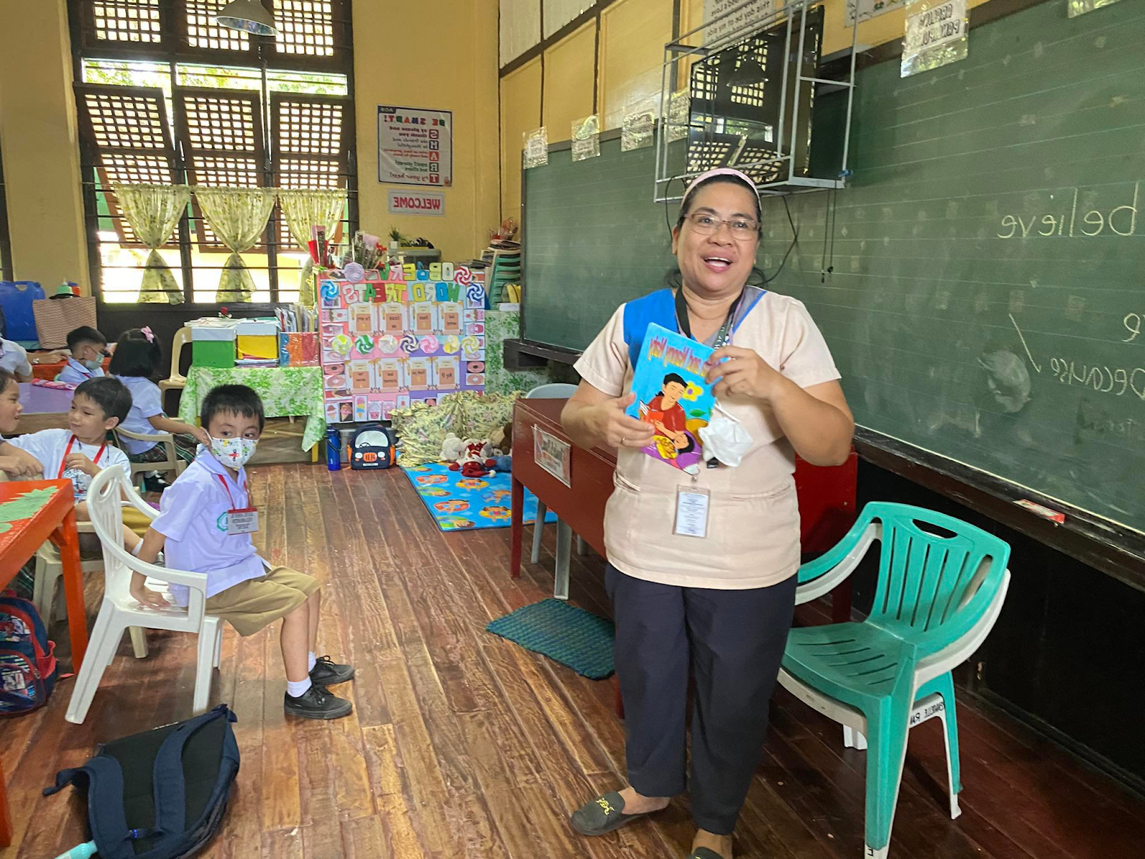
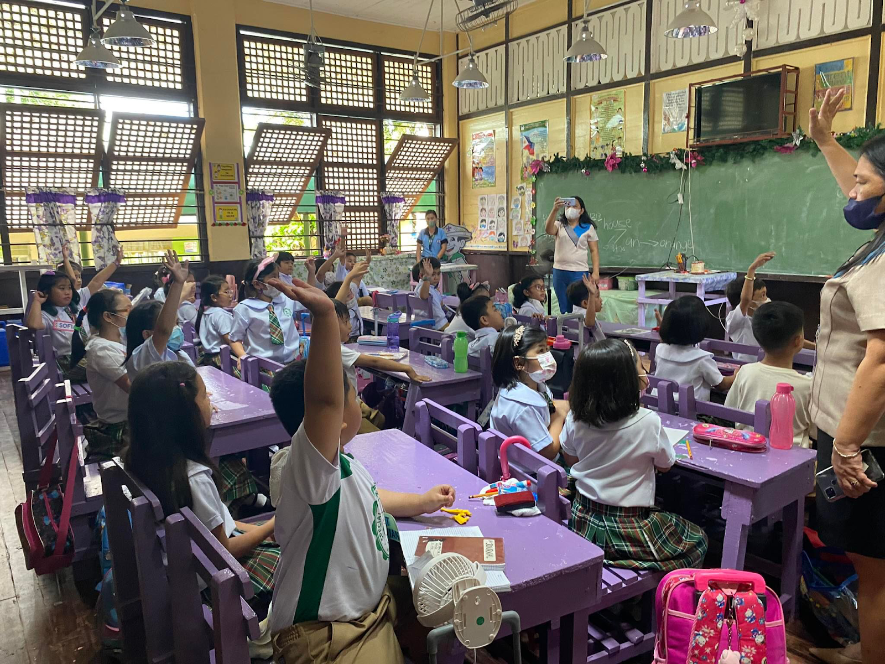
Methodology
TEACHER’S TRAINING
Findings
ABC+ teacher training reflected pandemic pivots that adjusted to the varying circumstances of teachers
ABC+ teacher training was reported by teachers to have helped them to a great extent, particularly in literacy instruction and integration of SEL and GESI
Strategies from ABC+ teacher training helped learners catch up on their reading delays earlier than the expected duration of recovery
The development of MTB-MLE-based instructional materials was added as a criterion for K–3 teachers’ competency for professional promotion
Notes:
ABC+ teacher training reflected pandemic pivots that adjusted to the varying circumstances of teachers.
ABC+ teacher training was reported by teachers to have helped them to a great extent in literacy instruction and integration of SEL and GESI.
Strategies from ABC+ teacher training helped learners to catch up in their reading delays earlier than the expected duration of recovery,
The development of MTB-MLE-based instructional materials was added as a criterion for K–3 teachers’ competency for professional promotion.
There is an observed increased capacity in curriculum development of K-3 teachers.
Teachers diligently adopted the ABC+’s teaching strategies and teaching processes, including integrating gender equality and social inclusion, and social-emotional learning.
The pre-service training preparation given by the identified teacher education institutions (TEIs) in their respective region continuously contextualized the development of teaching and learning materials based on context.

Slide 10
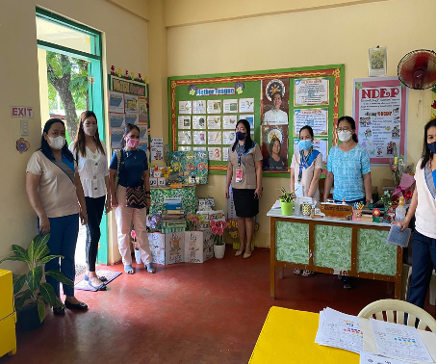
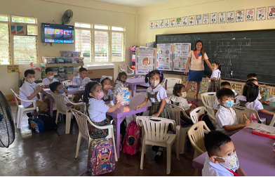
Methodology
TEACHER’S TRAINING
Findings
There is an observed increased capacity in curriculum development of K-3 teachers
Teachers diligently adopted ABC+’s teaching strategies and teaching processes, including integrating GESI and SEL
The pre-service training preparation (given by the identified teacher education institutions in their respective region) continuously contextualized the development of teaching and learning materials
Notes:
ABC+ teacher training reflected pandemic pivots that adjusted to the varying circumstances of teachers.
ABC+ teacher training was reported by teachers to have helped them to a great extent in literacy instruction and integration of SEL and GESI.
Strategies from ABC+ teacher training helped learners to catch up in their reading delays earlier than the expected duration of recovery,
The development of MTB-MLE-based instructional materials was added as a criterion for K–3 teachers’ competency for professional promotion.
There is an observed increased capacity in curriculum development of K-3 teachers.
Teachers diligently adopted the ABC+’s teaching strategies and teaching processes, including integrating gender equality and social inclusion, and social-emotional learning.
The pre-service training preparation given by the identified teacher education institutions (TEIs) in their respective region continuously contextualized the development of teaching and learning materials based on context.

Slide 11
Methodology
TEACHER’S TRAINING
Opportunities for DepEd
Central Office | Regional Office
The NEAP could continue exploring a training design; and schedule to support and cater to teachers’ needs, situations, and well-being | Application of some ABC+ practices in teaching training Assist schools in disseminating best practices, especially in implementing recovery programs that concentrate on literacy development

Slide 12
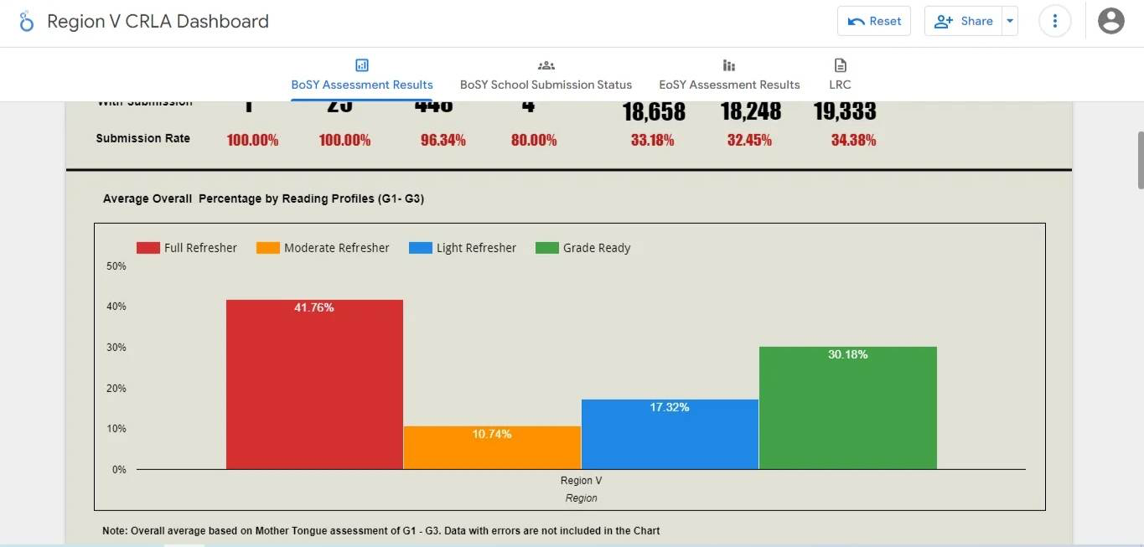
Methodology
COMPREHENSIVE RAPID LITERACY ASSESSMENT
Findings
Region V has begun incorporating CRLA results as one of the key performance indicators in their quarterly Monitoring and Evaluation sessions
Data dashboards showing children who can read were effective in the host regions
Schools’ use of CRLA allowed them to design learning continuity and recovery programs that are informed by assessment data.
Notes:
Region V has begun incorporating CRLA results as one of the key performance indicators in their quarterly Monitoring and Evaluation sessions
Data dashboards showing children who can read were effective in the host regions ensuring that technical support was given to schools in need
Schools’ use of CRLA allowed them to design learning continuity and recovery programs that are informed by assessment data.
Schools continued bridging the learning gaps by maximizing CRLA results in formulating plans and activities even after concluding the 8-week DepEd Regions V and VI curriculum.
Schoolteachers were also trained to utilize their dashboard to conduct systematic assessments using the Comprehensive Rapid Literacy Assessment, which then served as their basis for data-driven interventions.

Slide 13
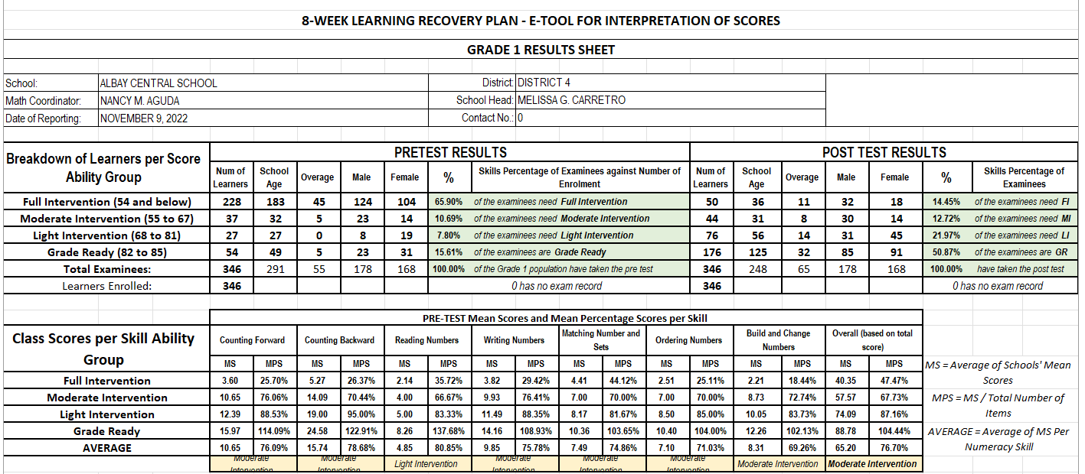
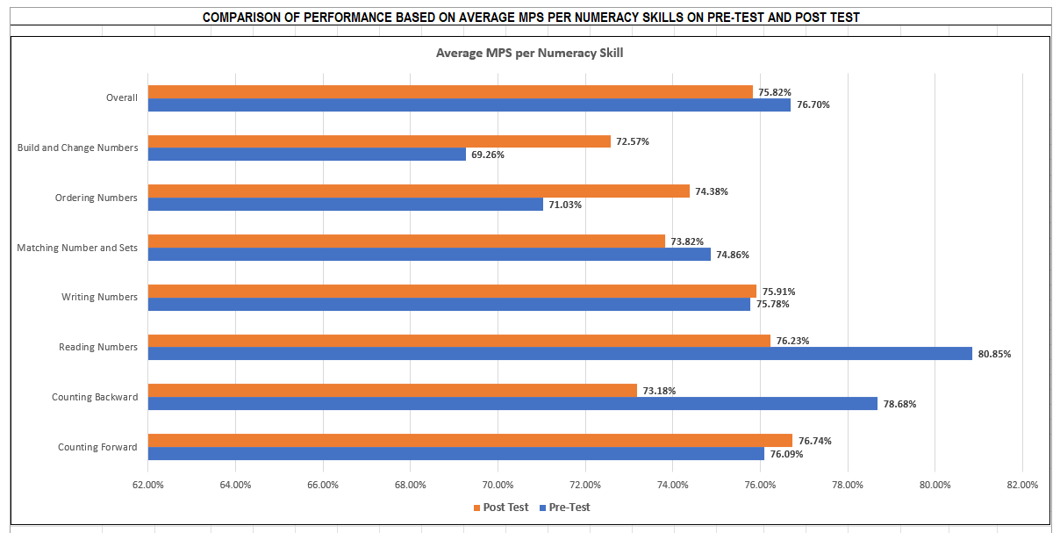
Methodology
COMPREHENSIVE RAPID LITERACY ASSESSMENT
Findings
Schools continued bridging the learning gaps by maximizing CRLA results in formulating plans and activities, even after the 8-week DepEd Regions V and VI curriculum
School teachers were trained to utilize their dashboard to conduct systematic assessments using CRLA, which then served as their basis for data-driven interventions
Notes:
Region V has begun incorporating CRLA results as one of the key performance indicators in their quarterly Monitoring and Evaluation sessions
Data dashboards showing children who can read were effective in the host regions ensuring that technical support was given to schools in need
Schools’ use of CRLA allowed them to design learning continuity and recovery programs that are informed by assessment data.
Schools continued bridging the learning gaps by maximizing CRLA results in formulating plans and activities even after concluding the 8-week DepEd Regions V and VI curriculum.
Schoolteachers were also trained to utilize their dashboard to conduct systematic assessments using the Comprehensive Rapid Literacy Assessment, which then served as their basis for data-driven interventions.

Slide 14
Methodology
COMPREHENSIVE RAPID LITERACY ASSESSMENT
Opportunities for DepEd
Central Office | Regional Office
National adaptation of CRLA | Technical training on the use of data dashboard (RO, DO, & School levels) Training on how information from dashboard maybe used to improve instructions

Slide 15
Methodology
PARTNERSHIP WITH PARENTS
ABC+ trained HLPs in the use of SRMs during remote teaching and learning
ABC+strong support systems (e.g. human and use of technology resources) for parents and teachers especially during the pandemic

Slide 16
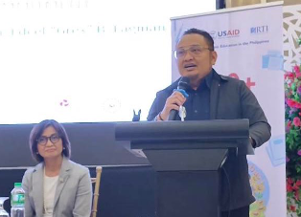
Methodology
MULTI-STAKEHOLDER PARTNERSHIP
One barangay in Region V set-up a community learning hub. Others established reading centers, which benefited not only the learners but also illiterate community members
ABC+ partnered with the DILG - Local Government Academy to develop a model for Early Grade Literacy Education Governance
Governor Edcel Lagman of Region V expressed support for ABC+’s program by strengthening the local education sectoral mechanism (ESM)
Notes:
ABC+ partnered with the Department of the Interior and Local Government Local Government Academy (DILG-LGA) to develop a model for Early Grade Literacy education governance to capacitate local communities.
Governor Edcel “Grex” Lagman of Region V expressed support to ABC+’s program by strengthening the local section education mechanisms (ESM).

Slide 17
Methodology
MULTI-STAKEHOLDER PARTNERSHIP
Opportunities for DepEd
Central Office | Regional Office
Partnership with the DILG – LGA to strengthen and sustain barangay learning hubs and barangay reading centers through MOA/MOU Creation of policy on how schools may collaborate with the Parent Teacher Community Association to mobilize volunteer parents, youth organizations, and NGOs to support the Home Learning Partners Program | Strengthen and sustain Home Learning Partners Program Creation of contextualized training program to train parents and community members/volunteers from barangays who will serve as trainer-of-trainers to promote and use Parents and Community Session Guides Creation of memorandum based on DepEd policy to allow teachers to train parents and community volunteers to establish and sustain learning hubs and reading/learning centers. Continued collaboration with tapped stakeholders

Slide 18
STORIES (ALBAY AND ILOILO)

